Slide 1
The Length of Cycles in Random Mallows Permutations
By Alexey Gladkich
Joint work with Prof. Ron Peled

Slide 2
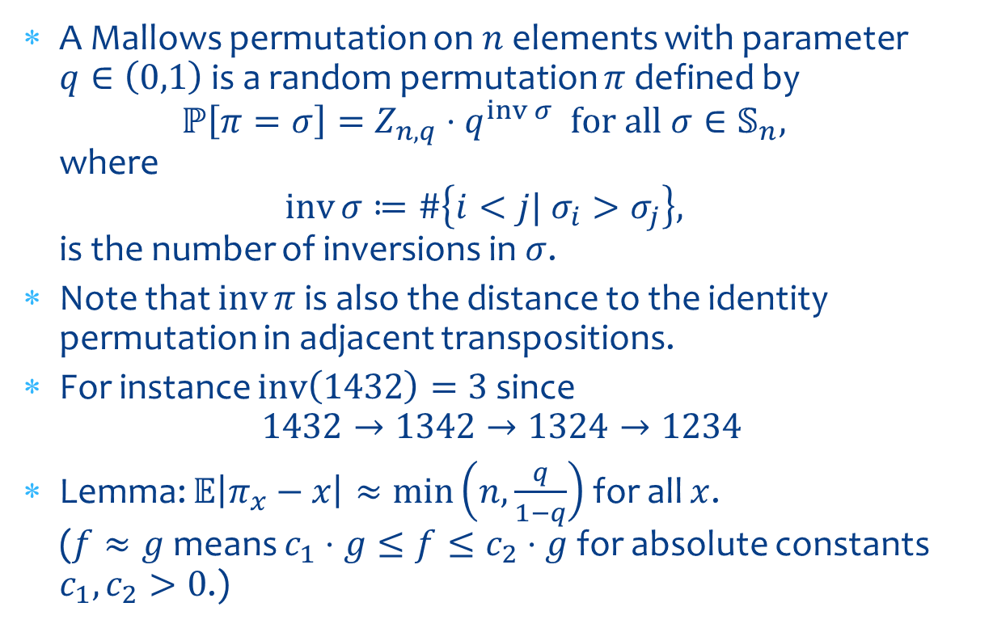
Mallows Permutation
A Mallows permutation on $n$ elements with parameter $q∈\left(0,1\right)$is a random permutation $π$ defined by
$ℙ\left[π=σ\right]=Z_{n,q}⋅q^{\operatorname{inv}{σ}} \text{for} \text{all} σ∈𝕊_{n},$
where
$\operatorname{inv}{σ}≔\#\left\{i<j| σ_{i}>σ_{j}\right\},$
is the number of inversions in $σ$.
Note that $\operatorname{inv}{π}$ is also the distance to the identity permutation in adjacent transpositions.
For instance $\operatorname{inv}\left(1432\right)=3$ since
$1432→1342→1324→1234$
Lemma: $𝔼\left|π_{x}−x\right|≈\min\left(n,\frac{q}{1−q}\right)$ for all $x$.
($f≈g$ means $c_{1}⋅g≤f≤c_{2}⋅g$ for absolute constants $c_{1},c_{2}>0$.)

Slide 3

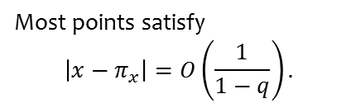
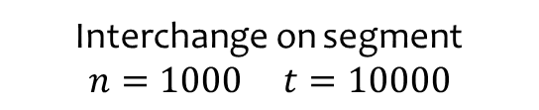
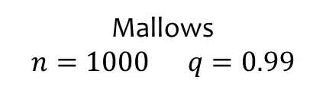
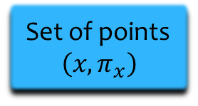
Mallows vs 1D Interchange
Mallows
$$n=1000 q=0.99$$
Interchange on segment
$$n=1000 t=10000$$
Set of points
$$\left(x,π_{x}\right)$$
Most points satisfy
$$\left|x−π_{x}\right|=O\left(\frac{1}{1−q}\right).$$
Most points satisfy
$$\left|x−π_{x}\right|=O\left(\sqrt{t}\right).$$

Slide 4
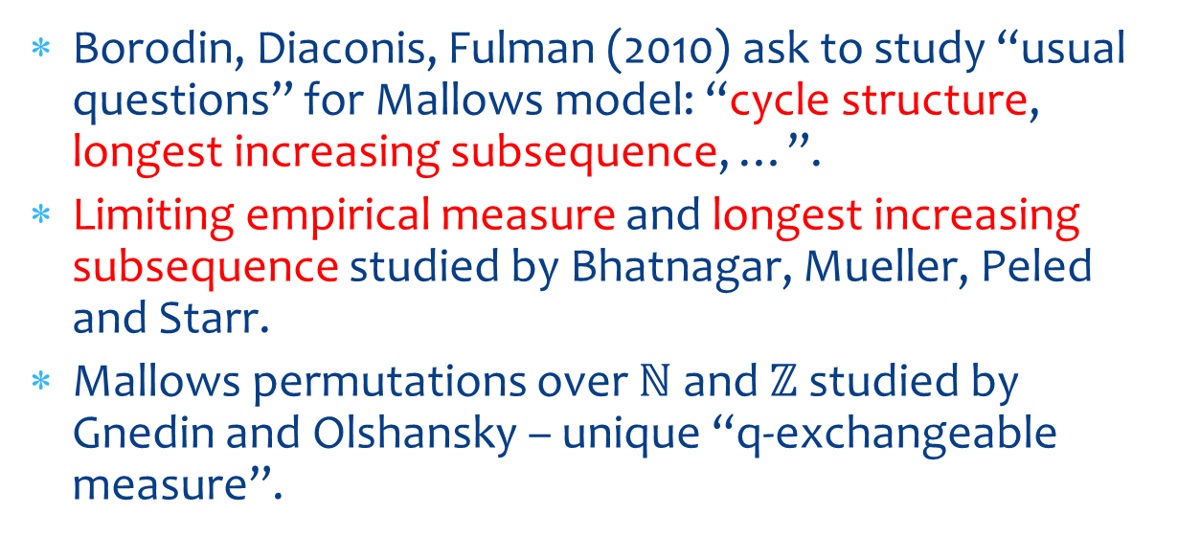
Motivation and related results
Borodin, Diaconis, Fulman (2010) ask to study “usual questions” for Mallows model: “cycle structure, longest increasing subsequence, …”.
Limiting empirical measure and longest increasing subsequence studied by Bhatnagar, Mueller, Peled and Starr.
Mallows permutations over $ℕ$ and $ℤ$ studied by Gnedin and Olshansky – unique “q-exchangeable measure”.

Slide 5
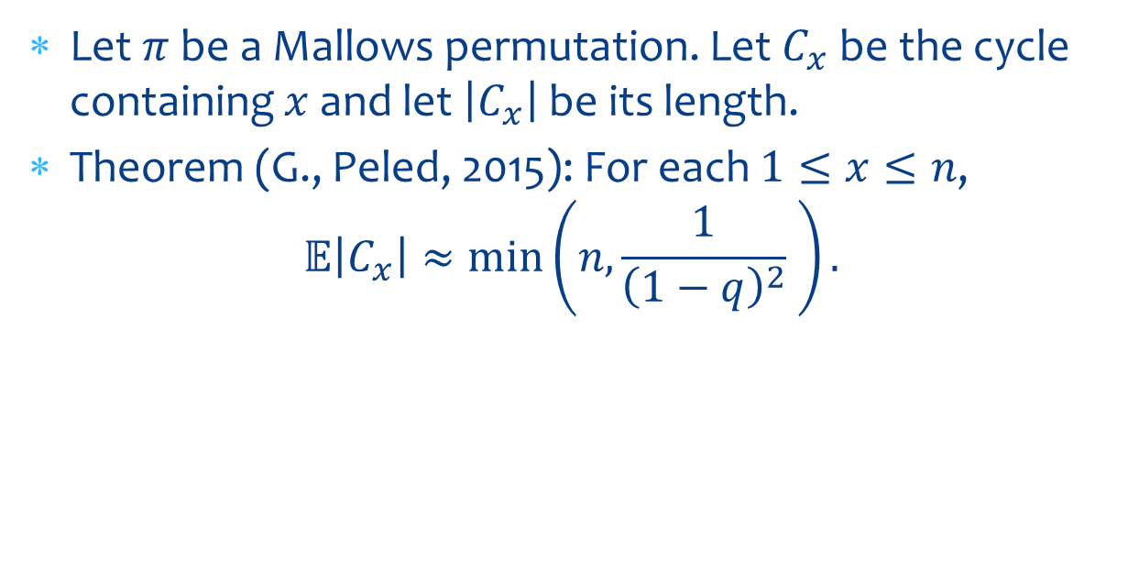
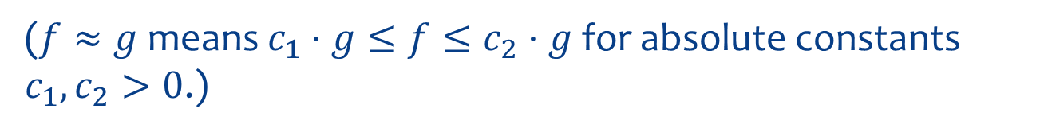
Our Main Results
Let $π$ be a Mallows permutation. Let $C_{x}$ be the cycle containing $x$ and let $\left|C_{x}\right|$ be its length.
Theorem (G., Peled, 2015): For each $1≤x≤n$,
$𝔼\left|C_{x}\right|≈\min\left(n,\frac{1}{{\left(1−q\right)}^{2}} \right).$
($f≈g$ means $c_{1}⋅g≤f≤c_{2}⋅g$ for absolute constants $c_{1},c_{2}>0$.)

Slide 6


Our Main Results
Let $π$ be a Mallows permutation. Let $C_{x}$ be the cycle containing $x$ and let $\left|C_{x}\right|$ be its length.
Theorem (G., Peled, 2015): For each $1≤x≤n$,
$𝔼\left|C_{x}\right|≈\min\left(n,\frac{1}{{\left(1−q\right)}^{2}} \right).$
In the case $n⋅{\left(1−q\right)}^{2}→0$, is it true that
$$\frac{\left|C_{x}\right|}{n}→U\left(0,1\right)?$$
($f≈g$ means $c_{1}⋅g≤f≤c_{2}⋅g$ for absolute constants $c_{1},c_{2}>0$.)

Slide 7
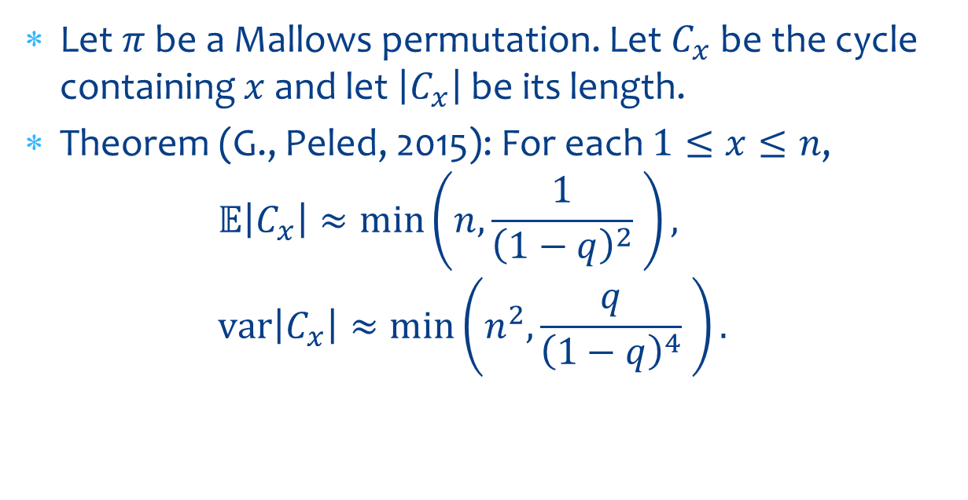
Our Main Results
Let $π$ be a Mallows permutation. Let $C_{x}$ be the cycle containing $x$ and let $\left|C_{x}\right|$ be its length.
Theorem (G., Peled, 2015): For each $1≤x≤n$,
$𝔼\left|C_{x}\right|≈\min\left(n,\frac{1}{{\left(1−q\right)}^{2}} \right),$
$\operatorname{var}\left|C_{x}\right|≈\min\left(n^{2},\frac{q}{{\left(1−q\right)}^{4}} \right).$
($f≈g$ means $c_{1}⋅g≤f≤c_{2}⋅g$ for absolute constants $c_{1},c_{2}>0$.)

Slide 8
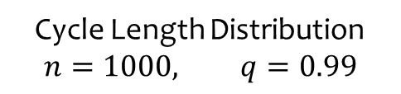
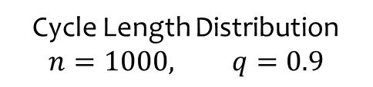
Simulations of Cycle Length
Cycle Length Distribution
$$n=1000, q=0.99$$
Cycle Length Distribution
$$n=1000, q=0.9$$

Slide 9
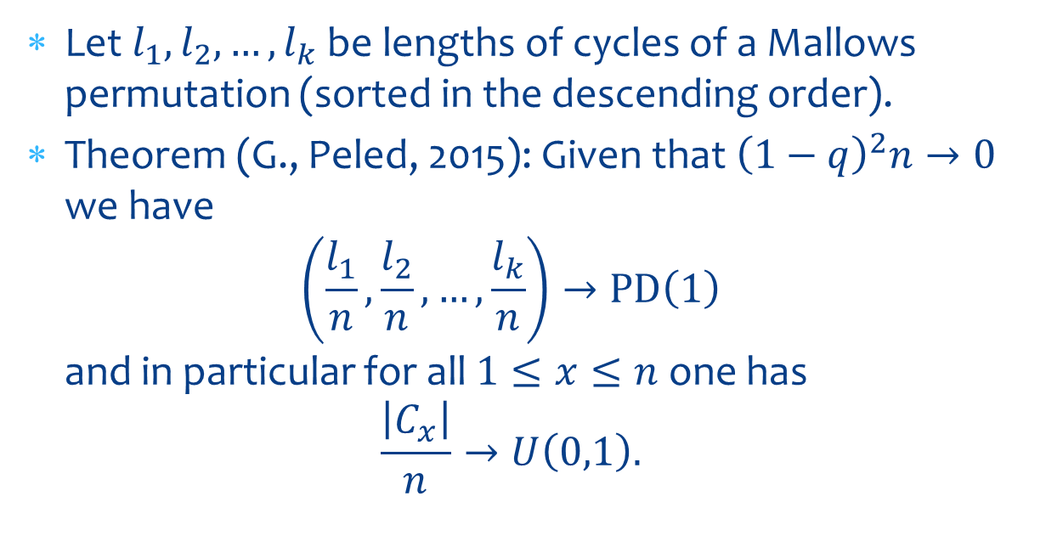
Our Main Results
Let $l_{1},l_{2},…,l_{k}$ be lengths of cycles of a Mallows permutation (sorted in the descending order).
Theorem (G., Peled, 2015): Given that ${\left(1−q\right)}^{2}n→0$ we have
$\left(\frac{l_{1}}{n},\frac{l_{2}}{n},…,\frac{l_{k}}{n}\right)→\text{PD}\left(1\right)$
and in particular for all $1≤x≤n$ one has
$\frac{\left|C_{x}\right|}{n}→U\left(0,1\right).$

Slide 10

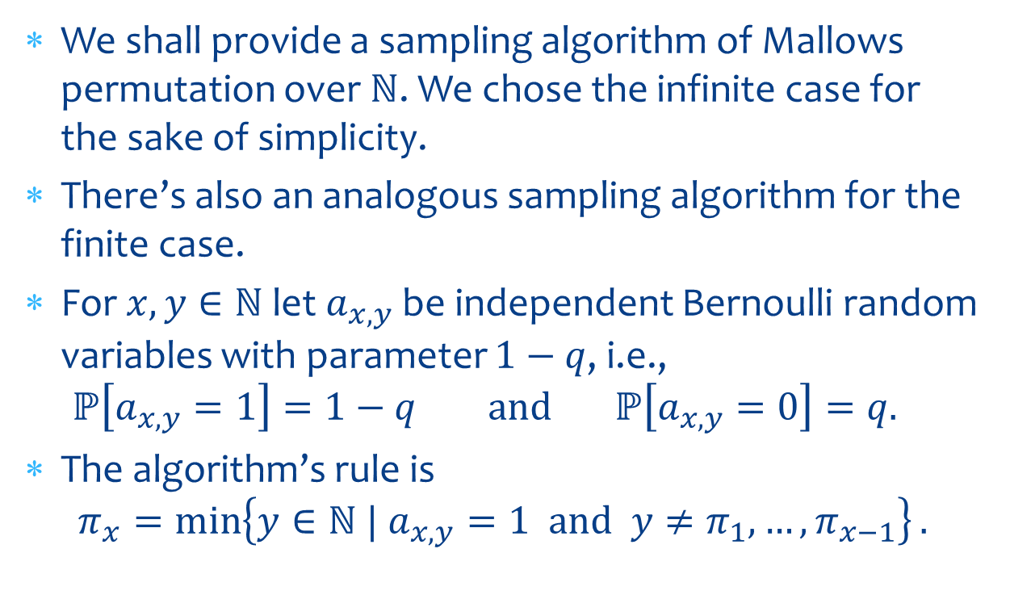
Sampling Algorithm over $ℕ$
We shall provide a sampling algorithm of Mallows permutation over $ℕ$. We chose the infinite case for the sake of simplicity.
There’s also an analogous sampling algorithm for the finite case.
For $x,y∈ℕ$ let $a_{x,y}$ be independent Bernoulli random variables with parameter $1−q$, i.e.,
$ℙ\left[a_{x,y}=1\right]=1−q \text{and} ℙ\left[a_{x,y}=0\right]=q.$
The algorithm’s rule is
$π_{x}=\min\left\{y∈ℕ | a_{x,y}=1 \text{and} y≠π_{1},…,π_{x−1}\right\}.$

Slide 11

Sampling Algorithm over $ℕ$
0 | 1 | 0 | 1 | 0 | 1 | 0
0 | 0 | 0 | 0 | 0 | 0 | 0
0 | 1 | 1 | 0 | 0 | 1 | 0
0 | 0 | 0 | 0 | 1 | 0 | 0
1 | 1 | 0 | 0 | 1 | 0 | 0
0 | 0 | 0 | 1 | 0 | 0 | 0
0 | 0 | 0 | 1 | 0 | 0 | 1
$$π_{x}=\min\left\{y∈ℕ | a_{x,y}=1 \text{and} y≠π_{1},…,π_{x−1}\right\}.$$

Slide 12
Sampling Algorithm over $ℕ$
0 | 1 | 0 | 1 | 0 | 1 | 0
0 | 0 | 0 | 0 | 0 | 0 | 0
0 | 1 | 1 | 0 | 0 | 1 | 0
0 | 0 | 0 | 0 | 1 | 0 | 0
1 | 1 | 0 | 0 | 1 | 0 | 0
0 | 0 | 0 | 1 | 0 | 0 | 0
0 | 0 | 0 | 1 | 0 | 0 | 1
$$π_{x}=\min\left\{y∈ℕ | a_{x,y}=1 \text{and} y≠π_{1},…,π_{x−1}\right\}.$$

Slide 13
Sampling Algorithm over $ℕ$
0 | 1 | 0 | 1 | 0 | 1 | 0
0 | 0 | 0 | 0 | 0 | 0 | 0
0 | 1 | 1 | 0 | 0 | 1 | 0
0 | 0 | 0 | 0 | 1 | 0 | 0
1 | 1 | 0 | 0 | 1 | 0 | 0
0 | 0 | 0 | 1 | 0 | 0 | 0
0 | 0 | 0 | 1 | 0 | 0 | 1
$$π_{x}=\min\left\{y∈ℕ | a_{x,y}=1 \text{and} y≠π_{1},…,π_{x−1}\right\}.$$

Slide 14
Sampling Algorithm over $ℕ$
0 | 1 | 0 | 1 | 0 | 1 | 0
0 | 0 | 0 | 0 | 0 | 0 | 0
0 | 1 | 1 | 0 | 0 | 1 | 0
0 | 0 | 0 | 0 | 1 | 0 | 0
1 | 1 | 0 | 0 | 1 | 0 | 0
0 | 0 | 0 | 1 | 0 | 0 | 0
0 | 0 | 0 | 1 | 0 | 0 | 1
$$π_{x}=\min\left\{y∈ℕ | a_{x,y}=1 \text{and} y≠π_{1},…,π_{x−1}\right\}.$$

Slide 15
Sampling Algorithm over $ℕ$
0 | 1 | 0 | 1 | 0 | 1 | 0
0 | 0 | 0 | 0 | 0 | 0 | 0
0 | 1 | 1 | 0 | 0 | 1 | 0
0 | 0 | 0 | 0 | 1 | 0 | 0
1 | 1 | 0 | 0 | 1 | 0 | 0
0 | 0 | 0 | 1 | 0 | 0 | 0
0 | 0 | 0 | 1 | 0 | 0 | 1
$$π_{x}=\min\left\{y∈ℕ | a_{x,y}=1 \text{and} y≠π_{1},…,π_{x−1}\right\}.$$

Slide 16
Sampling Algorithm over $ℕ$
0 | 1 | 0 | 1 | 0 | 1 | 0
0 | 0 | 0 | 0 | 0 | 0 | 0
0 | 1 | 1 | 0 | 0 | 1 | 0
0 | 0 | 0 | 0 | 1 | 0 | 0
1 | 1 | 0 | 0 | 1 | 0 | 0
0 | 0 | 0 | 1 | 0 | 0 | 0
0 | 0 | 0 | 1 | 0 | 0 | 1
$$π_{x}=\min\left\{y∈ℕ | a_{x,y}=1 \text{and} y≠π_{1},…,π_{x−1}\right\}.$$

Slide 17
Sampling Algorithm over $ℕ$
0 | 1 | 0 | 1 | 0 | 1 | 0
0 | 0 | 0 | 0 | 0 | 0 | 0
0 | 1 | 1 | 0 | 0 | 1 | 0
0 | 0 | 0 | 0 | 1 | 0 | 0
1 | 1 | 0 | 0 | 1 | 0 | 0
0 | 0 | 0 | 1 | 0 | 0 | 0
0 | 0 | 0 | 1 | 0 | 0 | 1
$$π_{x}=\min\left\{y∈ℕ | a_{x,y}=1 \text{and} y≠π_{1},…,π_{x−1}\right\}.$$

Slide 18
Sampling Algorithm over $ℕ$
0 | 1 | 0 | 1 | 0 | 1 | 0
0 | 0 | 0 | 0 | 0 | 0 | 0
0 | 1 | 1 | 0 | 0 | 1 | 0
0 | 0 | 0 | 0 | 1 | 0 | 0
1 | 1 | 0 | 0 | 1 | 0 | 0
0 | 0 | 0 | 1 | 0 | 0 | 0
0 | 0 | 0 | 1 | 0 | 0 | 1
What do we know about the cycle structure?
What do we reveal at the next step?

Slide 19
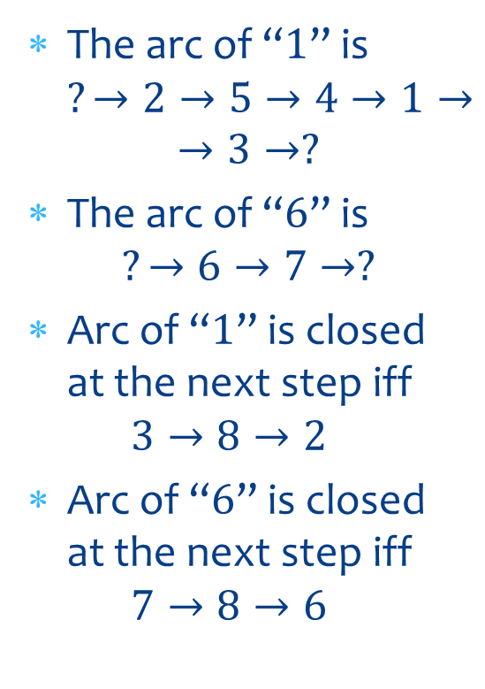
Sampling Algorithm over $ℕ$
The arc of “$1$” is
$?→2→5→4→1→→3→?$
The arc of “$6$” is
$?→6→7→?$
Arc of “$1$” is closed at the next step iff
$3→8→2$
Arc of “$6$” is closed at the next step iff
$7→8→6$
0 | 1 | 0 | 1 | 0 | 1 | 0
0 | 0 | 0 | 0 | 0 | 0 | 0
0 | 1 | 1 | 0 | 0 | 1 | 0
0 | 0 | 0 | 0 | 1 | 0 | 0
1 | 1 | 0 | 0 | 1 | 0 | 0
0 | 0 | 0 | 1 | 0 | 0 | 0
0 | 0 | 0 | 1 | 0 | 0 | 1

Slide 20
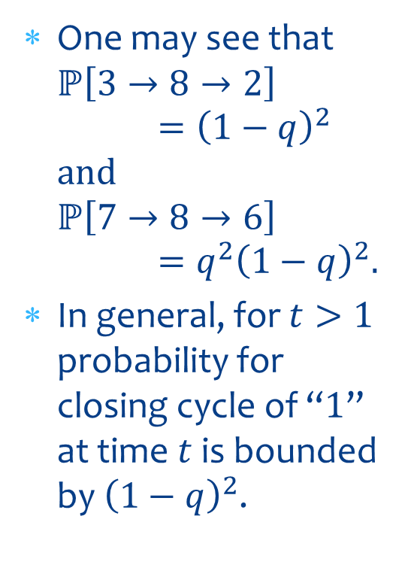
Sampling Algorithm over $ℕ$
One may see that
$ℙ\left[3→8→2\right]={\left(1−q\right)}^{2}$
$\text{and}$
$ℙ\left[7→8→6\right]=q^{2}{\left(1−q\right)}^{2}.$
In general, for $t>1$ probability for closing cycle of “$1$” at time $t$ is bounded by ${\left(1−q\right)}^{2}$.
0 | 1 | 0 | 1 | 0 | 1 | 0
0 | 0 | 0 | 0 | 0 | 0 | 0
0 | 1 | 1 | 0 | 0 | 1 | 0
0 | 0 | 0 | 0 | 1 | 0 | 0
1 | 1 | 0 | 0 | 1 | 0 | 0
0 | 0 | 0 | 1 | 0 | 0 | 0
0 | 0 | 0 | 1 | 0 | 0 | 1

Slide 21
Open Questions
Find the limiting distribution of the cycle length in the subcritical and critical regime.
Study other models of “band permutations”.
Kozma and Sidoravicius have results for the interchange model.
Conjectured localization transition in random band matrices has similar nature.

