Slide 1
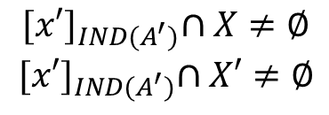
GRANULAR SPACES IN THE PAWLAK ROUGH SET MODEL
$DS=(U,A,d)$; ${ A}^{′}εP\left(A\right)=\left\{A^{′}:A^{′}⊆A\right\}$
$$G_{A}=\left\{{\left[x\right]}_{IND(A)}:xεU\right\}$$
$$G_{P(A)}=\left\{{\left[x\right]}_{IND\left(A^{′}\right)}:xεU \&{ A}^{′}εP(A)\right\}$$
$$G_{d}=\left\{{\left[x\right]}_{IND(d)}:xεU\right\}$$
$$[{x]}_{IND(A)}⊆[{x]}_{IND(A^{′})}$$
$${[x]}_{IND(A^{′})}⊆X$$
$${[x]}_{IND(A^{′})}$$
$$X′$$
$${[x]}_{IND(A)}$$
$${[x′]}_{IND(A)}$$
$${[x′]}_{IND(A^{′})}$$
$$X$$
$${[x′]}_{IND(A)}⊆{[x′]}_{IND(A^{′})}$$
$${[x′]}_{IND(A^{′})}∩X≠∅$$
$${[x′]}_{IND(A^{′})}∩X′≠∅$$
$$X,X′∈G_{d}$$

