Slide 1
COMPUTING MODEL BASED ON INTERACTIVE GRANULAR COMPUTING
&
ROUGH SETS:
TOWARD FOUNDATIONS
OF
COMPLEX INTELLIGENT SYSTEMS
Andrzej Skowron
Systems Research Institute
Polish Academy of Sciences
January 2026

Slide 2
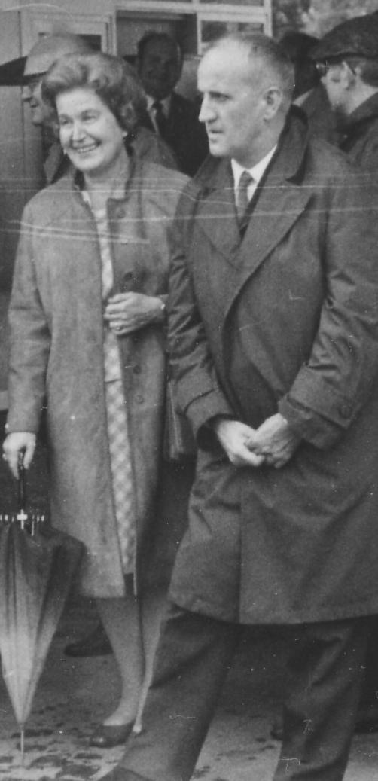
To
Professors
Helena Rasiowa and
Zdzisław Pawlak in memoriam

Slide 3
AGENDA
Motivations for
  development of computing model creating the basis for the design and analysis of Complex Intelligent Systems (IS’s), i.e., Intelligent Systems dealing with complex phenomena
      Interactive Granular Computing (IGrC)
        Complex granules (c-granules)
          Specification (syntax)
          Abstract and physical semantics
            States and dynamics
        c-granules with control (in particular societies of such c-granules)
          Structure of c-granules: from atomic and elementary to networks; IS’s – examples of c-granules with control
          Control as a sub-granule of a given c-granule with control
          Modeling of perception of situations (objects) in the physical world by control: generation and management (steering) of configurations of sub-granules
          Granular computations of c-granules with control
      IGrC and Rough Sets (RS)
        Challenge for control of a given c-granule (IS): The discovery of adaptive complex games used to generate high quality, approximate solutions to problems along granular computations that are steered by the control of c-granule.
      Summary

Slide 4
MOTIVATIONS FOR NEW COMPUTING MODEL

Slide 5
NEEDS FOR RELEVANT MODEL OF COMPUTATIONS:
EXAMPLE OF CONCEPT OF MULTI-AGENT SYSTEM
An important open issue in the Agent Based Simulation field is the lack of an univocal definition of the term “agent” and of the paradigms and methodology used to build models; in software-engineering, a system of independent programs is considered a multi-agent system, although there is no clarity about what the term exactly defines. The term “agent”, deriving from the Latin “agens”, identifies someone (or something) who acts; the same word can also be used to define a mean through which some action is made or caused. The term is used in many different fields and disciplines, such as economics, physics, natural sciences, sociology and many others.
Marco Remondino: Reactive and deliberative agents applied to simulation of socio-economical and biological systems. International Journal of Simulation 6(12-13) 1473-8031 (2025)

Slide 6
THE RELEVANT COMPUTING MODEL: FOUNDATIONS FOR DESIGN AND ANALYSIS OF INTELLIGENT SYSTEMS DEALING WITH COMPLEX PHENOMENA (IS’s)
Many partial proposals in many different domains exist,
e.g., complex (adaptive) systems, multi-agent systems, machine learning, robotics, cognitive science, neuroscience, computational intelligence, web intelligence, granular computing, natural computing, multisensory learning, cyber-physical systems, Internet of things.
Still we need
the relevant computing model for developing the foundations of IS’s.
WE PROPOSE IGrC AS A MODEL THAT PROVIDES THE BASIS FOR DEVELOPING INSIGHTFUL REASONING METHODS FOR UNDERSTANDING SITUATIONS IN THE REAL PHYSICAL WORLD TO A SATISFACTORY DEGREE, TO MAKE THE RIGHT DECISIONS.

Slide 7
COMPLEX SYSTEMS
Complex system: the elements are difficult to separate. This difficulty arises from the interactions between elements. Without interactions, elements can be separated. But when interactions are relevant, elements co-determine their future states. Thus, the future state of an element cannot be determined in isolation, as it co-depends on the states of other elements, precisely of those interacting with it.
Gershenson, C., Heylighen, F.: How can we think the complex? In: Richardson, K. (Ed.): Managing Organizational Complexity: Philosophy, Theory and Application, pp. 47–61. Information Age Publishing (2005)

Slide 8

COMPLEX SYSTEMS
MODELING PROBLEM
system state ?
H ?
$$\frac{ds}{dt}=H\left(s,e,t\right)$$
$$\frac{de}{dt}=F(s,e,t)$$
only partially known at a given moment of time;
should be discovered adaptively
environment state ?
F ?
K. Egan, W. Li, R. Carvalho: Automatically discovering ordinary differential equations from data with sparse regression. Communications Physics 7(20) 2024. DOI: 10.1038/s42005-023-01516-2
H. Sayama: Introduction to the Modeling and Analysis of Complex Systems" (2015). Milne Open Textbooks 14. https://knightscholar.geneseo.edu/oer-ost/14

Slide 9
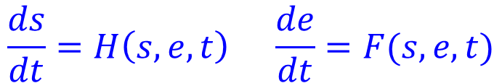
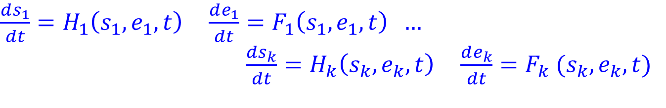
COMPLEX SYSTEMS
MODELING PROBLEM
THE BEHAVIOR OF THE WHOLE IS NOT DEFINED BY ITS PARTS
$$\frac{ds}{dt}=H\left(s,e,t\right) \frac{de}{dt}=F(s,e,t)$$
s is not defined by s₁ ,…, s_{k} only
e is not defined by e₁ ,…, e_{k} only
H is not defined by H₁ ,…, H_{k} only
F is not defined by F₁ ,…, F_{k} only
$\frac{ds_{1}}{dt}=H_{1}\left(s_{1},e_{1},t\right) \frac{de_{1}}{dt}=F_{1}\left(s_{1},e_{1},t\right) …$
$\frac{ds_{k}}{dt}=H_{k}\left(s_{k},e_{k},t\right) \frac{de_{k}}{dt}=F_{k} (s_{k},e_{k},t)$

Slide 10
COMPLEX ADAPTIVE SYSTEMS (CAS)
Exhibiting internal boundaries dividing any of such system into a diverse array of semi-autonomous subsystems called agents; agent has a program guiding its interactions with other agents and other parts of its environment.
CAS are signal/boundary systems. The steering of CAS is expressed by modifying signal/boundary hierarchies.
Interactions are basic concepts of the approach. Categories of interactions in signal/boundary systems: diversity, recirculation, niche, and coevolution.
[…] The niche, …, is made up of physical and virtual boundaries that determine the limits of …inter-
actions.
Ecosystems, for example, have highly, diverse niches with smells and visual patterns as signals.
Governments have departmental hierarchies, with memoranda as signals. Biological cells have a wealth of membranes, with proteins as signals. Markets have traders and specialists who use buy and sell orders as signals. And so it is with other complex adaptive systems. Despite a wealth of data and descriptions concerning different complex adaptive systems, we still know little about how to steer these systems.
John Holland: Signals and Boundaries. Building Blocks for Complex Adaptive Systems MIT Press 2012.

Slide 11

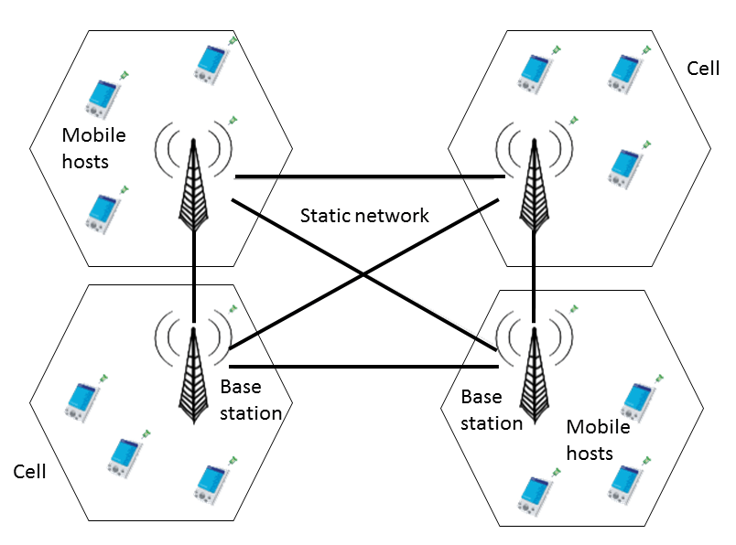


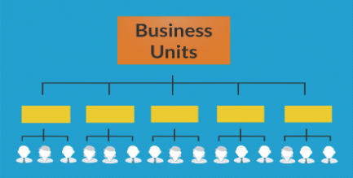
COMPLEX INTELLIGENT SYSTEM (IS) i.e. INTELLIGENT SYSTEM DEALING WITH COMPLEX PHENOMENA IN THE REAL WORLD: EXEMPLARY PROJECT OncoBot
sensors,
actuators
softbots, robots,…
Internet
mobile
networks
chatboots
interactions: dialogue, queries
some interactions can be implemented through Internet, some through cellular (mobile) networks
Human-in-the loop, Human Centered AI
OncoBot
(IS)
medical experts
interactions: dialogues, queries, …
domain databases of cases and rules
knowledge bases about particular units
business units
general knowledge bases, e.g., guides, risk management standards, physical laws, principles often expressed in natural language
links to experts, domain centers, …
patients

Slide 12
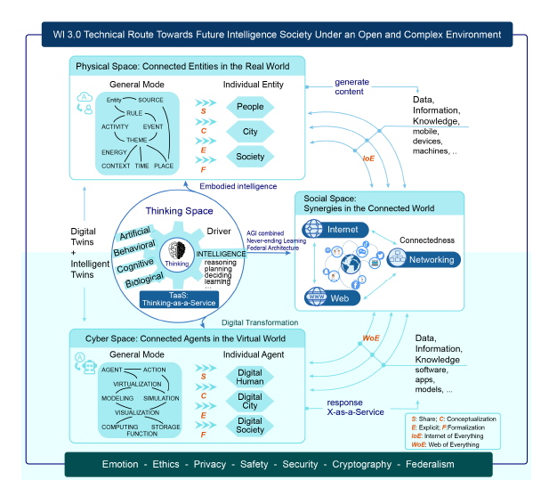
WEB INTELLIGENCE 3.0
THE SOCIAL-CYBER-PHYSICAL-THINKING SPACE:
COMPLEX NETWORK OF SOCIETIES OF C-GRANULES
Kuai, H., Huang, J.X., Tao, X. et al.: Web Intelligence (WI) 3.0: in search of a better-connected world to create a future intelligent society. Artif Intell Rev 58, 265 (2025). https://doi.org/10.1007/s10462-025-11203-z

Slide 13
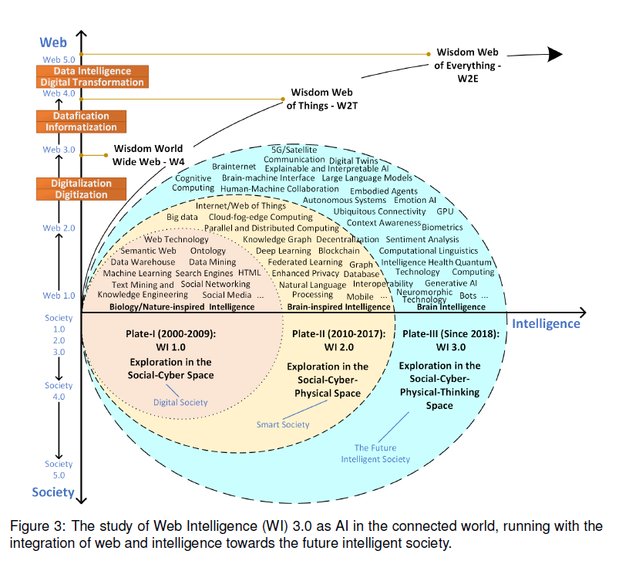
The role of solid foundations of IGrC is crucial for development of exploration
methods in the Social-Cyber-Physical-Thinking Space
H. Kuai, Y.Y. Yao, J. Liu et al.: Web Intelligence: AI in the Connected World. The Innovation (submitted)

Slide 14
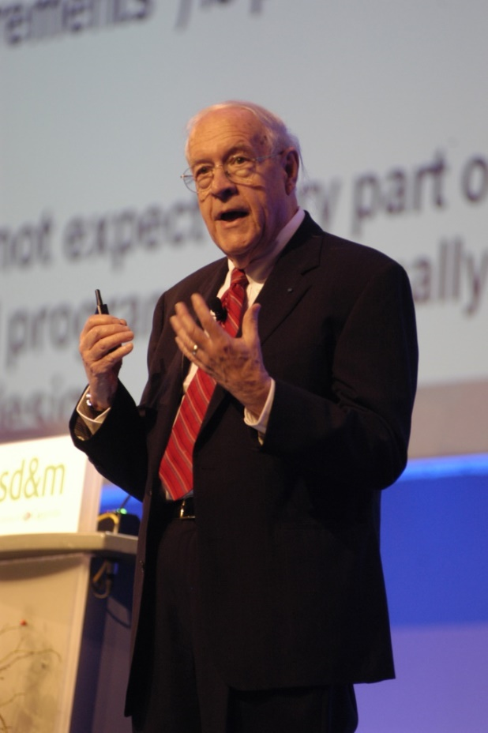
DEALING WITH COMPLEX PHENOMENA
Mathematics and the physical sciences made great strides for three centuries by constructing simplified models of complex phenomena, deriving, properties from the models, and verifying those properties experimentally.
This worked because the complexities ignored in the models were not the essential properties of the phenomena. It does not work when the complexities are the essence.
Frederick Brooks: The Mythical Man-Month: Essays on Software Engineering. Addison-Wesley, Boston, 1975. (extended Anniversary Edition in 1995).
Frederick Brooks introduced the distinction between:
Essential complexity — inherent to the problem’s nature; irreducible.
Accidental complexity — due to imperfect tools; reducible.

Slide 15
The Turing test, as originally conceived, focused on language and reasoning; problems of perception and action were conspicuously absent. The proposed tests will provide an opportunity to bring four important areas of AI research
(language, reasoning, perception, and action) back into sync after each has regrettably diverged into a fairly independent area of research.
BEYOND THE TURING TEST
&
REASONING
C. L. Ortitz Jr. Why we need a physically embodied Turing test and what it might look like. AI Magazine 37 (2016) 55–62.

Slide 16
PHYSICAL SEMANTICS
Constructing the physical part of the [learning] theory and unifying it
with the mathematical part should be considered as one of
the main goals of statistical learning theory
Vladimir Vapnik, Statistical Learning Theory, Wiley 1998, (Epilogue: Inference from sparse data, p. 721)

Slide 17
EMBODIED AI
Embodied AI refers to the integration of artificial intelligence into physical systems, enabling them to interact with the physical world. These systems can include general-purpose robots, humanoid robots, autonomous vehicles (AVs), and even factories and warehouse facilities. The fusion of machine learning, sensors, and computer vision lets these systems perceive, reason, and act in real-world environments.
https://www.nvidia.com/en-us/glossary/embodied-ai/
[…] Yann LeCun, argue that LLMs alone cannot achieve AGI due to several fundamental limitations: their lack of persistent memory, reasoning and planning capabilities, and physical grounding. LeCun specifically asserts that true intelligence requires interaction with the physical world through sensors and embodiment. He emphasizes that while LLMs demonstrate impressive linguistic capabilities, they lack genuine understanding and even suggests that “the sensory-motor abilities of a cat surpass those of an LLM.”
E. Y. Chang: Multi-LLM Agent Collaborative Intelligence: The Path to Artificial General Intelligence. Association for Computing Machinery, New York, NY 2025. doi.org/10.1145/3749421

Slide 18
WHAT IS A COMPUTATION ?
Two main problems of Computer Science:
What is a state?
What is a transition relation?
What's an algorithm?
Yuri Gurevich (2011)
https://www.youtube.com/watch?v=FX2J24u92GI

Slide 19
WHAT IS A COMPUTATION ?
It seems that we have no choice but to recognize the dependence of our mathematical knowledge (...) on physics, and that being so, it is time to abandon the classical view of computation as a purely logical notion independent of that of computation as a physical process
David Deutsch, Artur Ekert,and Rossella Lupacchini, Machines, logic and quantum physics.
Bull. Symbolic Logic 6 (2000) 265–283, p. 268

Slide 20
ROLE OF LANGUAGE:
BASIC PHILOSOPHICAL MOTIVATION
soul (psyche)
→ observer
object (referent)
→ physical object
and/or phenomenon
thought (likenesses of
real existing things and
phenomena)
→ model (of concept)
symbol
→ name, word (syntax)
ARISTOTLE THETRAHEDRON
&
WITTGENSTEIN
LANGUAGE GAMES
Meaning of words is not a static label, but a dynamic process emerging from action in open world; emerging from their use within specific social activities and contexts.
ARISTOTLE
PYRAMID
Language is much more than a static relationship between the observer, the object, the imagination, and the name. Language is primarily a tool for interacting with other abstract and physical objects (people agents, units, granules) in order to achieve goals. Therefore, the meaning of a word is simply the rules of its use in a specific social context, that is, within the framework of a language game.

Slide 21
[…] interaction is a critical issue in the understanding of complex systems of any sorts: as such, it has emerged in several well-established scientific areas other than computer science, like biology, physics, social and organizational sciences.
INTERACTIONS
Andrea Omicini, Alessandro Ricci, and Mirko Viroli, The Multidisciplinary Patterns of Interaction from Sciences to Computer Science.
In: D. Goldin, S. Smolka, P. Wagner (eds.):
Interactive computation: The new paradigm, Springer 2006

Slide 22
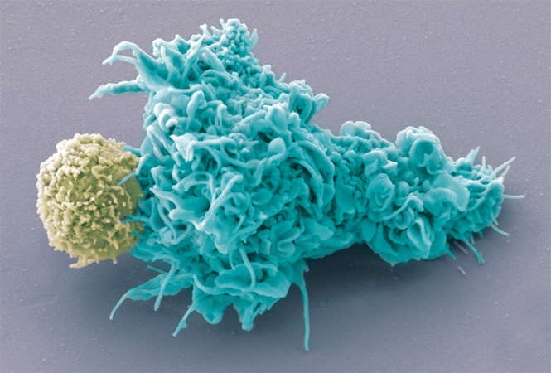
[…] One of the fascinating goals of natural computing is to understand, in terms of information processing, the functioning of a living cell. An important step in this direction is understanding of interactions between biochemical reactions. … the functioning of a living cell is determined by interactions of a huge number of biochemical reactions that take place in living cells.
INTERACTIONS & MULTISCALING
A human dendritic cell (blue pseudo-color) in close interaction with a lymphocyte (yellow pseudo-color). This contact may lead to the creation of an immunological synapse.
The Immune Synapse by Olivier
Schwartz and the Electron Microscopy
Core Facility, Institut Pasteur
http://www.cell.com/Cell_Picture_Show
Andrzej Ehrenfeucht, Grzegorz Rozenberg: Reaction Systems: A Model of Computation Inspired by Biochemistry, LNCS 6224, 1–3, 2010
B. Allen, B. C. Stacey, Y. Bar-Yam: Multiscale information theory and the marginal utility of information, Entropy 19(6): 273 (2017) doi:10.3390/e19060273.

Slide 23
COMPLEX INTELLIGENT SYSTEM (IS)
CHALLENGE FOR IS CONTROL:
DEVELOPMENT OF REASONING METHODS SUPPORTING
GENERATION & COORDINATION OF DIFFERENT KINDS OF INTERACTIONS WITH ABSTRACT AND PHYSICAL OBJECTS AND REASONING (EXPRESSED IN DIFFERENT LANGUAGES: FORMAL AND NATURAL) ABOUT THEIR RESULTS FOR MAKING THE RIGHT DECISIONS (i.e. FOR JUDGMENT)
Traditional statistics is strong in devising ways of describing data and inferring distributional parameters from sample.
Causal inference requires two additional ingredients:
- a science-friendly language for articulating
causal knowledge,
and
- a mathematical machinery for processing that
knowledge, combining it with data and drawing
new causal conclusions about a phenomenon.
Judea Pearl: Causal inference in statistics: An overview. Statistics Surveys 3, 96-146 (2009)

Slide 24
TWO MAIN CONCERNS REGARDING
COMPLEX INTELLIGENT SYSTEMS (IS)
COMPLEXITY: very difficult and risky, e.g. in already complex medical environments; design and analysis of IS based on the IGrC model
LACK OF TRUST: toward Human-Centered AI, Human-in-the-Loop ML; interactions (dialogues) with experts and chatbots based on the IGrC model
IGrC is proposed as the computing model for developing trustworthy intelligent systems that deal with complex phenomena in the real physical world.
B. Shneiderman, Human Centered AI, Oxford University Press, Oxford, UK (2022)
R. M. Monarch, Human-in-the-Loop Machine Learning. Active Learning and Annotation for Human-Centered AI, MANNING, Shelter Island, NY (2021)

Slide 25
THE SOLID FOUNDATIONS OF IGrC WILL HELP TO DESIGN AND ANALYSE THE BEHAVIOUR OF AI SYSTEMS ACROSS DIFFERENT DOMAINS.

Slide 26
PANEL: BEYOND BENCHMARKS: RETHINKING REASONING IN LANGUAGE MODELS
(NIPS 2025 https://neurips.cc/virtual/2025/loc/san-diego/128665)
Large Reasoning Models (LRMs), which generate explicit chains of thought, raise new optimism but also expose clear limits: they often underperform standard models on simple tasks, improve briefly at medium complexity, and then collapse on harder ones despite having unused compute. Crucially, reasoning is not the same as knowledge recall, tool use, or agent-like behavior. True reasoning involves solving novel problems, decomposing them into steps, generalizing to new contexts, recombining partial results, and finally generating novel hypotheses—capabilities current systems largely lack. Today’s evaluations, focused on final answers and contaminated benchmarks, risk giving a misleading sense of progress.

Slide 27
WORLD ARTIFICIAL INTELLIGENCE CONFERENCE & HIGH-LEVEL MEETING ON GLOBAL AI GOVERNANCE
(July 26-29, 2025 Shanghai)
Despite the proliferation of approximately 3,755 large language models (LLMs) globally and 1,509 in China, most are pre-trained on similar natural language corpora sourced from the Internet.
T. Huang: Innovative research paradigms, AI models, and autonomous robots at the 2025 world artificial intelligence conference. The Innovation 6(12): 101082, December 1, 2025 www.cell.com/the-innovation

Slide 28
FOR DEVELOPMENT OF
IS
INTERDISCIPLINARY COLLABORATION
ACROSS DIFFERENT DOMAINS
IS NEEDED

Slide 29
HINTS FROM COMPUTING IN NATURE
G. Rozenberg, T. Back, J.N. Kok (eds.):Handbook of Natural Computing. Springer Berlin Heidelberg, Berlin, Heidelberg (2012). doi:10.1007/978-3-540-92910-9_57
Deeper understanding of human brain and network structures can also help to unravel the mysteries of neural networks and construct more transparent yet more powerful AI models.
T. Huang, H.Xu, H. Wang et al. (2023). Artificial intelligence for medicine: Progress, challenges, and perspectives. The Innovation Medicine 1:100030. doi.org/10.59717/ j.xinnmed.2023.100030.
The potential of AI in medicine is vast, yet much remains to be explored and refined. Researchers should strive to develop more advanced AI model architectures and algorithms that can better handle the intricacies of medical data. This includes exploring novel neural network designs, optimization techniques, and learning strategies. These AI models are not merely incremental improvements but rather transformative forces that will reshape the very fabric of medical practice and research.
J., Xu, H. Xu, T. Chen et al. (2025). Artificial intelligence for medicine 2025: Navigating the endless frontier. The Innovation Medicine 3:100120. doi/10.59717/j.xinn-med.2025.100120
e.g. LMM → SMM

Slide 30
HINTS FROM COMPUTING IN NATURE
G. Rozenberg, T. Back, J.N. Kok (eds.):Handbook of Natural Computing. Springer Berlin, Heidelberg (2012). doi:10.1007/978-3-540-92910-9_57
Now, AI is transitioning from a powerful analytical tool to an interactive intelligence, driving innovation in four key areas. Brain computer interfaces (BCI) allow paralyzed patients to control devices with their thoughts, opening new doors for neuro rehabilitation. Intelligent robotic systems are revolutionizing surgery, shifting from passive assistance to autonomous decision making, enhancing precision and safety. AI-powered reproductive technology is optimizing IVF success rates through predictive modeling, addressing fertility challenges. AI-driven elderly care integrates continuous health monitoring with robotic assistance, providing personalized support for aging populations. As AI moves from analyzing static data to real-time interaction, it’s reshaping healthcare. No longer just a tool for pattern detection, AI is becoming a truly inteligent and responsive partner — helping doctors make more informed decisions, improving patient care, and driving a future where medicine is more precise, efficient, and human-centered.
AI in Medicine: From Data-Driven Insights to Interactive Intelligence. The Innovation Medicine 3 (2025). https://www.the-innovation.org/medicine/archive

Slide 31
ROBUST, INTERACTIVE,
AND HUMAN-ALIGNED AI SYSTEMS
[…] the grand challenge of creating intelligent agents that can safely and seamlessly learn from and adapt to humans. To accomplish this goal, we need to continue to develop improved AI systems that can manage uncertainty over a wide range of sources, can efficiently fuse multiple forms of human feedback, and enable efficient verification and interpretability.
[…] Successfully and efficiently integrating human input into the study of robust AI and robotics will not only require extending existing learning techniques but will also require developing new theoretical and algorithmic techniques that will benefit from insights from fields such as human factors, causal inference, cognitive science, robust control, and formal verification.
D. S. Brown: Toward robust, interactive, and human-aligned AI systems. AI Magazine 2025: 46:e70024. doi/org/10.1002/aaai.70024

Slide 32
MULTISENSORY LEARNING
[…] my research is inspired by the way humans naturally engage with the world using all their senses. My long-term goal is to build intelligent systems that can see, hear, touch, smell, taste, and interact with their surroundings—enabling them to perceive, understand, and act within richly multisensory environments. Realizing this vision requires interdisciplinary collaboration across computer vision, robotics, natural language processing, machine learning, augmented reality, acoustic learning, and cognitive science. By integrating insights from these domains, my research aims to empower machines to emulate and enhance human multisensory capabilities, ultimately paving the way for more capable, adaptive, and intuitive artificial agents.
R. Gao: Multisensory machine intelligence. AI Magazine 2025: 46:e70026 doi.org/10.1002/aaai.70026

Slide 33
TO MAKE SUCH ITERDISCIPLINARY COOPERATION FEASIBLE, IT IS NECASSARY TO GROUD IT IN THE RELEVANT COMPUTING MODEL

Slide 34
INTERACTIVE GRANULAR COMPUTING (IGrC) MODEL

Slide 35
IGrC:
A RESPONSE TO ESSENTIAL COMPLEXITY
PARADIGM SHIFT :
FROM "HOW TO DO IT? (process-focused)"
TO "WHAT MUST BE DONE? (action/purpose-focused)"
Key Idea: One cannot eliminate or constrain the very essence of complexity. One can blend into it and steer adaptively by discovering the sets of rules of interaction (complex games in IGrC).
The Role of IGrC:
Approximate solutions to problems constructed along granular computations
Ongoing interactions with the complex physical and abstract objects
Adaptive discovery of sets of interaction rules (complex games)
Emergent learning from experience
Evolution of models in real time
Paradigm Shift
From purely abstract modeling →
To abstract–physical modeling grounded in real interactions

Slide 36
ECORITHMS
PARADIGM SHIFT :
FROM "HOW TO DO IT?" TO "WHAT MUST BE DONE?"
function to be computed is not known a priori
model of function should be learned by interacting with the environment
The algorithms I discuss in this book are special. Unlike most algorithms, they can be run in environments unknown to the designer, and they learn by interacting with the environment how to act effectively in it. After sufficient interaction they will have expertise not provided by the designer, but extracted from the environment. I call these algorithms ecorithms.
    Valiant, L.: Probably Approximately Correct. Nature’s Algorithms for Learning and Prospering in a Complex World. Basic Books, A Member of the Perseus Books Group, New York (2013)

Slide 37
VAGUENESS IN PHILOSOPHY
PARADIGM SHIFT :
FROM "HOW TO DO IT?" TO "WHAT MUST BE DONE?"
Discussion on vague (imprecise) concepts includes the following :
1. The presence of borderline cases.
2. Boundary regions of vague concepts are
not crisp.
3. Vague concepts are susceptible to sorites
paradoxes.
Keefe, R. (2000) Theories of Vagueness. Cambridge Studies in Philosophy, Cambridge, UK)
Concepts that trigger actions and plans are often complex and vague, concerning situations in the real physical world. Therefore, models of these concepts can only temporarily be of high quality and must continuously adapt through interaction with the physical world.

Slide 38
GRANULES & PERCEPTION
Lotfi Zadeh: an information granule is a clump of objects (or points) drawn together by various criteria such as indistinguishability, similarity, proximity, or functionality.
Leslie Valiant, of Harvard University, has been named the winner of the 2010 Turing Award for his efforts to develop computational learning theory.
http://www.techeye.net/software/leslie-valiant-gets-turing-award#ixzz1HVBeZWQL
Current research of Professor Valiant http://people.seas.harvard.edu/~valiant/researchinterests.htm
A fundamental question for artificial intelligence is to characterize the computational building blocks that are
necessary for cognition.
COMPLEX GRANULES
The discovery of such granules requires
insightful methods of reasoning.

Slide 39
IGrC MODEL BASED ON INTERACTION BETWEEN ABSTRACT AND PHYSICAL OBJECTS
In IGrC, we study a new type of (behavioral) rules using the idea that the development of Complex Intelligent Systems (IS) (i.e., Intelligent Systems that deal with complex phenomena), such as OnkoBot, should be based on new rules originating from interactions between abstract and physical objects rather than on simple rules that are confined to the abstract space (as in the case of cellular automata).
Stephen Wolfram: A New Kind of Science
https://www.wolframscience.com/nks/
https://www.wolframscience.com/resources/
https://publications.stephenwolfram.com/foundations-mathematics-mathematica/
[...] nature follows definite laws, definite rules: otherwise we couldn’t do science at all. […] The question is what kinds of rules one uses.
[…] I think what’s happened is that mathematics has ended up using only rather special kinds of rules. […] But in fact there’s a vast universe of other rules out there, which mathematics has essentially never looked at.
Thesis: all of mathematics (and physics) can emerge from simple iterative rules.

Slide 40
TWO PERSPECTIVES ON THE NATURE OF COMPLEXITY
IN MATHEMATICS AND COMPUTER SCIENCE
accepting irreducible complexity
(in the sense defined by Frederick Brooks)
vs.
seeking simple sources of complexity
(Wolfram)
Challenge:
How IGrC can help to discover such simple rules ?
Stephen Wolfram: A New Kind of Science
https://www.wolframscience.com/nks/
https://www.wolframscience.com/resources/
https://publications.stephenwolfram.com/foundations-mathematics-mathematica/
[...] nature follows definite laws, definite rules: otherwise we couldn’t do science at all. […] The question is what kinds of rules one uses.
[…] I think what’s happened is that mathematics has ended up using only rather special kinds of rules. […] But in fact there’s a vast universe of other rules out there, which mathematics has essentially never looked at.
Thesis: all of mathematics (and physics) can emerge from simple iterative rules.

Slide 41
GRANULAR COMPUTING (GrC): GRANULES CLOSED
IN THE ABSTRACT SPACE ONLY
INTERACTIVE GRANULAR COMPUTING (IGrC):
GRANULES
IN THE ABSTRACT AND PHYSICAL SPACES FOR PRCEPTION MODELING

Slide 42
FROM GrC TO IGrC
GrC, with abstract information granules as basic objects, is generalized to IGrC through the introduction of complex granules (c-granules), which are the fundamental objects of IGrC. These combine abstract and physical objects, enabling the perception of their properties through the control of c-granules. The IGrC model differs from the classical Turing model. In the IGrC model, both language and reasoning issues as well as actions and perception are significant. Research on IGrC utilizes existing partial results from various fields, such as multi-agent systems, perception and action, machine learning, natural language processing, and more.

Slide 43
INFORMATION GRANULES OF GrC AS SPECIAL CASES OF C-GRANULES OF IGrC
The IGrC model substantially extends the GrC model. GrC granules can be considered special cases of c-granules of IGrC. Any information granule g_{o} from GrC can be identified as a c-granule g consisting of an i-layer that encodes g_{o} and two transformation specifications: store and read (labeled by the address that points to physical memory). The control of the c-granule g can use these specifications to either store g_{o} in the p-layer of g or read g_{o} from it into the i-layer of g (without losing any information).

Slide 44
COMPLEX GRANULES
(C-GRANULES)

Slide 45
GRANULAR COMPUTING (GrC)
&
INTERACTIVE GRANULAR COMPUTING (IGrC)
g =(syn(g), sem(g)) – granule
syn(g) – syntax
sem(g) – semantics
(only in IGrC)
abstract
physical

Slide 46
GrC & IGrC
Remarks.
In order to successfully search for high-quality granules (information granules in GrC and c-granules in IGrC) as computational building blocks for cognition, they must first be discovered:
  languages for expressing granules on hierarchical levels,
  interpretations of the languages that define the (abstract and/or physical) semantics of granules,
  relevant utility measures that estimate whether the discovered granules can be treated as satisfactory computational building blocks for cognition,
  efficient searching strategies for granules expressed in the languages that have satisfactory qualities relative to these measures,
  adaptive strategies accordingly modifying the aforementioned entities to successfully support the discovery of computational building blocks for cognition.

Slide 47
GrC & IGrC
Remarks (cont.).
The semantics of granules should be based on constructively defined relational systems consisting of sets of objects and the relationships between them. These sets of objects include pre-defined granules for the currently considered hierarchical level and new granules defined on this level (in the language for expressing granules). These new granules are constructed by control of a given c-granule aiming to discover the granules as computational building blocks for cognition. The languages for expressing granules are interpreted within these relational systems.
Furthermore, constructive methods that expand upon the traditional concept of an algorithm must be developed. Consider, e.g., Leslie Valiant's ecorithms, which are based on learning. These methods aim to estimate the membership of objects or situations perceived from physical space within the considered granules. These methods should be supported by reasoning models, such as those used for reasoning across different hierarchical levels.
An implementation module (IM) realizes physical semantics. The IM is a sub-granule of the c-granule control.
L. Valiant: Probably Approximately Correct. Nature’s Algorithms for Learning and Prospering in a Complex World. Basic Books, A Member of the Perseus Books Group, New York (2013)
L. Valiant: http://people.seas.harvard.edu/~valiant/researchinterests.htm

Slide 48

C-GRANULE: INTUITION
C-granules may have many sub-granules. State of c-granule is changing with local time of c-granule. The dynamics is steered by control of c-granule aiming by selection and realization of transformations (associations) to satisfy goals (needs, specification of problem to be solved). This is based on perceived information about physical and abstract objects as well as their interactions.
specifications of (families of) spatio-temporal windows realized by control as physical pointers to the corresponding parts of the physical space
w – scope of granule g composed out of family of granules g₁ ,…, g_{i}
g₁
i-layer(g)
||w|| - realization of w with the family of physical objects in
p-layer(g)
w_{1:}: tr₁ inf₁
…
w₂: tr₂ inf₂
g
w: tr inf
w_{i} : tr_{i,} inf_{i}
soft_suit
with physical objects directly accessible for measurements
g₂
link_suit with physical objects providing transmission of interactions
properties of physical objects from hard_suit, link_suit and their interactions encoded in inf_{i} are based on already perceived properties, granule structure, physical laws and/or knowledge bases
p-layer(g)
$o_{w_{2}}$
hard_suit with target physical objects
see: signals in the book by Holland

Slide 49




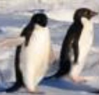


C-GRANULE: INTUITION
specifications of (families of) spatio-temporal windows realized by control as physical pointers to the corresponding parts of the physical space
x₃
x₂
g₁
i-layer(g)
t₂
t₃
t₅
t₄
t₆
w_{1:}: tr₁ inf₁
t₁
t₇
…
w₂: tr₂ inf₂
x₁
g
w: tr inf
w_{i} : tr_{i,} inf_{i}
g₂
inf₂ includes video information gathered during physical semantics realization of specification of transformation tr₂
(e.g. tracking objects what may require cooperation with cameras placed in soft_suit or link suit) from parts of the physical space pointed by spatio-temporal window specification w₂ ;
inf₂ also includes information about the expected results of tr₂ realization;
these results may be different from the actual results due to interactions with the environment

Slide 50
LANGUAGE OF C-GRANULES

Slide 51
PHILOSOPHICAL MOTIVATION
FOR LANGUAGE OF C-GRANULE
observer → c-granule with
control aiming to achieve goals (satisfy needs) by interaction with the abstract and physical world
2. object → physical object
3. model → abstract model
represented in
i-layer (e.g., classifier)
4. name → name, expression
(syntax) used by
control of c-granule for
communication
with c-granules
&
5. language games (rules of
interaction and use) →
stored in i-layer of c-granule
specifications of associations for rules of interaction and their use realized by physical semantics in the open world
1. observer 2. object
3. model
4. name
ARISTOTLE THETRAHEDRON
&
WITTGENSTEIN
LANGUAGE GAMES
Meaning of words is not a static label, but a dynamic process emerging from action in open world; emerging from their use within specific social activities and contexts.
ARISTOTLE
PYRAMID
C-GRANULE

Slide 52
EXAMPLE OF LANGUAGE GAME: CHESS
Let’s consider a game of chess played by an intelligent system (IS) — treated as a specific c-granule — against a human. Of course, one might try to limit the operation of the IS control to an abstract space that takes into account the rules of chess and various knowledge bases. However, this proves to be insufficient. In a specific game, the IS should take into account, e.g., the opponent's class, her/his current predisposition, emotional state (e.g., whether her/his is currently fully focused on the game), which will require the IS to interact with the current opponent (being a physical object!) and perceive her/his skills and other traits caused by interactions with other objects in the real world. It is easy to see that an analogous situation can occur in applications related to medical diagnostics.

Slide 53
IGrC & THE BIOLOGY OF LANGUAGE:
TOWARD COMPUTERS PUTING REASONING LANGUAGE, PERCEPTION AND ACTION INTO SYNC
[…] goal in this book is to provide a coherent view on the relation between language and the brain based on the multifold empirical data coming from different research fields
Angela D. Friederici: Language in Our Brain: The Origins of a Uniquely Human Capacity. MIT Press 2017
[…] processing and perception access a common “knowledge base,” core internal language, a computational system that yields an unbounded array of structured expressions.
PROPOSAL:
IGrC as the basic tool for modeling such computational systems
[…] Friederici’s most striking conclusions concern specific regions of Broca’s area (BA 44 and BA 45) and the white matter dorsal fiber tract that connects BA 44 to the posteriori temporal cortex.
N. Chomsky: Preface. In: Angela D. Friederici: Language in Our Brain: The Origins of a Uniquely Human Capacity. MIT Press 2017

Slide 54
LANGUAGE OF I-LAYER OF C-GRANULE FOR EXPRESSING RELATIONS IN GrC and IGrC
BASIC POSTULATE
The language in the information layer of the c-granule allows for the expression of 'relations' (called in IGrC associations) between abstract and physical objects. These types of relations are not purely mathematical in the sense of set theory. C-granule control attempts to construct models of these associations with physical semantics using models defined in the abstract world. Interaction with the physical world supports the construction of these models and makes their adaptation possible. Thus, we have two worlds of relations: those that allow for the expression of properties of abstract objects and those that do not fit within classical set theory. The focus is on how these abstract relations can 'approximate' the latter, i.e. associations.
IS’s are aiming to discover or learn such approximations of associations. This process is related to many challenges.

Slide 55
LANGUAGE OF I-LAYER OF C-GRANULE FOR EXPRESSING RELATIONS IN GrC and IGrC
GrC:
Formal or (fragments of natural) language for expressing relations between abstract objects only.
Remark: As long as the specific representation of the granules in a finite granular space is not important, one can base the language of granules on any enumeration of its granules. Often, specifying such granules uses only their semantic part.
IGrC:
Language allows us to use relations over abstract and physical objects due to the need to express relations between them in the perception process. Physical objects can only be partially perceived, which implies that the control of the considered c-granule may only have partial and incomplete information about the physical semantics of realized specifications in the physical world (e.g., arguments for or against their satisfiability in the currently perceived situation concerning the currently diagnosed patient in the physical world).

Slide 56
LANGUAGE OF C-GRANULE:
DESCRIPTION IN I-LAYER OF C-GRANULE BEHAVIOR
LANGUAGE for description of c-granule behavior, e.g.,
behavior of the control of c-granule, including its different module
sub-granules constructed by the c-granule representing properties of abstract and physical objects as well as relations and associations between them
  properties of perceived so far physical and abstract objects and/or interactions between them
  properties of behavioral patterns
  specifications of spatio-temporal windows
  specifications of transformations (associations)
  expected and/or real results of realization of transformations
  information about performed or planned reasoning processes and reasoning results about stored information
  aggregation operations and their results
  information about local time of c-granule; period for transformation realization; initialization (suspension, resumption) moment of transformation realization; cancelling moment of c-granules pointed by control

Slide 57
LANGUAGE OF C-GRANULE:
DESCRIPTION IN I-LAYER OF C-GRANULE BEHAVIOR (Cont.)
  communication protocols with, e.g., knowledge bases, experts, sensors, actuators, and other c-granules
communication expressions used by c-granule for encoding information into the external world, e.g., messages with important information, queries, orders, calls for cooperation
communication expressions used by c-granule in decoding information from the external world, e.g., messages with important information, queries, orders, calls for cooperation
information about languages used by other c-granules in the environment
information about behavior of other c-granules (teams of c-granules or societies of c-granules) from the environment, e.g., behavioral patters
usefulness of other c-granules in achieving the goals (needs) by the considered c-granule
trustworthiness of other granules relative to the goals (needs) of the considered c-granule
…

Slide 58
LANGUAGE OF FORMULAS AND THEIR INTERPRETATION IN I-LAYER
L – language of formulas over a set of constants (representing names of objects, situations, results of measurements, …), functional and relational symbols.
Interpretation I: A finite set of formulas from L (intuition: true facts in the current situation).
In GrC, we are unaware of how, when, or why they are obtained, but in IGrC, we are.

Slide 59


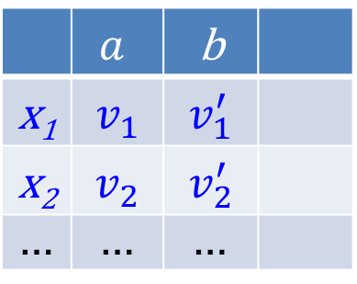



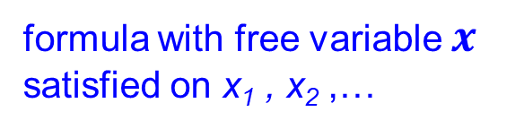
EVOLVING LANGUAGE
OF C-GRANULES
constants
information system
interpretation I
 | $$a$$ | b
x₁ | $$v_{1}$$ | $$v_{1}^{′}$$
x₂ | $$v_{2}$$ | $$v_{2}^{′}$$
… | … | …
$$a\left(x_{1}\right)=v_{1}$$
$$b\left(x_{1}\right)=v_{1}^{′}$$
$$a\left(x_{2}\right)=v_{2}$$
$$b\left(x_{2}\right)=v_{2}^{′}$$
…
…
variable
functional symbols
new
expressions
(formulas)
…
$$a\left(x\right)=v$$
formula with free variable $x$ satisfied on x₁ , x₂ ,…

Slide 60
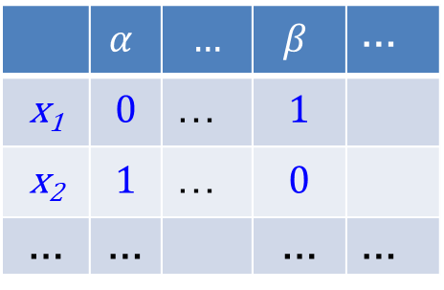


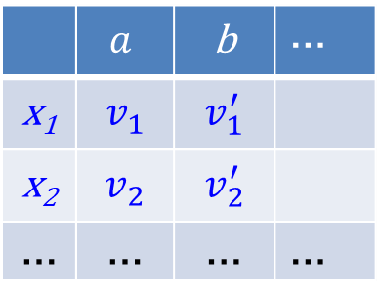
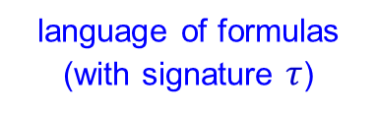

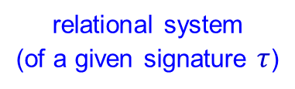


EVOLVING LANGUAGE
OF C-GRANULES
information system
information system
 | $$a$$ | b | …
x₁ | $$v_{1}$$ | $$v_{1}^{′}$$
x₂ | $$v_{2}$$ | $$v_{2}^{′}$$
… | … | … | …
 | $$α$$ | … | $$β$$ | …
x₁ | $$0$$ | … | $$1$$
x₂ | $$1$$ | … | $$0$$
… | … |  | … | …
…
relational system
(of a given signature $τ$)
new information granules
${(V}_{a}, ≤,…)$, ${(V}_{b}, ρ,…)$, …
$(α,I_{a}(α))$, where $α ∈L_{a}, I_{a}\left(α\right)⊆U=\{x_{1},x_{2},…\}$
language of formulas
(with signature $τ$)
$(β,I_{b}(β))$, where$β∈L_{b},$ ${ I}_{b}(β)⊆U$ $=\{x_{1},x_{2},…\}$
in information system new information granules can be defined by aggregation of attributes (formulas), e.g., using conjunction
$L_{a}$, $L_{b}$, …
interpretation of the language in the relational
systeem (of signature $τ)$
$(α∧β ,I_{a}(α)∩I_{b}(β$))
$I_{a}$, $I_{b},\text{…}$
Remark. Interpretation may be fuzzy, not necessarily crisp.

Slide 61
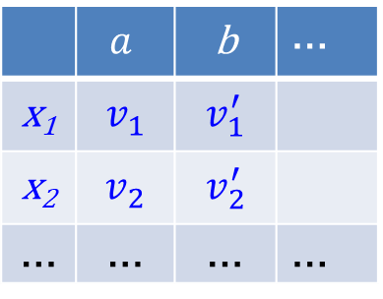
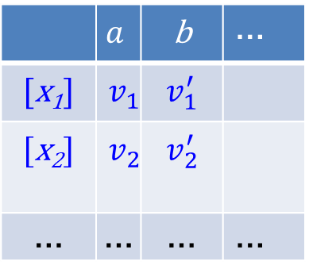
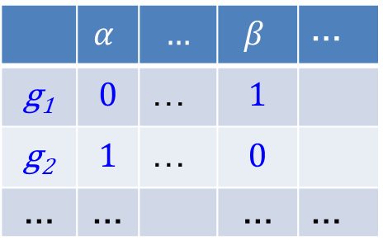
EVOLVING LANGUAGE
OF C-GRANULES
elementary granules in rough sets: indiscernibility classes represented by vectors of attribute values
information system
 | $$a$$ | b | …
[x₁] | $$v_{1}$$ | $$v_{1}^{′}$$
[x₂] | $$v_{2}$$ | $$v_{2}^{′}$$
… | … | … | …
information system
…
 | $$a$$ | b | …
x₁ | $$v_{1}$$ | $$v_{1}^{′}$$
x₂ | $$v_{2}$$ | $$v_{2}^{′}$$
… | … | … | …
Discovery of new languages in which relevant attributes can be defined and interpreted in relational systems over new granules is necessary
information system
 | $$α$$ | … | $$β$$ | …
g₁ | $$0$$ | … | $$1$$
g₂ | $$1$$ | … | $$0$$
… | … |  | … | …
More general granules,
e.g., tolerance (similarity) classes,
time windows, classifiers, granulation of already constructed granules
(including structural objects defined by aggregation of already defined granules with constraints or dynamic granules)
…

Slide 62
HOW C-GRANULES ARE GENERATED, MODIFIED AND MANAGED?
…
How to perceive properties of these objects and their interactions ?
What? Where? How? When? Why?...
…
How to generate the relevant configurations of physical objects and modify interactions between them?
How to generate the relevant configurations of physical objects and modify interactions between them?
…
physical objects
outside of the informational layer
…
…
…
How to establish communication, cooperation or competition with other granules perceiving the physical objects?
Perceived properties should be robust
(to a high degree)
with respect to unpredictable interactions from the environment (see boundaries in the book by Holland)

Slide 63
ANSWERS TO QUERRIES What? Where? How? When?... DEPEND ON THE CONTEXT
EXAMPLE: AI in LOGISTICS 5.0
All these concepts require further multi-level decompositions dependent on the context to make them understandable by AI system.
For example,
AI resilience is an AI system's ability to adapt to disruptions or shocks and recover its performance and functionality without permanent changes.
This concerns: Operations, Inventory, Warehouse,
Packaging, Transportation,
Staging, Return.
Next, e.g., staging is a process in which products or shipments are manually removed and placed
in separate, consolidated areas
for inspection.
Why?
Motivation
How?
Solutions
Who?
Human centeric
LOGISTICS 5.0
What?
Resilience
When?
Contact points
Where?
Ecosystem
B. Nicoletti: Artificial Intelligence for Logistics 5.0. From Foundation Models to Agentic AI. Springer (2025)
E. Y. Chang: Multi-LLM Agent Collaborative Intelligence: The Path to Artificial General Intelligence. Association for Computing Machinery, New York, NY 2025. doi.org/10.1145/3749421

Slide 64
FROM LOGICAL TO ANALYTICAL OPTIMIZATION
What? Where? How? When? Why? ...
for better understanding of the perceived situation to make it possible to answer these queries
Developing specifications of transformations for interaction with the physical world aiming to generate the configuration of physical objects to be perceived
Performing dialogues with experts,
knowledge bases, chatboots
Optimization problem in logical form
different constraints (concerning, e.g., time, costs, risks) should be taken into consideration
Challenge:
Traditional statistics is strong in devising ways of describing data and inferring distributional parameters from sample.
Causal inference requires two additional ingredients:
- a science-friendly language for articulating
causal knowledge,
and
- a mathematical machinery for processing that
knowledge, combining it with data and drawing
new causal conclusions about a phenomenon.
J. Pearl: Causal inference in statistics: An overview. Statistics Surveys 3, 96-146 (2009).
DOI: 10.1214/09-SS057
Select, using the relevant reasoning methods, the best promising their results and perform a decomposition to the relevant analytical optimization problem
Optimization problem in analytical form

Slide 65
FORM LOGICAL TO ANALYTICAL FORMULATION OF OPTIMIZATION PROBLEM
There are numerous reasoning methods necessary to rich the analytical formulation of the optimization problem, particularly related to queries: What? Where? How? When? Why?
Among them are reasoning methods supporting:
What?
  dialogues with knowledge bases, experts, or chtabots for better understanding the perceived situation,
  resolving conflicts between rules of control matched by the currently perceived situation,
  discovery of rules of the control of c-granule;
Where?
  discovery of the relevant spatio-temporal windows used by c-granule control to point to physical or abstract objects,
  searching for relevant c-granules for cooperation/competition;
When?
  establishing the correct configuration of objects to perceive at a given moment or time period,
  establishing (i) the initiation time of interactions influenced by the control of c-granules with the perceived configuration of objects and (ii) the period for perceiving the current situation,
Why?
  preserving of satisfiability (to a satisfactory degree) constraints concerning, e.g., time, costs, and risks,
  changing the dangerous current situation to a safe situation,
modification of infeasible c-granule needs to feasible ones (see Maslow's hierarchy of needs);
How?
  selection or discovery of proper sensors and/or actuators for interacting with the physical world,
  decomposition of complex, vague concepts to a level that allows (i) direct implementation in the physical world or (ii) description in a formalized language used by the control of c-granule to specify properly analytical optimization problems.
[…] Information granulation plays a key role in implementation of the strategy of divide-and-conquer in human problem-solving. Lotfi A. Zadeh: Foreword. In: S.K. Pal, L.Polkowski, A. Skowron (eds.) Rough-Neural
Computing. Techniques for Computing with Words. Springer 2004.
A. H. Maslow: A theory of human motivation. Psychological Review 50: 370-396 (1943)

Slide 66
EXAMPLES OF
GRANULAR ALGEBRAS

Slide 67
GRANULAR ALGEBRA
=
ATOMIC GRANULES
+
OPERATIONS ON GRANULES
Examples of families of elementary granules
…
g =(syn(g), sem(g)) – granule
syn(g) – syntax of g expressed in a language L
sem(g) – semantics of g: crisp (or fuzzy) set of objects (already defined granules)

Slide 68
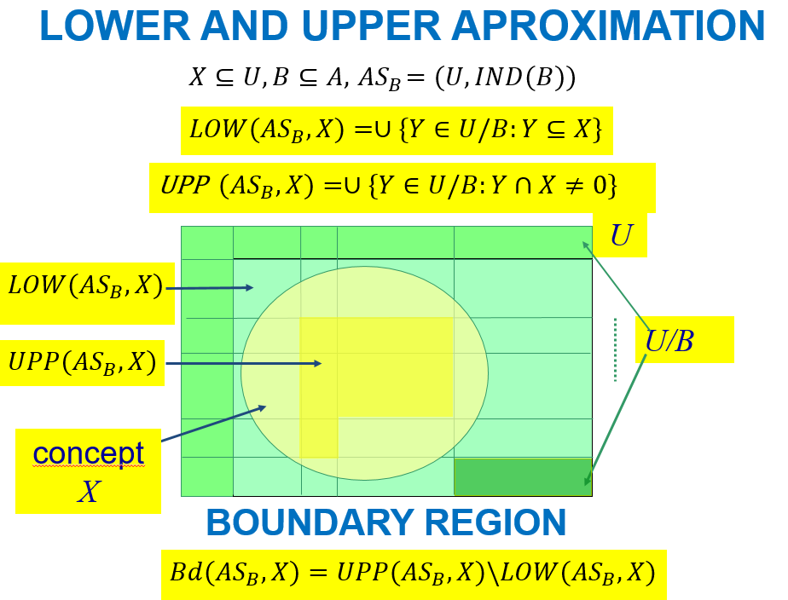
ATOMIC ABSTRACT GRANULES FROM INFORMATION SYSTEMS
 | a₁ | a₂ | … | a_{m}
x₁ | v₁ | v₂ | … | v_{m}
 | … | … | … | …
indiscernibility classes of (subsets of) attributes
partitions defined by attributes
partitions defined by subsets of attributes
granules defined by calculi over the above granules
…
computational building blocks
for concept approximation in the rough set approach

Slide 69



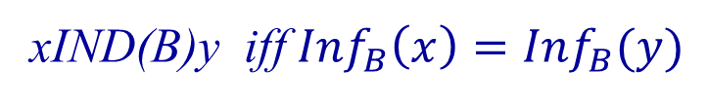

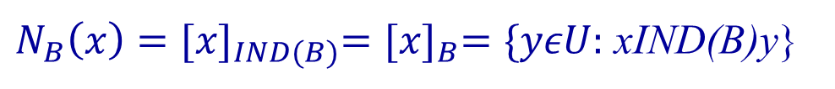
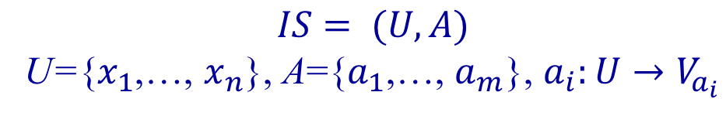

INDISCERNIBILITY RELATIONS OF INFORMATION SYSTEM
$$B$$
Information system (data table)
 | a₁ | a₂ | … | a_{m}
x₁ | v₁ | v₂ | … | v_{m}
 | … | … | … | …
$$IS= (U,A)$$
U={$x_{1}$,…, $x_{n}$}, A={$a_{1}$,…, $a_{m}$}, $a_{i}:U→V_{a_{i}}$
$$B⊆A$$
$$B−indiscernibility relation of IS$$
xIND(B)y iff ${Inf}_{B}\left(x\right)={Inf}_{B}(y)$
$N_{B}\left(x\right)={[x]}_{IND(B)}={[x]}_{B}=\{yεU:$ xIND(B)y}
x
u=Inf_{B}(x)
signature of x
$${Inf}_{B}\left(x\right)={Inf}_{B}(y)$$
neighborhood of x
elementary granule
$U/B=$ {${[x]}_{B}$: x$ε$U}
tolerance or similarity

Slide 70
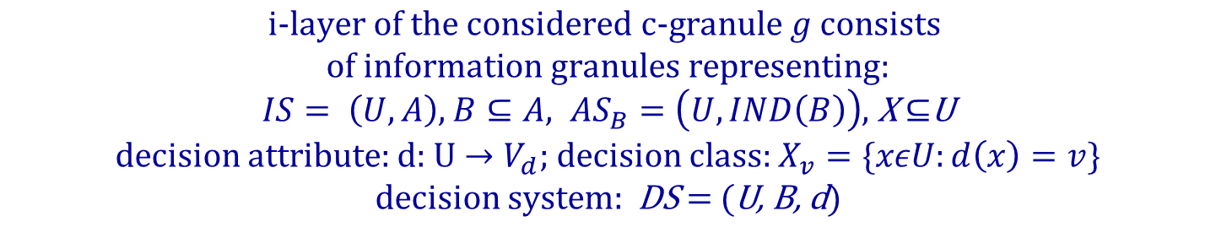
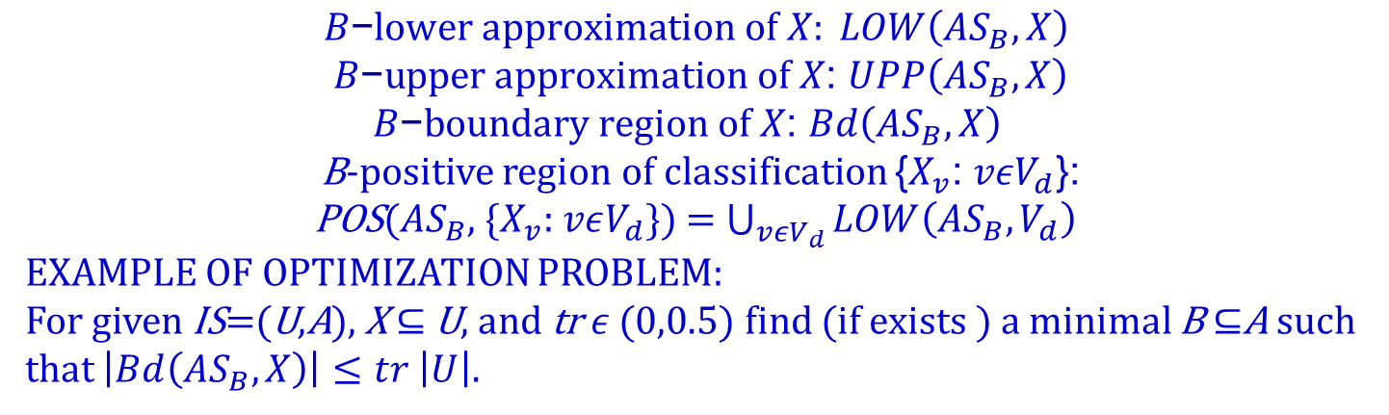
EXAMPLES OF DEFINABLE GRANULES IN THE PAWLAK MODEL OF ROUGH SETS
$$i\text{−}layer of the considered c\text{−}granule g consists$$
$$of information granules representing:$$
$IS= \left(U,A\right),$ $B⊆A, {AS}_{B}=\left(U, IND\left(B\right)\right)$, X $⊆$U
decision attribute: d: U $→V_{d}$; decision class: $X_{v}=\{xεU:d\left(x\right)=v\}$
decision system: DS = (U, B, d)
Examples of granules definable (generated) from elementary granules (i.e., indiscernibility classes of IND(B)) by their interaction (realized in the abstract space) with the relevant information granules represented by algorithms provided by the control of g. Construction of the algorithms is supported by a sub-granule of control of g, called reasoning module.
$$B\text{−}lower approximation of X: LOW\left({AS}_{B},X\right)$$
$B\text{−}upper approximation of X$: $UPP\left({AS}_{B},X\right)$
$B\text{−}boundary region of X$: $Bd\left({AS}_{B},X\right)$
B-positive region of classification {$X_{v}$: $vεV_{d}$}:
POS(${AS}_{B}$, {$X_{v}$: $vεV_{d}$}) = $\bigcup_{vεV_{d}}{LOW\left({AS}_{B},V_{d}\right) }$
EXAMPLE OF OPTIMIZATION PROBLEM:
For given IS=(U,A), X $⊆$ U, and tr$ε$ (0,0.5) find (if exists ) a minimal B $⊆$A such that $\left|Bd\left({AS}_{B},X\right)\right|≤tr$ $\left|U\right|.$

Slide 71
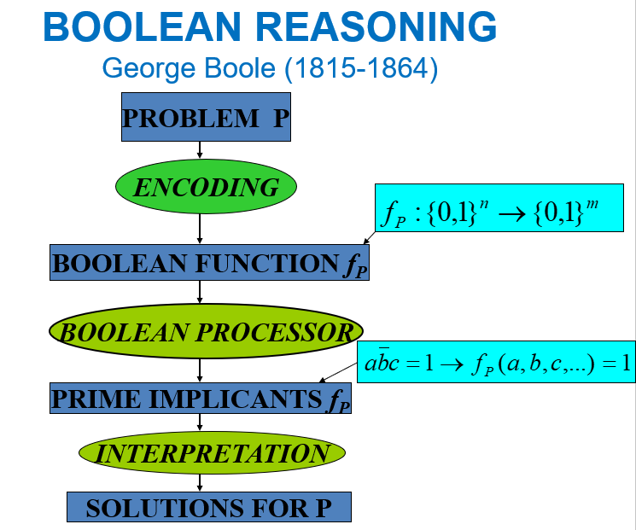
OPTIMIZATION PROBLEMS
feature selection
data reduction
discretization
symbolic value grouping
decision rules
…
Z. Pawlak, A. Skowron: Rough Sets and Boolean Reasoning. Inf. Sci. 177(1) 41-73 (2007)

Slide 72
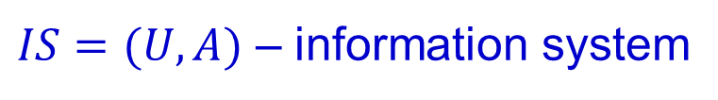


ILLUSTRATIVE EXAMPLES OF GRANULAR ALGEBRAS
$IS=(U,A)$ – information system
${GA}_{IS} −granular algebra$ defined by IS
ATOMIC GRANULES OF
Example 1. partitions defined by IND(a) for a ∈ A
Example 2. partitions defined by coarsening of partitions defined by IND(a) for a ∈ A (where a coarsening of the partition defined by a ∈ A relative to any partition V of V_{a} is the partition of V_{a} defined by relation x r_{V} y iff a(x), a(y)∈ V for some V∈ V ).
DEFINABLE GRANULES OF
(GENERATED FROM ATOMIC GRANULES AND OPERATIONS ON GRANULES)
Example 1&2: partitions of U generated from atomic granules and their intersections.
${GA}_{IS}$:
$${GA}_{IS}$$
Remark. In the case of discretization: V_{a} ⊆R (where R is the set of reals) and V is a finite (and relevant for the problem) family of partitions of R (or interval of reals) into intervals. This allows for inducing classification for unseem cases so far.
Z. Pawlak, A. Skowron: Rough Sets and Boolean Reasoning.
Inf. Sci. 177(1) 41-73 (2007)

Slide 73
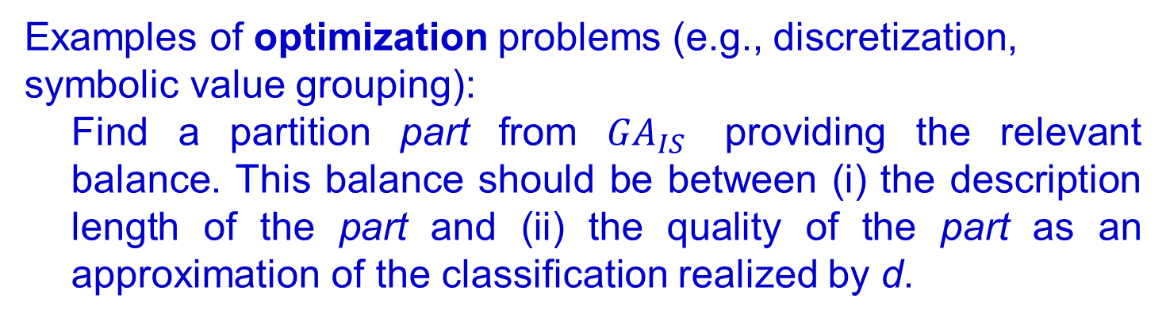
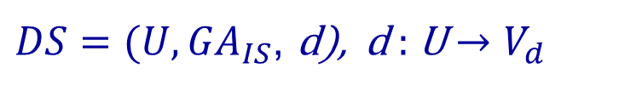
EXAMPLE OF OPTIMIZATION PROBLEM:
SEARCHING FOR THE OPTIMAL PARTITION (GRANULE)
FROM A GIVEN FAMILY OF PARTITIONS (GRANULES)
APPROXIMATING DECISION C-GRANULE
Extended decision system relative to universe of granular calculus GA_{IS} defined as, e.g., in Example 2.
Decision system as granular algebra linking two granular algebras defined by IS and d
$DS=(U, {GA}_{IS}$, d), d : U $→V_{d}$
Examples of optimization problems (e.g., discretization, symbolic value grouping):
Find a partition part from ${GA}_{IS}$ providing the relevant balance. This balance should be between (i) the description length of the part and (ii) the quality of the part as an approximation of the classification realized by d.

Slide 74
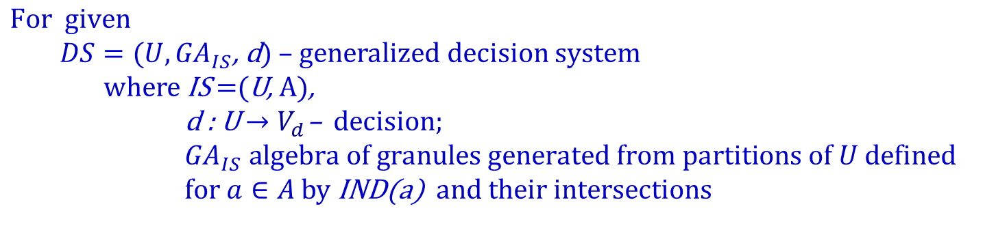

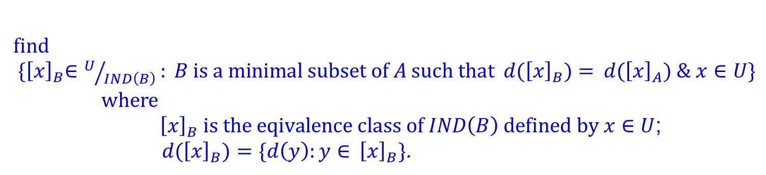
EXAMPLE OF OPTIMIZATION PROBLEM:
C-GRANULES AS MINIMAL DECISION RULES (Cont.)
$$\text{For} \text{given}$$
$DS=(U, {GA}_{IS}$, d) – generalized decision system
where IS =(U, A),
d : U $→$ $V_{d}$– decision; ${ GA}_{IS} algebra of granules generated from partitions of U$defined $for a∈A$by IND(a)$and their intersections$
find
${ \{\left[x\right]}_{B}∈U/{IND\left(B\right)}: B is a minimal subset of A such that$ ${ d(\left[x\right]}_{B})={ d(\left[x\right]}_{A}) \& x∈U\}$
where
${\left[x\right]}_{B} is the eqivalence class of IND\left(B\right) defined by x∈U$;
${ d(\left[x\right]}_{B})=\{d\left(y\right):y∈{ \left[x\right]}_{B}\}$.
Every such ${\left[x\right]}_{B}$defines a (minimal) decision rule
$∧\{a=a\left(x\right):a∈B\}⟹{d∈δ}_{B}$(x)
where
$δ_{B}$(x) ={v $∈V_{d}:∃y∈{\left[x\right]}_{B}$: d(y)=v}= ${d(\left[x\right]}_{B}).$

Slide 75
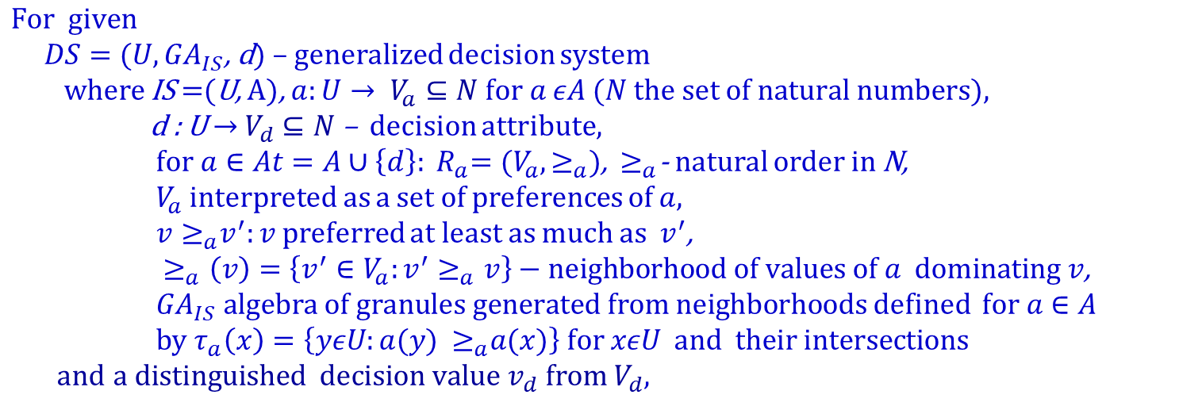
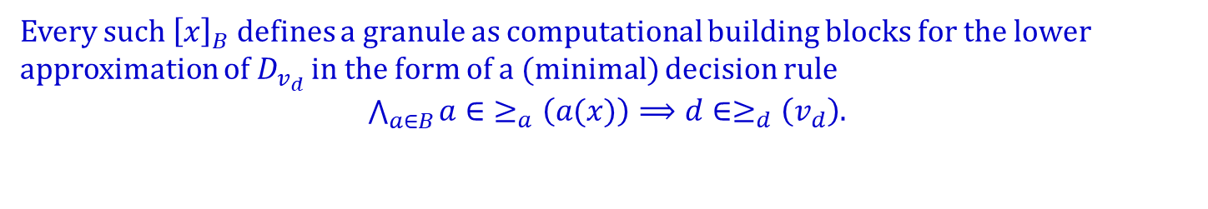
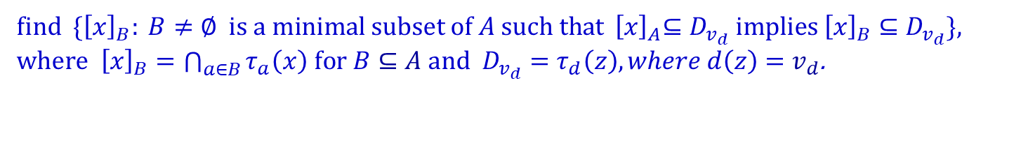
EXAMPLE OF OPTIMIZATION PROBLEM:
C-GRANULES AS COMPUTATIONAL BUILDING BLOCKS FOR APPROXIMATION OF CONCEPTS IN THE FORM OF MINIMAL DECISION RULES IN DOMINANCE ROUGH SETS (Cont.)
$$\text{For} \text{given}$$
$DS=(U, {GA}_{IS}$, d) – generalized decision system
where IS =(U, A), $a:U→ V_{a}⊆N for a εA (N the set of natural numbers)\text{,}$
d : U $→$ $V_{d}$ $⊆N$– decision attribute,
${ for a∈At=A∪\left\{d\right\}: R}_{a}=(V_{a},≥_{a})$,${ ≥}_{a}$- natural order in N,
${ V}_{a}$ interpreted as a set of preferences of $a$,
${{ v≥}_{a}v}^{′}:v$preferred at least as much as $v^{′}$,
$≥_{a}\left(v\right)=\left\{v^{′}∈V_{a}:v^{′}≥_{a}v\right\}−neighborhood of values of a dominating v$,
${ GA}_{IS} algebra of granules generated from neighborhoods$ defined $for a∈A$
by $τ_{a}\left(x\right)=\left\{yεU:a(y){ ≥}_{a}a(x)\right\} for xεU and their intersections$
and $a distinguished decision value{ v}_{d} from V_{d}$,
find ${ \{\left[x\right]}_{B}: B≠∅ is a minimal subset of A such that$ ${ \left[x\right]}_{A}⊆D_{v_{d}} implies{ \left[x\right]}_{B}⊆D_{v_{d}}$},
where ${\left[x\right]}_{B}=\bigcap_{a∈B}{τ_{a}\left(x\right) for B⊆A}$ and $D_{v_{d}}=τ_{d}\left(z\right), where d\left(z\right)=v_{d}$.
Every such ${\left[x\right]}_{B}$defines a granule as computational building blocks for the lower approximation of $D_{v_{d}}$ in the form of a (minimal) decision rule
$\bigwedge_{a∈B}{a∈}≥_{a}\left(a(x)\right)⟹d∈≥_{d}\left(v_{d}\right)$.
S. Greco, B. Matarazzo, R. Słowiński: Rough sets theory for multi-criteria decision analysis. European Journal of Operational Research 129(1):1-47 (2001)

Slide 76
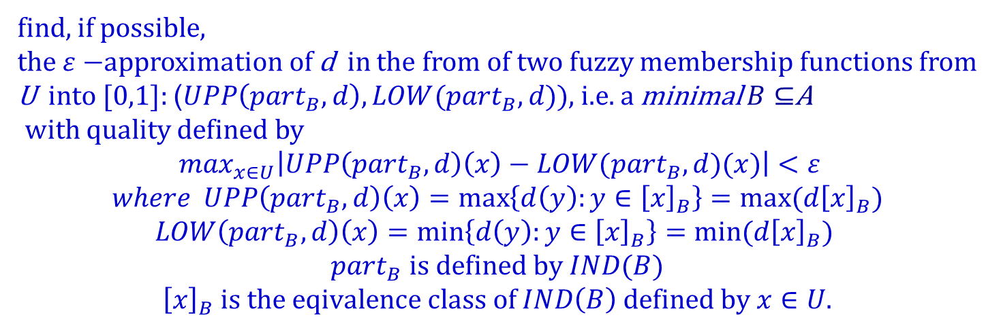
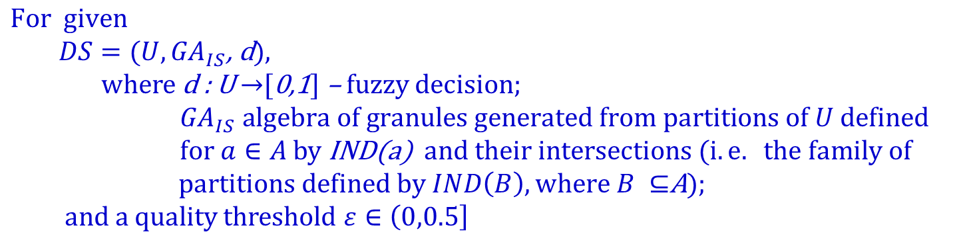
EXAMPLE OF OPTIMIZATION PROBLEM:
ROUGH-FUZZY APPROXIMATION OF THE DECISION RELATIVE TO A GIVEN ALGEBRA OF GRANULES
$$\text{For} \text{given}$$
$DS=(U, {GA}_{IS}$, d),
where d : U $→$[0,1] – fuzzy decision; ${ GA}_{IS} algebra of granules generated from partitions of U$defined $for a∈A$by IND(a)$and their intersections (i.e. the family of$
$partitions defined by IND\left(B\right), where B ⊆$A);
and a quality threshold $ε∈\left(0,0.5\right]$
find, if possible,
the $ε−$approximation of d in the from of two fuzzy membership functions from U into [0,1]: ($UPP\left({part}_{B},d\right),LOW({part}_{B},d)$), i.e. a minimal $B⊆$A
with quality defined by
$\max_{x∈U}\left|UPP\left({part}_{B},d\right)\left(x\right)−LOW({part}_{B},d)(x)\right|<ε$
$$where UPP\left({part}_{B},d\right)\left(x\right)=\max\left\{d\left(y\right):y∈{\left[x\right]}_{B}\right\}=max⁡(d{\left[x\right]}_{B})$$
$$LOW\left({part}_{B},d\right)\left(x\right)=\min\left\{d\left(y\right):y∈{\left[x\right]}_{B}\right\}=min⁡(d{\left[x\right]}_{B})$$
$${part}_{B} is defined by IND(B)$$
$${\left[x\right]}_{B} is the eqivalence class of IND\left(B\right) defined by x∈U.$$
A. M. Radzikowska, E. E. Kerre: A comparative study of fuzzy rough sets. Fuzzy Sets and Systems 126 (2002) 137–155

Slide 77
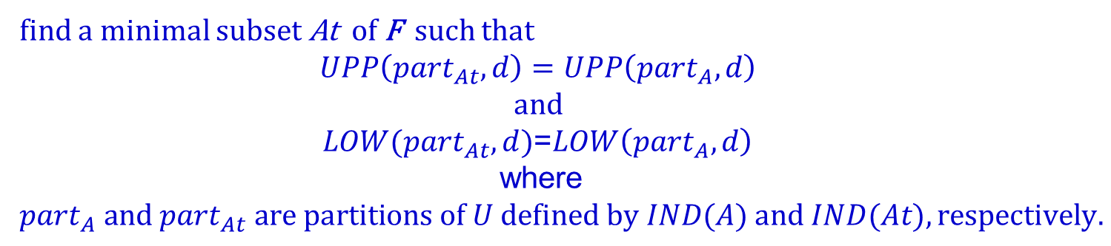
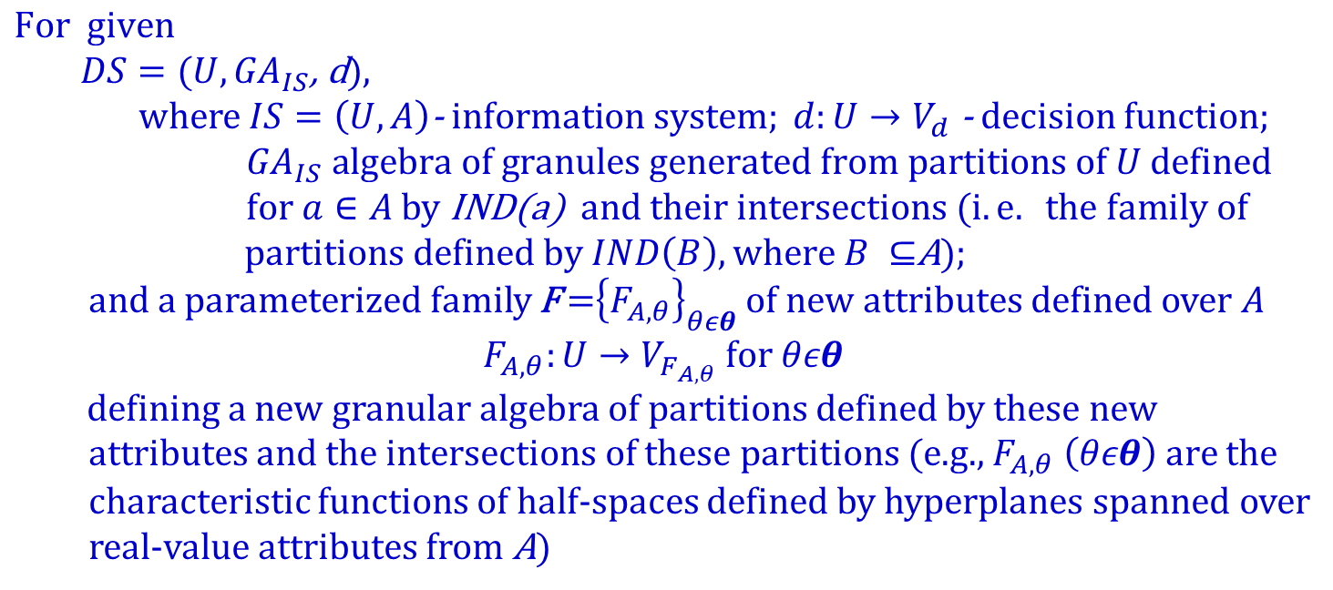
EXAMPLE OF OPTIMIZATION PROBLEM:
C-GRANULES IN FEATURE ENGINEERING
$$\text{For} \text{given}$$
$DS=(U, {GA}_{IS}$, d),
where $IS=\left(U,A\right)\text{−} information system; d:U→V_{d}$ - decision function; ${ GA}_{IS} algebra of granules generated from partitions of U$defined $for a∈A$by IND(a)$and their intersections (i.e. the family of$
$partitions defined by IND\left(B\right), where B ⊆$A);
and a parameterized family F =${\left\{F_{A,θ}\right\}}_{θεθ}$ of new attributes defined over $A$
$$F_{A,θ}:U→V_{F_{A,θ}} for θεθ$$
$d$efining a new granular algebra of partitions defined by these new
attributes and the intersections of these partitions (e.g., $F_{A,θ} \left(θεθ\right) are$the
characteristic functions of half-spaces defined by hyperplanes spanned over
real-value attributes from A)
find a minimal subset At of F such that
$$UPP\left({part}_{At},d\right)=UPP\left({part}_{A},d\right)$$
$$and$$
$LOW({part}_{At},d)$=$LOW\left({part}_{A},d\right)$
where ${part}_{A} and {part}_{At} are partitions of U defined by IND(A) and IND(At), respectively.$
V. Vapnik, Statistical Learning Theory, Wiley (1998)

Slide 78
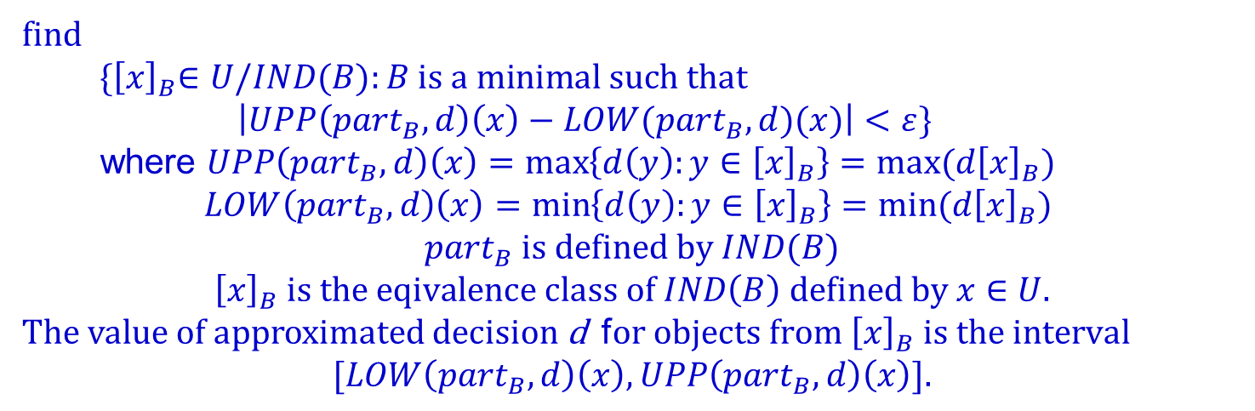
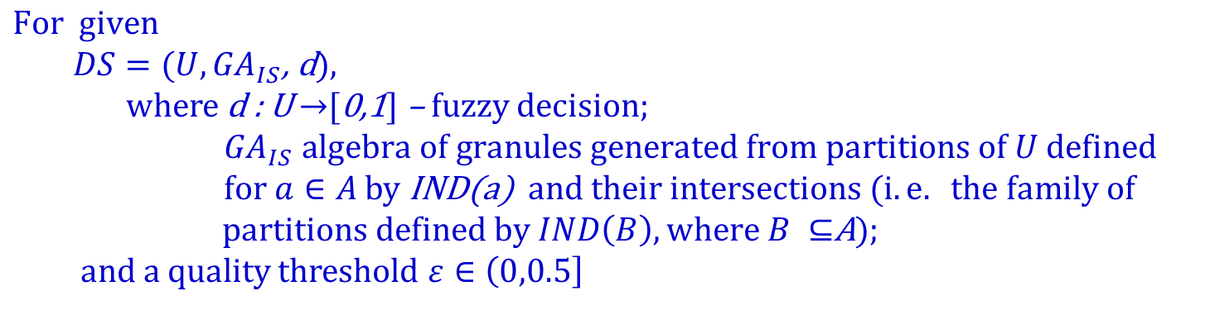
EXAMPLE OF OPTIMIZATION PROBLEM:
ROUGH-FUZZY DECISION RULES RELATIVE
TO A GIVEN ALGEBRA OF GRANULES
$$\text{For} \text{given}$$
$DS=(U, {GA}_{IS}$, d),
where d : U $→$[0,1] – fuzzy decision; ${ GA}_{IS} algebra of granules generated from partitions of U$defined $for a∈A$by IND(a)$and their intersections (i.e. the family of$
$partitions defined by IND\left(B\right), where B ⊆$A);
and a quality threshold $ε∈\left(0,0.5\right]$
find
$${ \{\left[x\right]}_{B}∈U/IND(B):B is a minimal such that$$
$\left|UPP\left({part}_{B},d\right)\left(x\right)−LOW({part}_{B},d)(x)\right|<ε\}$
where $UPP\left({part}_{B},d\right)\left(x\right)=\max\left\{d\left(y\right):y∈{\left[x\right]}_{B}\right\}=max⁡(d{\left[x\right]}_{B})$
$$LOW\left({part}_{B},d\right)\left(x\right)=\min\left\{d\left(y\right):y∈{\left[x\right]}_{B}\right\}=min⁡(d{\left[x\right]}_{B})$$
$${part}_{B} is defined by IND(B)$$
$${\left[x\right]}_{B} is the eqivalence class of IND\left(B\right) defined by x∈U.$$
The value of approximated decision d f$or objects from {\left[x\right]}_{B} is the interval$
$$[LOW\left({part}_{B},d\right)\left(x\right),UPP\left({part}_{B},d\right)\left(x\right)].$$
J. G. Bazan, A. Osmólski, A. Skowron, D. Ślęzak, M. S. Szczuka, J. Wróblewski: Rough Set Approach to the Survival Analysis. In: RSCTC Proceedings, LNCS 2475, pp. 522—529, Springer, 2002. doi.org/10.1007/3-540-45813-1\_69

Slide 79
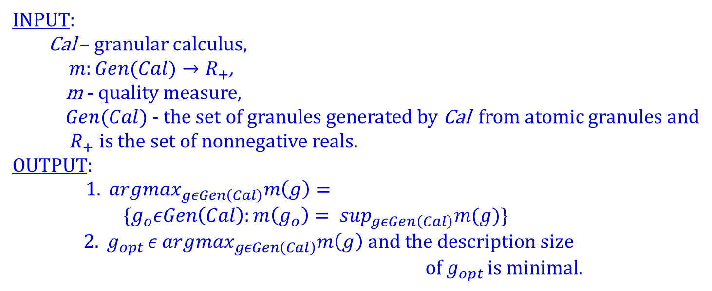
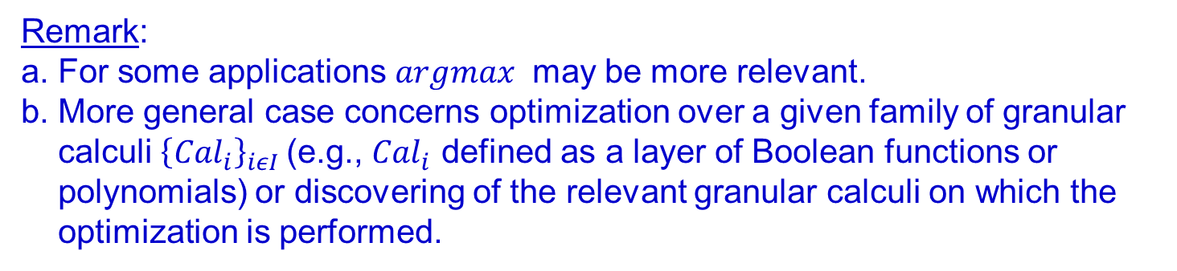
GENERAL OPTIMIZATION SCHEME OVER GRANULAR CALCULUS
INPUT:
Cal – granular calculus,
$m:Gen(Cal)→R_{+}$,
m - quality measure,
$Gen(Cal)$- the set of granules generated by Cal from atomic granules and
$R_{+}$ is the set of nonnegative reals.
OUTPUT:
${1. argmax}_{gεGen\left(Cal\right)}m\left(g\right)=$
$\{g_{o}εGen\left(Cal\right):m\left(g_{o}\right)= \sup_{gεGen\left(Cal\right)}m(g)\}$
${ 2. g}_{opt }{ε argmax}_{gεGen\left(Cal\right)}m\left(g\right)$ and the description size
of $g_{opt }$is minimal.
Remark:
a. For some applications $argmax$ may be more relevant.
b. More general case concerns optimization over a given family of granular
calculi ${\left\{{Cal}_{i}\right\}}_{iεI}$(e.g., ${Cal}_{i}$ defined as a layer of Boolean functions or
polynomials) or discovering of the relevant granular calculi on which the
optimization is performed.

Slide 80
GRANULAR CALCULUS
  Granular relational system
granular algebra consists of
  atomic granules
    generated from a preceding granular level relative to the considered one
    generated through interactions of specifications of transformations (associations) with the physical world realized by control of c-granules (e.g., by performing sensory measurements or actions or dialogues with users)
  aggregation granular operations (e.g., intersection, generalization)
granular relations (expressing properties of granules or relations between granules)
Granular language
    allowing for the interpretation of language (concerning the abstract and physical semantics) in the considered granular relational system. It is used to express or specify granules. It is helping to search for granules from the granular calculus that are expected to be computational building blocks relevant to cognition [using terminology that Leslie Valiant would use], (e.g., the approximation of target concepts or classifications). For example, these can be elementary granules in rough sets, which are defined as conjunctions of atomic formula (descriptors of the form a=v) and are interpreted in the granular relational system.

Slide 81
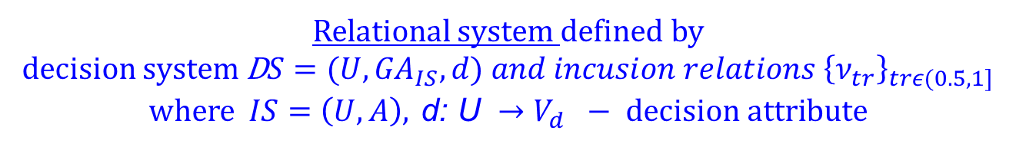
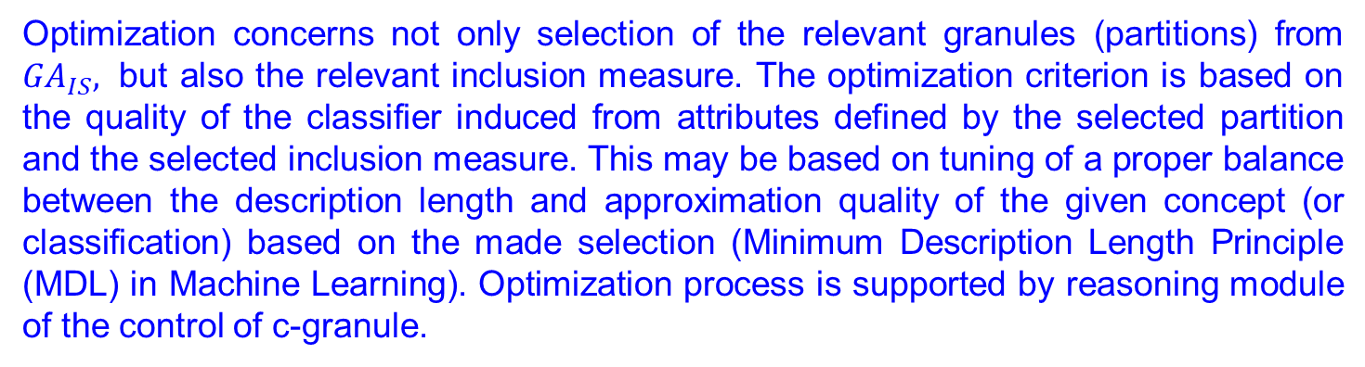
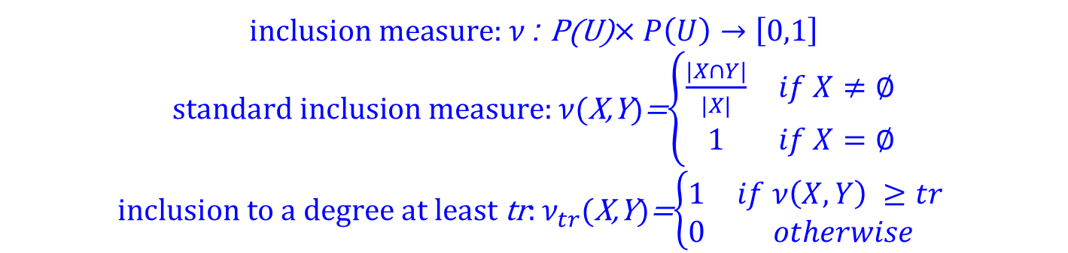
EXAMPLE OF GRANULAR CALCULUS :
DECISION SYSTEMS WITH INCLUSION MEASURES
Relational system defined by
decision system D$S=(U,{GA}_{IS}, d) {and incusion relations \left\{ν_{tr}\right\}}_{trε(0.5,1]}$ where $IS=\left(U,A\right), \text{d}\text{: }\text{U} →V_{d} − decision attribute$
$\text{inclusion} \text{measure}$: $ν$: P(U)$×P\left(U\right)→\left[0,1\right]$
$\text{standard} \text{inclusion} \text{measure}\text{:}$ $ν$(X,Y)=$\left\{\begin{matrix}\frac{|X∩Y|}{|X|} & if X≠∅ \\ 1 & if X=∅\end{matrix}\right.$
$\text{inclusion} \text{to} \text{a} \text{degree} \text{at} \text{least} \text{tr}\text{:}$ $ν_{tr}$(X,Y)=$\left\{\begin{matrix}1 & if ν\left(X,Y\right) ≥tr \\ 0 & otherwise\end{matrix}\right.$
Language: granules can be defined by intersection of granules expressed in the language using conjunction.
Optimization concerns not only selection of the relevant granules (partitions) from ${GA}_{IS},$ but also the relevant inclusion measure. The optimization criterion is based on the quality of the classifier induced from attributes defined by the selected partition and the selected inclusion measure. This may be based on tuning of a proper balance between the description length and approximation quality of the given concept (or classification) based on the made selection (Minimum Description Length Principle (MDL) in Machine Learning). Optimization process is supported by reasoning module of the control of c-granule.

Slide 82
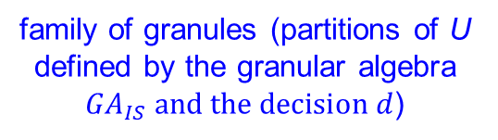
GRANULAR CALCULI DEFINED BY
DECISION SYSTEMS EXTENDED BY
VECTORS OF FAMILIES OF RELATIONS e.g., parameterized decision systems, parameterized tolerance/similarity decision systems, parameterized quality relations etc.
APPROXIMATION SPACE OVER GRANULAR RELATIONAL SYSTEM OF GRANULAR CALCULUS
$$\left(U,{GA}_{IS}, {d, \left\{ν_{tr}\right\}}_{trε\left[0.5,1\right]} , ℱ_{1}, …,ℱ_{k}\right)$$
family of granules (partitions of U defined by the granular algebra ${GA}_{IS} and the decision d$)
vector of families of relations
expressing properties of granules and relations between them used to define new granules in the language of granular calculus
Language: allowing to define new granules by intersection of already defined granules, and aggregation of, e.g., tolerance/ similarity relations or weighted quality measures.
Calculi of granules and granular relational systems over them in the case of tasks related to approximation of concepts or classifications are called approximation spaces.
OPTIMIZATION PROBLEMS:
Searching for (semi-)optimal solutions of the specified problems (concerning of, e.g., approximation of concepts or classifications) relative to a given calculus of granules (with quality measures).

Slide 83
ILLUSTRATIVE EXAMPLE:
AGGREGATION & GENERALIZATION OPERATIONS
More advanced reasoning may consider: (i) the risk of generalization, which can be measured by concept purity relative to the decisions of objects within it and the size of the space without training cases, and/or (ii) the description length of the induced granule (concept). Note that different languages for expressing distances at different hierarchical levels should be discovered (compare, e.g., granular ball computing).
shrinking generalization for
obtaining the relevant granule for decision green
new concept on a higher level
aggregation of granules by tuning the generalization to relevant extensions of the initial part of training sample
overgeneralization
concepts on a lower level
see, e.g., Xia, S., Liu, Y., Ding, X., Wang, G., Yu, H., Luo, Y.: Granular ball computing classifiers for efficient, scalable and robust learning. Inf. Sci. 483, (2019) 136–152. doi:10.1016/j.ins.2019.01.010
…
…

Slide 84
ATOMIC GRANULES LINKING
ABSTRACT AND PHYSICAL OBJECTS
encoding information from information granules into physical objects
decoding results of sensory measurements and actions from physical objects into information granules

Slide 85



DECODING RESULTS
OF SENSORY MEASUREMENTS AND ACTIONS BY
C-GRANULES FROM PHYSICAL OBJECTS INTO INFORMATION LAYERS OF C-GRANULES: EXAMPLES
im =
physical object(s)
g = (syn(g), sem(g))
We start from the basic Pawlak model …
information granule (from a relevant granular calculus) representing results of sensory measurement
txt =
…
…
a=v
…
im₁=
…
im_{k}=
a₁=v₁,…, a_{k}=v_{k}
a₁=v₁
a_{k}=v_{k}
…
…
a₁=v₁
a_{k}=v_{k}
t₁
t_{k}
…
…
t₁
t_{k}

Slide 86
ENCODING INFORMATION FROM INFORMATION GRANULES INTO PHYSICAL OBJECTS:
EXAMPLE
phone number=999, action = on
generation of signal for cellular network providing connection with the customer with number 999
cellular network
customer with the number 999

Slide 87
DECODING INFORMATION
FROM PHYSICAL OBJECTS INTO I-LAYER:
EXAMPLE: QUARTZ CLOCK
i-layer
Decoded numeric value of time
Display Driver: decoding
soft_suit
Counter
Frequency Divider
The oscillation is
divided down to
one pulse per
second.
Oscillator Circuit
with Quartz Crystal
(producing oscillations)
and
Power Supply
link_suit
&
p-layer
hard_suit
(they can intertwine)

Slide 88
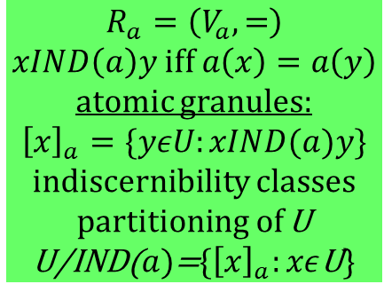
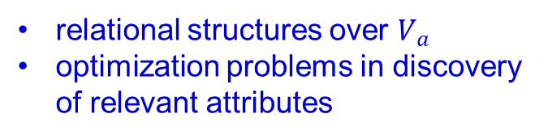


ATOMIC GRANULES DEFINED ON THE BASIS OF ATTRIBUTES AS ATOMIC BUILDING BLOCKS FOR CONCEPT FORMATION
relational structures over $V_{a}$
optimization problems in discovery of relevant attributes
$$a:U→V_{a}$$
$$R_{a}=\left(V_{a},=\right)$$
$$xIND\left(a\right)y iff a\left(x\right)=a\left(y\right)$$
atomic granules:
$${\left[x\right]}_{a}=\{yεU:xIND(a)y\}$$
indiscernibility classes
partitioning of U
U/IND($a)$={${\left[x\right]}_{a}:xε$U}
$$R_{a}=\left(V_{a},τ\right)$$
$$xτ_{a}y iff a\left(x\right) τ a\left(y\right)$$
$τ$ – tolerance or similarity relations
atomic granules:
$${\left[x\right]}_{τ}=\{yεU:xτ_{a}y\}$$
covering of U by tolerance classes
U/ $τ$={${\left[x\right]}_{τ}:xε$U }
possible partition of U from $τ_{a}$, e.g.
{$P_{x}^{τ}$: x $∈U$} where
$$P_{x}^{τ}=\{y∈U: ∀z∈U(xτz iff yτz)\}$$
combination of these two approaches may help to construct better granules, e.g., construct granules for recognition regions with different certainty for decision
L. Ma, M. Li: Covering rough set models, fuzzy rough set models and soft rough set models induced by covering similarity. Information Sciences 689 (2025)doi.org/10.1016/j.ins.2024.121520
Z. Pawlak: Rough sets. Theoretical Aspects of Reasoning About Data. Kluwer (1991). doi.org/10.1007/978-94-011-3534-4

Slide 89


ATOMIC GRANULES DEFINED ON THE BASIS OF ATTRIBUTES AS ATOMIC BUILDING BLOCKS FOR CONCEPT FORMATION
optimization problems in discovery of relevant attributes
$$a:U→V_{a}$$
d$:U→V_{d}$
$V_{a}$ - a finite set of values of attribute $a$
P - a partition of $V_{a}$
${ a}^{P}$ constructed from a
$a^{P}:U→P$
$a^{P}\left(x\right)∋a\left(x\right), for xε$U
a large set of partitions P
optimization problem: selection of P with (semi-) minimal |P | satisfying a given optimization criterion based on purity of $d\left(P\right)=\{d\left(a^{−1}(p)\right):p∈P\}$

Slide 90



ATOMIC GRANULES DEFINED ON THE BASIS OF ATTRIBUTES AS ATOMIC BUILDING BLOCKS FOR CONCEPT FORMATION (cont.)
optimization problems in discovery of relevant attributes
$$a:U→V_{a}$$
structural objects
$$a\left(x\right)={ag}_{a}\left[a_{1}\left(π_{1}\left(x\right)\right),…,a_{k}\left(π_{k}\left(x\right)\right)\right]$$
$π_{1},…,π_{k}$ - decompositions of objects
into parts selected from $Π_{a}$; $π_{i}:U→U_{i}$
$a_{1},…,a_{k}$ - attributes of parts of objects selected from ${At}_{a}$; $a_{i}:U_{i}→V_{a_{i}}$
${ag}_{a}$- aggregation of attribute values
of parts selected from ${Ag}_{a}$;
$${ag}_{a}:→V_{a_{1}}×…×{ V}_{a_{k}}→V_{a}$$
optimization problem: selection of (semi-) optimal $π_{i}$, $a_{i}$, ${ag}_{a}$ from $Π_{a}$, ${At}_{a}$, ${Ag}_{a}$
relative to a given optimization criterion
Discovery of $Π_{a}, {At}_{a} and{ Ag}_{a}$
necessary !

Slide 91
DISCOVERY OF GRANULAR CALCULUI
Unlike classical mathematical logic, where they are a priori given, granular calculi composed out of granular relational system and granular languages should be discovered by control of c-granules using data obtained through interaction with the physical and abstract worlds including human experts and chatbots.
Although the aforementioned discovery is challenging, it is important for explainability and scalability, unlike LLM, which is based on the iteration of the neural scheme.
It is worth mentioning an analogy with mathematical proofs, which are based on the discovery of new concepts and their properties, making the proofs feasible and understandable.

Slide 92






DISCOVERY OF GRANULES AS COMPUTATIONAL BUILDING BLOCKS FOR COGNITION IN HIERARCHICAL LEARNING
$$discovery of L−language of syntax of new granules$$
and its interpretation (satisfiability relation $⊨$)
$new granules: g^{∗}=(syn\left(g^{∗}\right), sem\left(g^{∗}\right))$
selection from L
$α_{1} . . .{ α}_{j}$ . . . $α_{m}$ syntax of new granules (attributes)
new granules:
$g_{j}^{∗}=($syn($g_{j}^{∗}$), sem($g_{j}^{∗}$))
$=(α_{j},${$g_{i}ϵU:g_{i}⊨α_{j}$})
$$g_{1}$$
…
$$g_{i}$$
…
${ g}_{n}$
$$U−universe of semantics$$
$${1 if g}_{i}⊨α_{j}$$
0 if $g_{i}⊨α_{j}$
satisfiability relation
(may be generalized to fuzzy, rough-fuzzy, argumentation based, paraconsistent)
discovery of relevant quality measures defined on granules
discovery of U
Gen(Cal) – set of granules generated by a given granular calculus Cal
Optimization problems in searching for the relevant granules: (i) Boolean reasoning (see, e.g., Z. Pawlak, A. Skowron: Rough Sets and Boolean Reasoning. Inf. Sci. 177(1), 41-73 (2007).
doi.org/10.1016/j.ins.2006.06.007, (ii) reinforcement learning also in interaction (dialogues) with LLM, Agentic systems and experts (see, e.g., https://arxiv.org/pdf/2509.08827; https://arxiv.org/pdf/2601.1535; https://openreview.net/pdf?id=RY19y2RI1O; https://www.linkedin.com/pulse/reinforcement-learning-market-report-veprc/; https://doi.org/10.1145/3729220)

Slide 93







DISCOVERY OF GRANULES AS COMPUTATIONAL BUILDING BLOCKS FOR COGNITION IN HIERARCHICAL LEARNING
$$discovery ofL−fragment of natural language for representation of syntax$$
$of new granules on a higher hierarchical level$and its interpretation (matching relation${ ⊩}_{deg}$)
selection from L
$α_{1} . . .{ α}_{j}$ . . . $α_{m}$ syntax of new granules
(sentences from L)
$$g_{1}$$
…
$$g_{i}$$
…
${ g}_{n}$
$${deg: g}_{i}⊩_{deg}α_{j}$$
new granules:
$g_{j}^{∗}=($syn($g_{j}^{∗}$), sem($g_{j}^{∗}$))
$=(α_{j},${$g_{i}ϵU:g_{i}⊩_{deg}α_{j}$})
$$U−universe of semantics$$
dscovery of matching relation $⊩_{deg}$ ($α_{j} matches g_{i} to$
$degree at least deg$)
discovery of U with granules from a lower hierarchical level
Gen(Cal) – set of granules generated by a given granular calculus Cal on a lower hierarchical level with syntax of granules represented in a fragment of natural language

Slide 94
TWO PARADIGMS OF LOGIC:
JUSTIFICATION & DISCOVERY
Bocheński says that
[…] one can ask two different basic questions:
  What follows given premises?
  From what premises can a given sentence (conclusion) be deduced?
  Aristotle primarily considered the first question,
justification,
[…] but poses also the second,
discovery, and tries to show
how the premises of a syllogism must be constructed in order to yield a given
conclusion,
discovery is
[…] not essentially a matter of formal logic.
Bocheński, J. (1961). A history of formal logic. University of Notre Dame Press.
E. Ippoliti,.F. Sterpetti (eds.): The Heuristic View. Logic, Mathematics, and Science.
Springer (2025)
For IS to be grounded in IGrC, generation of relevant granular computations, especially through the discovery of complex games, is essential for developing high-quality approximate solutions.

Slide 95
DISCOVERY AND EVOLUTION
OF COMPLEX GAMES INTERACTING WITH
THE ABSTRACT AND PHYSICAL WORLDS
transformations (associations) (tr), with specifications concerning their expected results (β), aiming to perform the relevant measurements/ actions/ plans toward achieving the expected target goals; the implementation of transformations may require interactions with abstract and physical objects
complex game
i.e., a finite set of rules
r: α →_{tr} β
β
tr
. . .
α
complex vague concepts (α) triggering actions/plans;
their approximations by classifiers may require interactions with abstract and physical objects

Slide 96
DISCOVERY OF PREMISSES FOR GIVEN CONSEQUENCES OF RULES OF COMPLEX GAMES (PD)
The c-granule g (in particular, IS) with control (and sub-granules consisting of, in particular testing samples) should be able to solve the following PD problem:
for given quality measure γ over granular computations and rule
consequence (tr, β), where
γ allows to check if a granular computation of g has a given property (to a degree) and
tr is a specification of transformation (association, action, plan, procedure) from a given set TR (of specifications of transformations of g) such that the realization of tr by g in the form of granular computation is expected
to satisfy property β (to satisfactory degree)
discover a concept (property, classifier) α_{tr} (with acceptable support) such that
if α_{tr} is satisfied in the currently perceived situation/object by g
to a satisfactory degree in comparison to satisfiability degrees of concepts discovered by g for transformations from TR \ {tr}
then
granular computations of g starting at a granular network for the currently perceived situation satisfying α_{tr} and ending at the granular network obtained after realization of tr are satisfying property β to a satisfactory degree what is checked using γ (and estimated relative to, e.g., a set of testing samples).

Slide 97
DISCOVERY
OF COMPLEX ADAPTIVE GAMES
INTERACTING
WITH THE ABSTRACT AND PHYSICAL WORLDS
complex games for situations with the relevant properties
. . .
complex vague concepts triggering complex games

Slide 98

DISCOVERY OF ADAPTATION STRATEGIES FOR COMPLEX GAMES STEERING (CGA PROBLEM)
The c-granule g (in particular, IS) with control (and sub-granules consisting of, in particular a set of testing samples) should be able to solve the following CGA problem:
Given
property α of the perceived situation (object) by the c-granule g,
class od complex games CCG,
quality measure γ for checking if a granular computation of g is of the
relevant quality (to a satisfactory degree),
discover
complex game ${CG=\{α}_{1}→_{{tr}_{1}}β_{1}$,…, $α_{k}→_{{tr}_{k}}β_{k}\}$ CCG and
an adaptation strategy S over CCG,
  assigning to
  the current granular network GN (with the current complex game ${CG}_{cr}$
  encoded in GN) of the currently realized granular computation Gcom
  (starting at $CG)$
the relevant game from CCG on the basis of the quality of GCom
(estimated using γ) and properties of history of granular computations
encoded in GN, such that
the granular computations of g, starting from a granular network with encoded $CG,$ satisfying the property α, and steered by the strategy S, are of acceptable quality (estimated relative, e.g., to a set of testing samples) defined by γ .

Slide 99

QUALITY OF GRANULAR COMPUTATION: EXAMPLE
Quality measure based on a distance between the real granular computation and the expected one derived on the basis of a given plan
Illustrative simple example:
$If \sum{d_{i}>tr}$ ($tr$ – threshold)
then modify the current complex game using the adaptive strategy.
…
more advanced formulas may be used, e.g., by taking into account rewards (positive and negative) assigned to states
the real granular computation
d₁
d₂
d₃
d₄
…
the expected granular computation
up to this state the real and expected granular computations are sufficiently close
…
computation of d_{i} is based on distance of attribute value vectors characterizing the states of granular computation

Slide 100

DISCOVERY OF PREMISES OF RULES:
EXEMPLARY SCHEME
$Given:tr,β$. Discover: $α$ (with some additional requirements)
such that $α→_{tr}β$
Objects are generated from objects with property β (defined by a classifier) using the deviation of the vectors of attribute values of objects satisfying β, which is properly tuned.
The aim of this tuning is to obtain objects that, after being transformed by tr, are satisfying β with a high chance.
These generated objects are then used as training samples to construct a classifier for the concept α, consisting of objects satisfying β after transformation by tr.
α
tr
tr
tr
tr
β
tr
¬ α
Objects with the property β (recognized by the relevant classifier induced from training sample).
tr
Remarks.
In searching: (i) large support of rules and/or closeness to the initial conditions are preferred , (ii) domain knowledge can help.
Note that β describes the expected results of the (physical) realization of tr, but the actual results may differ due to interactions with the environment, including physical objects.

Slide 101









DISCOVERY OF PLANS: EXEMPLARY SCHEME
$Given: α,β.$ $Discover rules$ $r_{k },$… , $r_{2}$, $r_{1 }such that$
$the realization of{tr}_{k }, \text{… , }{tr}_{2}\text{,} {tr}_{1}$ leads from $α to β$
Bottom-up
(from β toward α) discovery
of a sequence
of rules with constraints between them defining a plan
realized by
***
Discovery challenge:
Hitting α
e.g., conjunction of conditions
characterizing the analyzed case(s)
$$α⇒α_{k}$$
$${r_{k}:α}_{k}→_{{tr}_{k}}β_{k}$$
α_{k}
…
Remarks.
In searching:
(i) large support of rules is preferred,
(ii) backtracking strategies are often necessary,
(iii) domain knowledge can help
(iv) possible parallel search.
$$A=πr^{2}$$
β_{k}
…
α₂
$$A=πr^{2}$$
$${r_{2}:α}_{2}→_{{tr}_{2}}β_{2}$$
…
${tr}_{k },$… , ${tr}_{2}$, ${tr}_{1}$
β₂
$$β_{2}⇒α_{1}$$
$${r_{1}:α}_{1}→_{{tr}_{1}}β$$
α₁
tr₁
tr₁
Hint: Search for ways to decrease the distance (measured between vectors of attribute values) between cases covered by the currently constructed rule premise
(transformed into cases satisfying its consequence) and those covered by α.
tr₁
tr₁
objects with property β
¬ α₁
tr₁
tr₁

Slide 102
[…] OpenAI’s o3 and DeepSeek’s already-released DeepSeek R1 are set to redefine AI reasoning. o3 leverages innovative test-time search to achieve high-performance reasoning, while DeepSeek R1 has captured attention for its cost‐efficient design, transparent “aha moment,” and ability to tackle math, coding, and logic challenges at a fraction of traditional costs.
CHAIN-OF-THOUGHT (CoT) REASONING
Adaline Labs : https://labs.adaline.ai/p/inside-reasoning-models-openai-o3
But there are still large gaps in understanding human logical thinking. For example, there is still much to learn about commonsense reasoning and reasoning by analogy, etc.
M. Mitchell: Abstraction and Analogy-Making in Artificial Intelligence, Annals Reports of the New York Academy of Sciences 1505(1), 79-101 (2021)
[…] Reasoning models in AI are designed to emulate human-like logical thinking through a step-by-step process rather than relying solely on pattern matching. This approach allows the model to generate intermediate reasoning steps, resulting in more transparent and interpretable solutions.
Decomposition of complex vague concepts
[…] Information granulation plays a key role in implementation of the strategy of divide-and-conquer in human problem-solving.
L. A. Zadeh: Foreword. In: S. K. Pal, L. Polkowski, A. Skowron (eds.) Rough-Neural Computing. Techniques for Computing with Words. Springer 2004.

Slide 103

DISCOVERING
OF FAMILIES OF INTERACTING COMPLEX GAMES
. . .
…
. . .
…
knowledge
bases
physical
objects
experts
knowledge
bases
physical
objects
experts
…
…
. . .
…
knowledge
bases
physical
objects
experts

Slide 104
GRANULAR NETWORKS
AS OBJECTS ON WHICH GRANULAR COMPUTATIONS IN IGrC ARE REALIZED:
EXAMPLES

Slide 105



LINKING GRANULAR NETWORKS BY INTERFACES
PRODUCTS WITH CONSTRAINTS OF ALREADY CONSTRUCTED GRANULAR NETWORKS
$$Interface$$
$$Inter({GN}_{1},{GN}_{2})$$
granular network
granular network
$${ GN}_{1}$$
$${ GN}_{2}$$
relations between granules from GN₁ and GN₂
transformations of granules from GN₁ to GN₂
rules for reasoning about properties of granules from GN₂ on the basis of properties of granules from GN₁ transformed to granules from GN₂
methods for generation of new samples of granules in GN₁ and GN₂
…
elementary (atomic) granules
transformations for constructing granules
methods (algorithms) for generation new granules, modifying existing ones and reasoning about computations over them
can have nested structure
…
elementary (atomic) granules
transformations for constructing granules
methods (algorithms) for generation new granules, modifying existing ones and reasoning about computations over them
can have nested structure
…

Slide 106



LINKING GRANULAR NETWORKS BY INTERFACES
PRODUCTS WITH CONSTRAINTS OF ALREADY CONSTRUCTED GRANULAR NETWORKS
granular network can have nested structure:
granular network
$$interface$$
granular network
granular network
granular network
granular network
granular network
granular network
i$nterface$
i$nterface$

Slide 107








NETWORK OF APPROXIMATION SPACES
LINKED BY INTERFACES:
THE PAWLAK ROUGH SET MODEL
${ G}_{R}=\{g_{x}:x∈U$}
$G_{R_{d}}$ $=\{g_{y}^{′}: y∈U$}
$R⊆U×U$ – equivalence relation
${ g}_{x}=\left(f\left({\left[x\right]}_{R}\right),{\left[x\right]}_{R}\right)$, x $∈U$
f:U/R$→\{1,…,\left|U/R\right|\}$ - bijection
$R_{d}⊆U×U$ – equivalence relation
${ g}_{y}^{′}$=(h(${\left[y\right]}_{R_{d}}),$ ${\left[y\right]}_{R_{d}}$), y $∈$U
h: U/$R_{d}→\{1,…,$ $\left\lceil \text{U}\text{/}R_{d}\right\rceil$} - bijection
$$Inter(G_{R},G_{R_{d}})$$
$$g_{y}^{′}$$
$$g_{y^{,}}^{′}$$
$$g_{x}$$
$$r\left(g_{x},g_{y}^{′}\right) \text{iff}$$
${ \left[x\right]}_{R}⊆$ ${\left[y\right]}_{R_{d}}$
…
${ r}^{′}\left(g_{x},g_{y}^{′}\right) \text{iff}$
${ \left[x\right]}_{R}∩$ ${\left[y\right]}_{R_{d}}$ $≠∅$
$$g_{x^{′}}$$
…
$$g_{x},g_{x^{′}},…∈{ G}_{R}$$
Res
$$g_{y}^{′},g_{y^{,}}^{′},…∈G_{R_{d}}$$

Slide 108











NETWORK OF APPROXIMATION SPACES
LINKED BY INTERFACES:
THE PAWLAK ROUGH SET MODEL
$$DS=(U,A,d)$$
$g_{x,,A^{′}}$=($\inf_{A^{′}}$(x)), ${\left[x\right]}_{IND\left(A^{′}\right)}$); $g_{x,,d}$=(d=d(x), ${\left[x\right]}_{IND\left(d\right)}$)
$${ A}^{′}εP\left(A\right)=\left\{A^{′}:A^{′}⊆A\right\}$$
$r_{i}\left(g, g′\right)$ iff $sem\left(g\right)$ $⊆ sem\left(g^{′}\right)$
$r_{i}^{′}\left(g, g′\right)$ iff $sem\left(g\right)$ $∩ sem\left(g^{′}\right)$ $≠∅$, i=0,1,2
${ Inter(G}_{A}$, $G_{P(A)}$)
$G_{d}={\{g}_{x,d}$: x$∈U\}$
$$G_{P(A)}=\left\{g_{x,,A^{′}}:xεU \&{ A}^{′}εP(A)\right\}$$
$$G_{A}=\left\{g_{x,A}:xεU\right\}$$
$$g_{x,A^{′}}$$
$$r_{1}$$
$$g_{x^{′},d}$$
$$g_{x,A}$$
$$r_{0}$$
…
$$r_{0}^{′}$$
…
$$r_{1}^{′}$$
$$g_{x^{′},A^{′}}$$
$$g_{x^{′},A}$$
$$Res\text{0}$$
$Res$₁
$$g_{x,d}$$
…
${ Inter(G_{P\left(A\right)},G}_{d}$)
${ Inter(G_{A},G}_{d}$)
$$g_{x,d},g_{x^{′},d}∈G_{d}$$
$r_{2},$ $r_{2}^{′}, Res$₂

Slide 109













NETWORK OF APPROXIMATION SPACES LINKED BY INTERFACE:THE PAWLAK ROUGH SET MODEL
OPTIMIZATION OF CLASSIFICATION
RELATIVE TO A FAMILY OF INDISCERNIBILITY RELATIONS
${ G}_{I}=\{g_{i}:i∈I$}
$G_{R_{d}}$ $=\{g_{y}^{′}: y∈U$}
$R_{d}⊆U×U$ – equivalence relation
U/$R_{d}$ - classification
${ g}_{y}^{′}$=(h(${\left[y\right]}_{R_{d}}),$ ${\left[y\right]}_{R_{d}}$), y $∈$U
h: U/$R_{d}→\{1,…,$ $\left\lceil \text{U}\text{/}R_{d}\right\rceil$} - bijection
$R_{i}⊆U×U$ – equivalence relation
(or partition defined by $R_{i}$); U-finite set
${ g}_{i}=\left(f_{R_{i}},R_{i}\right)$, i $∈I$
$f_{R_{i}}$: U$→\{1,…,\left|U/R_{i}\right|\}$ - bijection
$$Inter(G_{I},G_{R_{d}})$$
$$r_{γ}\left(G_{I},G_{R_{d}}\right) \text{iff}$$
${ \sup_{iεI}POS}_{R_{i}}$($R_{d}$) $≥ γ$
where
$${ POS}_{R_{i}}\text{(}R_{d}\text{)=}\frac{\left|∪\{\underline{R_{i}}{\left[y\right]}_{R_{d}}:yεU\}\right|}{\left|U\right|}$$
$$g_{y}^{′}$$
$$g_{i}$$
$$g_{y^{,}}^{′}$$
…
$$g_{j}$$
$$\underline{R_{i}}{\left[y\right]}_{R_{d}}==∪\{zε U/R_{i}{: z⊆\left[y\right]}_{R_{d}}\}$$
…
$$g_{i},g_{j},…∈{ G}_{I}$$
$$γε(0,1]$$
$$g_{y}^{′},g_{y^{,}}^{′},…∈G_{R_{d}}$$
Res

Slide 110













NETWORK OF APPROXIMATION SPACES FOR PAWLAK’S ROUGH SET MODEL:
INCLUSION EXAMPLE
$R⊆U×U,R^{∗}⊆U^{∗}×U^{∗}−equivalence \left(indiscernibility\right) relations$
$U⊆U^{∗}$, $R^{∗}∩$($U×U$)=R
${ G}_{R}=\{g_{x}:x∈U$}
$$G_{R^{∗}}=\{g_{y}^{′}:y∈U^{∗}\}$$
$g_{y}^{′}=(h\left({\left[y\right]}_{R^{∗}}\right),{\left[y\right]}_{R^{∗}}$), y $∈U^{∗}$
h: $U^{∗}/R^{∗} →\{1,…,\left|U^{∗}/R^{∗}\right|\}$ - bijection
h(${\left[y\right]}_{R^{∗}}$)=f(${\left[y\right]}_{R}$) for $y∈U$
${ g}_{x}=\left(f\left({\left[x\right]}_{R}\right),{\left[x\right]}_{R}\right)$, x $∈U$
f:U/R$→\{1,…,\left|U/R\right|\}$ - bijection
$Inter(G_{R},G_{R^{∗}}$)
$$g_{x}$$
$$r\left(g_{x},g_{y}^{′}\right) \text{iff}$$
${ \left[x\right]}_{R}⊆$ ${\left[y\right]}_{R^{∗ }}∩$ $U$
$$g_{y}^{′}$$
…
…
$$g_{x^{′}}$$
${ r}^{′}\left(g_{x},g_{y}^{′}\right) \text{iff}$
${ \left[x\right]}_{R}∩$ ${\left[y\right]}_{R^{∗ }}≠∅$
$$g_{y^{,}}^{′}$$
$$g_{x},g_{x^{′}},…∈{ G}_{R}$$
Res
$$g_{y}^{′},g_{y^{,}}^{′},…∈G_{R^{∗}}$$

Slide 111




REASONING: EXAMPLE
(induction, conflict resolution)
$$x∈U^{∗}∖U$$
$$IND(A)⊆U^{∗}×U^{∗}$$
$${\left[x\right]}_{IND(A)}∩U≠∅$$
$${\left[x\right]}_{IND(A)}∩U=∅$$
--- similarity
--- reducts
--- rules
--- conflict resolution
…
$$d\left(x\right)=d\left(x_{0}\right)$$
$$for some x_{0}∈{\left[x\right]}_{IND(A)}∩U$$

Slide 112









NETWORK OF APPROXIMATION SPACES INDUCED FROM THE NETWORK OF APPROXIMATION SPACES FOR PAWLAK’S ROUGH SET MODEL: EXAMPLE
${ R}^{∗}⊆U^{∗}×U^{∗}, U⊆U^{∗}, R=R^{∗}∩\left(U×U\right)$, $G_{R^{∗}}=\left\{g_{x}^{∗}:x∈ U^{∗}\right\}$
$$R_{d}^{∗}⊆U^{∗}×U^{∗}$$
$$G_{R_{d}^{∗}}=\{g_{y}^{∗}: y∈ U^{∗}\}$$
$g_{x}^{∗}=\left(f^{∗}\left({\left[x\right]}_{R^{∗}}\right),{\left[x\right]}_{R^{∗}}\right)$, x $∈U^{∗}$
$f^{∗}$:$U^{∗}$/${ R}^{∗}→\{1,…,\left|U^{∗}\text{/}{ R}^{∗}\right|\}$- bijection,
$f^{∗}$(${\left[x\right]}_{R^{∗}}$)=$f\left({\left[x\right]}_{R}\right)$ for $x∈U$
dist – distance function between objects from $\{1,…,\left|U^{∗}\text{/}{ R}^{∗}\right|\}$
${ g}_{y}^{∗}$=(h(${\left[y\right]}_{R_{d}^{∗}}),$ ${\left[y\right]}_{R_{d}^{∗}}$), y $∈U^{∗}$
$h^{∗}$: $U^{∗}$/$R_{d}^{∗}→\{1,…,$ $\left\lceil U^{∗}\text{/}R_{d}^{∗}\right\rceil$} – bijection,
$h^{∗}$(${\left[x\right]}_{R^{∗}}$)=h$\left({\left[x\right]}_{R}\right)$ for $x∈U$
$$Inter(G_{R^{∗}},G_{R_{d}^{∗}})$$
$$g_{y}^{∗}$$
$$g_{y^{′}}^{∗}$$
$$g_{x}^{∗}$$
If ${\left[x\right]}_{R^{∗}}$ $∩U≠∅$ then
${r^{∗}\left(g_{x}^{∗},g_{y}^{∗}\right) \text{iff} \left[x\right]}_{{ R}^{∗}}∩U⊆$ ${\left[y\right]}_{R_{d}^{∗}}$ $∩U$
else
${ r}^{∗}\left(g_{x}^{∗},g_{y}^{∗}\right) \text{iff}{ r}^{∗}\left(g_{z}^{∗},g_{y}^{∗}\right) where f^{∗}({[z]}_{R^{∗}}$)
is closest (relative to dist) to $f^{∗}$(${[x]}_{R^{∗}}$) among objects from U
…
$$g_{x^{′}}^{∗}$$
…
$$g_{x}^{∗},g_{x^{′}}^{∗},…∈G_{R^{∗}}$$
Res*
$g_{y}^{∗}$,$g_{y^{′}}^{∗},…∈G_{R_{d}^{∗}}$
inductve extension
${R⊆U×U\text{, }G}_{R}=\{g_{x}:x∈U$}
$$Inter(G_{R},G_{R_{d}})$$
$$g_{y}^{′}$$
$$g_{y^{,}}^{′}$$
${ g}_{x}=\left(f\left({\left[x\right]}_{R}\right),{\left[x\right]}_{R}\right)$, x $∈U$
f:U/R$→\{1,…,\left|U/R\right|\}$ - bijection
$$g_{x}$$
…
$$r\left(g_{x},g_{y}^{′}\right) \text{iff}$$
${ \left[x\right]}_{R}⊆$ ${\left[y\right]}_{R_{d}}$
${R_{d}⊆U×U\text{, }G}_{R_{d}}$ $=\{g_{y}^{′}: y∈U$}
$$g_{x^{′}}$$
${ g}_{y}^{′}$=(h(${\left[y\right]}_{R_{d}}),$ ${\left[y\right]}_{R_{d}}$), y $∈$U
h: U/$R_{d}→\{1,…,$ $\left\lceil \text{U}\text{/}R_{d}\right\rceil$} - bijection
…
$$g_{x},g_{x^{′}},…∈{ G}_{R}$$
Res
$$g_{y}^{′},g_{y^{,}}^{′},…∈G_{R_{d}}$$
SIMPLIFIED NETWORK OF APPROXIMATION SPACES FOR PAWLAK’S ROUGH SET MODEL

Slide 113
INTERFACES BETWEEN GRANULAR NETWORKS
Calculus of granules:
elementary granules (may also contain sensory granules)
aggregation operations of granules on the higher level
language for expressing properties of granules (e.g., algebraic structure of granules from the level, relations between granules)
higher level
rules for generating atomic/elementary granules from the higher level from granules of the lower level
rules for establishing relations between granules from different levels
language for expressing properties of granules (e.g., from different levels)
interface
lower level

Slide 114





INTERFACES BETWEEN GRANULAR NETWORKS: ALGORITHMIC SEMANTICS OF GRANULES
higher level
granule constructed by $F$
$$g=F(g_{1},{…, g}_{k})$$
aggregation of results returned by algorithms (e.g., learning algorithms, classifiers)
$${Al}_{g}\left(x\right)=$$
$h_{g}({Al}_{g_{1}}\left(x\right),…,{Al}_{g_{k}}\left(x\right)$)
interactions
interface
algorithms associated with granules
lower level
granules to be aggregated
$$g_{1} … g_{k}$$
granule (provided by sensory measurements) creating input for granules to be aggregated
$x$
Remarks. This formula is important for hierarchical reasoning about the perceived situation. Note that computations of algorithms (that can be unconventional) may be disturbed by interactions with the environment – the real returned results may be different from the expected, given by formulas.

Slide 115




INTERFACES BETWEEN GRANULAR NETWORKS: ALGORITHMIC SEMANTICS OF GRANULES
higher level
granule constructed by $F$
$$g=F(g_{1},{…, g}_{k})$$
aggregation of algorithms (e.g., synchronization of concurrent models)
$${Al}_{g}\left(x\right)=$$
[$H_{g}({Al}_{g_{1}},….,{Al}_{g_{k}})]\left(x\right)$
interactions
interface
algorithms associated with granules
lower level
granules to be aggregated
$$g_{1} … g_{k}$$
granule (provided by sensory measurements) creating input for granules to be aggregated
$x$
Remarks. This formula is important for hierarchical reasoning about the perceived situation. In some tasks $H_{g}$ should be discovered from data (e.g., process mining). Note that computations of algorithms (that can be unconventional) may be disturbed by interactions with the environment – the real returned results may be different from the expected, given by formulas.

Slide 116




INTERFACES BETWEEN GRANULAR NETWORKS
INFERENCE RULES BASED ON ALGORITHMIC SEMANTICS OF GRANULES
higher level
granule constructed by $F$
$$g=F(g_{1},{…, g}_{k})$$
algorithm ${Al}_{g_{i}}$ with inputs extracted from x
exemplary inference rule
aggregation of algorithms
(e.g. to ensemble)
interactions
$$\frac{{Al}_{g_{i}}\left(x\right) is satisfying C_{i} at least to a degree \deg_{i} for i=1,…,k}{{{Al}_{g}\left(x\right)=h}_{g}({Al}_{g_{1}}\left(x\right),…,{Al}_{g_{k}}\left(x\right)\text{)} \text{is} \text{satisfying} \text{C} \text{at} \text{least} \text{to} \text{a} \text{degree} \text{deg} }$$
quality of ${Al}_{g}$ on inputs extracted from x
semantics of granules: functions computed by
algorithms associated to granules with inputs extracted from x
interface
granules to be aggregated
$$g_{1} … g_{k}$$
granule - a buffer (vector of variables) from which inputs for algorithms are decoded
$x$
lower level
L. Rokach: Ensemble Learning: Pattern Classification Using Ensemble. World Scientific (2nd Edition) 2019

Slide 117


INTERFACES BETWEEN GRANULAR NETWORKS: INTERACTIONS WITH THE ENVIRONMENT
Interactions may interfere with the input, construction, and aggregation of algorithms, as well as their computation.
The computations performed by the algorithms may also change interactions from the environment.
Instead [$H_{g}({Al}_{g_{1}},….,{Al}_{g_{k}})]\left(x\right)$ we have
[${⊗_{j}(H}_{g},e_{j})({⊗_{1}(Al}_{g_{1}},e_{1}),….,{⊗_{k}(Al}_{g_{k}},e_{k}))]\left(⊗_{i}(x,e_{i})\right)$
interaction of algorithm ${Al}_{g_{1}}$with the environment state e disturbing ${Al}_{g_{1}}$;
uncertainty in definitions of interaction operation $⊗_{1}$ and vector of values e₁ extracted from the global vector of values characterizing the environment – note that some values in e may be missing and/or e may not properly characterize the environment;
models for interaction operations and e may require adaptation due to unpredictable changes in the environment over time
Conclusion. The behavior of a granule g constructed from g₁ ,…, g_{k} cannot be defined based solely on the behavior of g₁ ,…, g_{k} , especially when dealing with complex phenomena. In this case, taking into account the interactions with the environment is unavoidable.

Slide 118





INTERFACES BETWEEN GRANULAR NETWORKS
INFERENCE RULES BASED ON CONCURRENT SEMANTICS OF GRANULES
granule constructed by $F$
higher level
$$g=F(g_{1},{…, g}_{k})$$
Petri net ${PN}_{g_{i}}$ with initial markings extracted from x
aggregation of Petri nets
(e.g. by synchronization)
exemplary inference rule
interactions
$$\frac{{PN}_{g_{i}}\left(x\right) is satisfying C_{i} at least to a degree \deg_{i} for i=1,…,k}{{{PN}_{g}\left(x\right)=h}_{g}({PN}_{g_{1}}\left(x\right),…,{PN}_{g_{k}}\left(x\right)\text{)} \text{is} \text{satisfying} \text{C} \text{at} \text{least} \text{to} \text{a} \text{degree} \text{deg} }$$
required property of ${PN}_{g}$ behavior on different initial markings
semantics of granules: behavior of Petri nets associated to granules with initial markings extracted from x
interface
granules to be aggregated
$$g_{1} … g_{k}$$
granule - a buffer (vector of variables) from
which inputs for Petri nets are decoded
$x$
lower level
L. Reinkemeyer (ed.): Process Mining in Action: Principles, Use Cases and Outlook. Springer 2020
A.Skowron, Z. Suraj (1995). Discovery of concurrent data models from experimental data tables: A rough set approach, Proceedings of the First International Conference on Knowledge Discovery and Data Mining, Montreal, August, 1995, AAAI Press, Menlo Park CA 1995, 288-293

Slide 119

INTERFACES BETWEEN GRANULAR NETWORKS
INFERENCE RULES BASED ON CONCURRENT SEMANTICS INDUCED FROM DATA OF GRANULES
$$\frac{{PN}_{g_{i}}\left(x\right) is satisfying C_{i} at least to a degree \deg_{i} for i=1,…,k}{{{PN}_{g}\left(x\right)=h}_{g}({PN}_{g_{1}}\left(x\right),…,{PN}_{g_{k}}\left(x\right)\text{)} \text{is} \text{satisfying} \text{C} \text{at} \text{least} \text{to} \text{a} \text{degree} \text{deg} }$$
${PN}_{g_{i}}$ induced from data may change according to changes in perceived data.
One may consider to characterize external interactions by additional to x vector e of values of some attributes. However, in e some values may be missing and e may not completely characterize the impact of the environment on the construction of concurrent models and/or x. Hence, adaptation of ${PN}_{g_{i}}$ may be needed.

Slide 120





INTERFACES BETWEEN GRANULAR NETWORKS
INFERENCE RULES BASED ON SEMANTICS OF GRANULES DEFINED BY DIFFERENTIAL EQUATIONS INDUCED FROM DATA
granule constructed by $F$
higher level
$$g=F(g_{1},{…, g}_{k})$$
differential equation ${EQ}_{g_{i}}$ with the initial conditions extracted from x
aggregation of differential equations
exemplary inference rule
interactions
$$\frac{{EQ}_{g_{i}}\left(x\right) is satisfying C_{i} at least to a degree \deg_{i} for i=1,…,k}{{{EQ}_{g}\left(x\right)=f}_{g}({EQ}_{g_{1}}\left(x\right),…,{EQ}_{g_{k}}\left(x\right)\text{)} \text{is} \text{satisfying} \text{C} \text{at} \text{least} \text{to} \text{a} \text{degree} \text{deg} }$$
required property of ${EQ}_{g}$ solutions for different initial conditions
semantics of granules: differential equations associated to granules with initial conditions extracted from x
interface
granules to be aggregated
$$g_{1} … g_{k}$$
granule - a buffer (vector of variables) from
which initial conditions for differential equations extracted
$x$
lower level
Xu, H., Chen, Y., Cao, R. et al. Generative discovery of partial differential equations by learning from math handbooks. Nature Communications (16) 10255 (2025). doi.org/10.1038/s41467-025-65114-2

Slide 121










INTERFACES BETWEEN GRANULAR NETWORKS OVER DIFFERENT UNIVERSES
generation of new types of granules (e.g., atomic) from given ones
$R^{′}{(g}^{out}$)
tr
$$g^{out}$$
$$g_{i}^{in}$$
tr
-- often represented by relevant algorithms
$$g_{1}^{in}$$
$$,…,$$
$$g_{i}^{in}$$
, $…,$
$$g_{k}^{in}$$
$$R({in_g}_{1}^{in},…,{in_g}_{i}^{in},…,{in_g}_{k}^{in})$$
Example: tr - learning algorithm constructing an ensemble of classifiers from given classifiers $g_{1}^{in},…,g_{i}^{in},…,g_{k}^{in}$; R’ - the quality measure of constructed classifier. Problem: Discover a constraint R (satisfied on sufficiently large data set) on inputs
${in_g}_{1}^{in},…,{in_g}_{i}^{in},…,{in_g}_{k}^{in}$ of${ g}_{1}^{in},…, g_{i}^{in}$,…, $g_{k}^{in}$
such that aggregation $g^{out}$ by tr of $g_{1}^{in},…,g_{i}^{in},…,g_{k}^{in}$ satisfying R satisfies R’ on testing data.

Slide 122










INTERFACES BETWEEN GRANULAR NETWORKS:
RULES CONCERNING ROBUSTNESS
$$g^{out} approximates \left(or is included in\right)$$
$C on U^{′}to degree at least ≥ε^{′}$
$${g^{out},C,U^{′}≥ε}^{′}$$
optimization of tr,
e.g. approximation of C by $g^{out}$to degree at least $ε^{′}$ should be on an extension $U^{′}$ of the universe U of arguments
$g^{out}$,
${ g}_{i}^{in}$,
, tr
aggregation
+
generalization
are represented by relevant algorithms;
C- concept
tr
$$g_{1}^{in}, {C,U≥ε}_{1}$$
$$,…,$$
$g_{i}^{in}$, $C,U≥ε_{i}$
$$,…,$$
$$g_{k}^{in},C,U≥ε_{k}$$

Slide 123









INTERFACES BETWEEN GRANULAR NETWORKS:
REASONING THROUGH LEVELS
$$g^{out},C,U^{′}≥δ$$
tr
rule in the interface between the bottom and top layers constructed by composition of rules
$$g_{1}^{out}, {C,U^{′}≥δ}_{1}$$
…
$$g_{k}^{out},C,U^{′}≥δ_{k}$$
$$ε_{1}^{′}{≥δ}_{1}$$
$$ε_{k}^{′}{≥δ}_{k}$$
$$g_{1}^{out},C,U^{′}≥ε_{1}^{′}$$
…
$$g_{k}^{out},C,U^{′}≥ε_{k}^{′}$$
tr₁
…
tr_{k}
Challenge: Keeping a proper balance between reactive and deliberative behavior.
D. Kahneman, Thinking, fast and slow. Farrar, Straus and Giroux
(2011).
$$g_{1}^{in}, {C,U≥ε}_{1}$$
…
$$g_{k}^{in},C,U≥ε_{k}$$

Slide 124








INTERFACES BETWEEN GRANULAR NETWORKS:
REASONING THROUGH LEVELS (cont.)
$$g^{out},C,U^{′}≥δ$$
THE BEHAVIOR OF THE WHOLE ($g^{out}$) IS NOT DEFINED BY ITS PARTS ($g_{1}^{out}$,…, $g_{k}^{out}$)
granule constructed through realization in the physical world its specification using advanced sensory measurements
tr
rule in the interface between the bottom and top layers constructed by composition of rules
$$g_{0}^{out}, {C,U^{′}≥δ}_{0}$$
$$g_{1}^{out}, {C,U^{′}≥δ}_{1}$$
…
$$g_{k}^{out},C,U^{′}≥δ_{k}$$
$$ε_{1}^{′}{≥δ}_{1}$$
$$ε_{k}^{′}{≥δ}_{k}$$
$$g_{1}^{out},C,U^{′}≥ε_{1}^{′}$$
…
$$g_{k}^{out},C,U^{′}≥ε_{k}^{′}$$
tr₁
…
tr_{k}
Challenge: Keeping a proper balance between reactive and deliberative behavior.
D. Kahneman, Thinking, fast and slow. Farrar, Straus and Giroux
(2011).
$$g_{1}^{in}, {C,U≥ε}_{1}$$
…
$$g_{k}^{in},C,U≥ε_{k}$$

Slide 125
DISCOVERY OF RELEVANT TRANSFORMATIONS tr:
EXAMPLES
  Discovery of tr for construction new granules in the form of
clusters encompassing discovery of
  attributes
  distance functions on attribute values
  aggregations of distance functions defined on attribute attributes
  representations of clusters, e.g., in the form of vectors of mean values of attributes in clusters and their radii
  quality measures of constructed clusters relative to given classification
  part of the universe on which the quality of the constructed clusters is low (e.g., the object/situation under classification is not in the scope of existing clusters included in the decision classes) and requires new discoveries
  …
rule-based classifiers encompassing discovery of
  attributes
  decision rules
  quality measures of rules
  methods for estimation of matching degrees of vectors of attribute values by rules
  reasoning methods for resolving conflicts between decision rules matching objects
  quality measures of constructed classifiers relative to given classification
  part of the universe on which the quality of the constructed classifier is low (e.g. for objects/situations under classifica-tion the difference of arguments for and against the decision is small) and requires new discoveries
  …

Slide 126
LIFELONG LEARNING (LL) IN DISCOVERY OF tr
clusters encompassing discovery of
  …
  part of the universe on which the quality of the constructed clusters is low (e.g., the object/situation under classification is not in the scope of existing clusters included in the decision classes) and requires new discoveries
rule-based classifiers encompassing discovery of
  …
  part of the universe on which the quality of the constructed classifier is low (e.g. for objects/situations under classifica-tion the difference of arguments for and against the decision is small) and requires new discoveries
LL is an advanced machine learning paradigm that learns continuously, accumulates the knowledge learned in the past, and uses/adapts it to help future learning and problem solving. In the process, the learner becomes more and more knowledgeable and better and better at learning. This continuous learning ability is one of the hallmarks of human intelligence. […] humans learn effectively with a few examples and in the dynamic and open world or environment in a self-supervised manner because our learning is also very much knowledge-driven: the knowledge learned in the past helps us learn new things with little data or effort and adapt to new/unseen situations. This self-suprevised (or self-aware) learning also enables us to learn on the job in the interaction with others and with the real-world environment with no external supervision.
Z. Chen, B. Liu: Synthesis Lectures on Artificial Intelligence and Machine Learning,
Morgan & Claypool Publishers (2018)

Slide 127
GRANULAR SOCIETIES
N(g₂)
N(g₁)
…
N(g_{k})
communications
interactions with environments
The N(g₁), N(g₂), …, N(g_{k}) are granular networks represented by the granules g₁, g₂, …, g_{k}, and the dark arrows represent the interactions between them that realize communication in the form of cooperation or competition.

Slide 128
HIERARCHIES OF GRANULAR NETWORKS OF GRANULAR SOCIETIES
The aim of granulation of granular (sub)societies into hierarchies is to discover computational building blocks for cognition of situations related to complex phenomena in physical spaces. This process involves identifying behavioral models of granular societies within more complex societies, as well as the relationships between them. In particular, it reveals rules that allow one to infer the properties of higher-level networks based on collections of lower-level networks that satisfy certain constraints. These constraints may be determined, e.g., by membranes or by interactions between collections of granules (see Holland's book).
The hierarchical approach may be also used for reasoning about the behavior of granular society on the lowest level of hierarchy.
complex dynamic granules
…
…
…
On each level, sensory measurements and actions pointing to the physical regions by the spatio-temporal windows are possible, with the expected results being granules of the relevant types for that level.

Slide 129








ROUGH SET BASED
ONTOLOGY APPROXIMATION
Feature Space
L_{d}
L_{E}
Expert’s Perception
Knowledge transfer from expert using positive and negative examples

Slide 130






APPLICATIONS :
APROXIMATION OF COMPLEX VAGUE CONCEPTS
130

Slide 131
CONTROL OF C-GRANULE g
(a sub-granule of g)
IS AIMING TO STEER GENERATED GRANULAR COMPUTATIONS IN ORDER TO ENSURE THE ACHIEVEMENT OF ITS GOALS (NEEDS) TO A SATISFACTORY DEGREE

Slide 132

IMPORTANCE OF PERCEPTION IN THE STATES OF REAL WORLD MODELING BY C-GRANULES
The main idea of this book is that perceiving is a way of acting. It is something we do. Think of a blind person tap-tapping his or her way around a cluttered space, perceiving that space by touch, not all at once, but through time, by skillful probing and movement. This is or ought to be, our paradigm of what perceiving is.
Alva Noë: Action in Perception, MIT Press 2004
Living and perceiving mean to participate – through embodied action (it should be purposeful and intentional).
See also:
Stephen Everso: Aristotle on Perception. Oxford University Press (1997)
Anna Marmodoro: Aristotle on perceiving objects. Oxford University Press (2014)

Slide 133
IMPORTANCE OF PERCEPTION IN THE STATES OF REAL WORLD MODELING BY C-GRANULES
Classically, control is identified by the appropriate function on control states. How are control states determined in the case of c-granules with control? They are not given a priori as in classical control problems. To construct models of states, the c-granule control organizes a series of experiments in the real world. At any moment, the control performs some experiments on various fragments of reality, selected by that control. This is accomplished through appropriate sub-granules generated by control as kinds of pointers to the physical world. In illustration of the control idea, these sub-granules are distinguished by thick arrows. Various physical objects are involved in these experiments. In the example with the blind person, objects such as a human, a cane, and an object being tapped by the cane are highlighted. Here, the exact description of objects using possible properties of them and their parts is not relevant. The aim is to perceive such properties of these objects and their interactions (e.g., the vibrations received by human from the cane or signals from the tapping) relevant for assessing whether there is an obstacle in the blind person's path or not. In this way, in every experiment, the perception of the physical objects involved, distinguished in the real world, is essential, particularly regarding which properties the objects are perceived through and how their aggregation match the specified properties in the i-layer of the sub-granule. These experiments, conducted by the Implementation Module (IM) of control, define what is called physical semantics. Thus, in each active sub-granule of control at a given moment, a certain experiment on real objects is conducted, providing knowledge about the currently perceived state (situation). This state (situation) is perceived through the glasses of those sub-granules. As a result, these experiments form the basis of how the control perceives the current state (situation) in the real world, which serves as the foundation for making right (wise) decisions (actions, plans). In this sense, control in each of its state, also encompasses the physical objects involved in the experiments in pursuit of constructing models of states of reality that ensure the execution of appropriate actions or plans (realizations of transformations or associations in c-granule language)—thus defining input for the control function—aimed at meeting the needs or goals of the c-granule. Hence, it is also distinguished a special sub-granule of control that in each state has the scope covering objects involved in the currently runed experiments.

Slide 134
C-GRANULE WITH CONTROL: INTUITION
Control of c-granules implements processes aimed at understanding perceived situations in order to construct approximate solutions to problems along the generated granular computations. This is achieved by discovering complex games. Each complex game consists of a set of rules. The predecessor in each such rule is a classifier for often complex, vague concepts that activate the rule. If the rule is selected by the control for implementation, a realization based on the transformation specification on the right side of the rule is triggered in the physical world starting realization on the current granular network. The implementation module (IM) of c-granule control is responsible for the physical realization of the transformation specification (i.e., for the physical semantics). It may be necessary to conduct a multi-level decomposition of the transformation specification intended for implementation before it can be directly realized in the physical world.

Slide 135
C-GRANULE WITH CONTROL: INTUITION
Control is involved in establishing associations between the informational and physical layers by implementing transformations (tr) through its implementation module (IM) (physical semantics).
i- layer
p-layer
CONTROL
of c-granule as a subgranule of c-granule
…
Control is initiating communications between the informational layer and the physical layer using relevant c-granules (generated by its IM), allowing the collection of properties of perceived physical objects and their interactions within the informational layer.
bc-granule with acsess to all sub-granules existing in the state
SIMPLIFIED VIEW OF NETWORK OF SUB-GRANULES INTERACTING WITH ABSTRACT AND PHYSICAL OBJECTS GENERATED AND STEERED UNDER SUPERVISION OF A GLOBAL SUBGRANULE OF THE CONTROL RESPONSIBLE FOR BASIC CYCLE (bc-granule)

Slide 136
REASONING SUPPORTING THE BASIC CONTROL CYCLE OF BC-GRANULE
specification of the prioritized needs (e.g. in dialogues with users)
Many reasoning modules (sub-granules) are supporting realization of the basic cycle by bc-granule. Advanced reasoning may support two different forms of control behavior in the realization of the basic cycle (bc-granule): reactive and deliberative. For example, the control of bc-granule may recognize that there are some arguments supporting the satisfiability of a concept that signals a high risk of reaching a very dangerous state if an immediate reaction is not taken. In other situations, there is more room for deliberation, which aims to better understand the current situation by taking additional measurements, performing actions, extracting information from knowledge bases or performing adaptation (e.g., attention). One may recognize an analogy here to Kahneman's fast and slow reasoning.
needs achievable
N
Y
Di, R, At
D, Di
modify needs that must be met
needs satisfied
N
The exemplary reasoning modules (sub-granules) of the bc-granule supporting the development of procedures named in boxes:
dialogues Di
decomposition D
adaptation A
conflicting information C
optimization O
uncertainty U
risk R
aggregation Ag
interactions I
needs N
attention At
…
N
Y
STOP
C
inf is satisfactory for rule selection from Rules
Y
N
R
O
select r from Rules on the basis of inf
decide how to update inf by relevant procedure
perform realization of r and update inf
I
real results of realization of r are close enough
to the predicted ones
U
update inf by the selected procedure
Ag
inf – information in i-layer about the currently perceived situation
Rules – set of rules for transformation of sub-granules
Y
N
A, At
perform adaptation of Rules, if necessary

Slide 137
REASONING SUPPORTING THE BASIC CONTROL CYCLE OF
BC-GRANULE
specification of the prioritized needs (e.g. in dialogues with users)
needs achievable
N
Y
Di, R, At
D, Di
modify needs that must be met
needs satisfied
N
The basic cycle (without a part marked green) may be more advanced in applications. For example, it may be necessary to check at the proper moment if the assigned needs are achievable. This would take into account domain knowledge concerning the perceived situation, the requirements for the solutions sought, and the resources used so far. If not, the needs should be modified accordingly, e.g., by selection less ambitious needs from the list of prioritized needs.
N
Y
STOP
C
inf is satisfactory for rule selection from Rules
Y
N
R
O
select r from Rules on the basis of inf
decide how to update inf by relevant procedure
perform realization of r and update inf
I
real results of realization of r are close enough
to the predicted ones
U
update inf by the selected procedure
Aude Billard, Sina Mirrazavi and Nadia Figueroa: Learning for Adaptive and Reactive Robot Control: A Dynamical Systems Approach. MIT Press (2022)
Daniel Kahneman: Thinking, fast and slow. Farrar, Straus and Giroux (1013)
Ashish Vaswani et al: Attention is All you Need. In: I. Guyon st al (eds.): Advances in Neural Information Processing Systems (NIPS) vol.30. Curran Associates, Inc. (2017) https://arxiv.org/abs/1706.03762
Ag
Y
N
A, At
perform adaptation of Rules, if necessary

Slide 138
C-GRANULE WITH CONTROL: COMMENTS
A c-granules is a dynamic object that changes over time. Its dynamics is steered by the control of c-granule (special sub-granule of given c-granules), which aims to select and realize transformations (associations) of abstract and physical objects to satisfy goals (needs or specifications of the problem to be solved). This is based on perceived information about these objects as well as their interactions.
Control of c-granule is using the bc-granule to supervise the behavior of the control to select and realize transformations (associations). The realization concerns generation of the network of relevant sub-granules from the currently perceived one.
In the network of sub-granules, supervised by the control of c-granule are also sub-granules realizing of the basic cycle of control.
cb-granule of control uses the context in which physical objects appear in networks of sub-granules, qualifying them for different regions: soft_suit, link_suit, or hard_suit. For example, in one sub-granule, the considered objects may be in the link_suit category, while in another, they may be in the hard_suit category.
cb-granule often consists of an information sub-granule with the information about the currently perceived situation on the basis of which the control of c-granule aims to select transformations for realization.

Slide 139
C-GRANULE WITH CONTROL: STATE
i-granules
i-layer
CONTROL SPECIFICATION
STATE (AT A GIVEN MOMENT)
OF THE CONTROL
OF C-GRANULE
contains of all sub-granules
(with abstract and physical objects) existing at this moment
as the result of realization of the control specification.
State should be distinguished from the specification of control behavior by an i-granule being a part of the state.
soft_suit
link_suit
p-layer
hard_suit

Slide 140
PHYSICAL SEMANTICS IS REALIZED BY IMPLEMENTATIONAL MODULE (IM)
A SUB-GRANULE
OF
C-GRANULE CONTROL
IM IS ABLE TO GENERATE OF NEW
C-GRANULES WITH LINKS (POINTERS) BETWEEN ABSTRACT AND PHYSICAL OBJECTS.
BY USING THESE C-GRANULES THE CONTROL PERCEIVES PROPERTIES OF PHYSCAL OBJECTS AND THEIR INTERACTIONS (BELONGING TO THE SCOPE OF THESE C-GRANULES) IN THE PHYSICAL WORLD

Slide 141


PHYSICAL SEMANTICS: INTUITION
conf
configuration of physical objects
implementational module
specification of rule
r$⨂IM$
$inf$
information
(e.g., in the form of information systems or time series) perceived by IM and stored into the i-layer using
c-granules
physical semantics
embedding of r in IM realised, e.g., by encoding r in a buffer of IM
physical objects
corresponding to specifications
of spatio-temporal windows
of c-granules;
physical objects are
linked by these c-granules
with the i-layer

Slide 142

INTUITION OF RULES IN RULE MODULE (RulM),
A SUBGRANULE OF CONTROL OF C-GRANULE
r : $α⇒_{tr}β$
α, β may have different components related, in particular to properties of stored in i-layer information or local time of c-granule
intuition of meaning
If
at the actual moment of local time of the c-granule,
the currently realized specification of associations by the physical semantics leads to the storage of information satisfying the property encoded in α in the i-layer
then
starting at a specified moment after that actual moment, the realization of specification of the transformation tr (treated as an association) by the physical semantics is expected to lead to the storage of information in the i-layer that satisfies the property encoded in β after a given period of time.

Slide 143

IMPLEMENTATIONAL MODULE (IM)
IM plays a crucial role in interaction
of abstract and physical objects;
IM realizes physical semantics
results of implementation
IM
specification of transformation
requirement of decomposition

Slide 144
C-GRANULE CONTROL
The structure of the control sub-granules, referred to as the control module (RM) of the c-granules, may be extremely complex. The RM has many submodules (sub-granules) responsible for supporting various aspects of inference through control, interconnected by different dependencies.

Slide 145

MODULES OF C-GRANULE CONTROL
…
management of constraints module
…
implementational module
for new rules
for new decomposition strategies
decomposition module
module of goals (needs)
for new granules and their aggregation
reasoning module
adaptation module
learning module
module of
management of interactions with physical objects
r : $α⇒_{tr}β$
rule module
(complex game:
set of rules)
CONTROL
with
cycle module
links to representation of information about the current configuration of c-granules
risk management module
links to specifications of generic c-granules and transformations of configurations of c-granules
links to representation of current c-granules
module of links to information granules
links to domain knowledge bases
…

Slide 146
C-GRANULE CONTROL
For instance, the structure of the control sub-granule known as the inference module (RM) is very intricate.

Slide 147
JUDGMENT IN IS’s BASED ON IGrC
CHALLENGE FOR CONTROL OF IS’s:
DEVELOPMENT OF REASONING METHODS SUPPORTING GENERATION & COORDINATION OF DIFFERENT KINDS OF INTERACTIONS AND REASONING ABOUT THEIR RESULTS FOR MAKING THE RIGHT DECISIONS
(I.E. FOR JUDGMENT)
[…] starting with Aristotle there was in fact a long tradition of trying to use logic as a framework for drawing conclusions about nature.
[… ] And indeed by this point logic was viewed mostly as a possible representation of human thought—and not as a formal system relevant to nature.
Stephen Wolfram:
https://publications.stephenwolfram.com/foundations-mathematics-mathematica/

Slide 148

FROM LMM TO REASONING MODELS
[…] Standard AI models might be good at describing the scene (listing objects), but reasoning models act like that detective. They delve deeper, performing logical deductions, solving complex problems, and planning multi-step actions.
R. Hightower: Chapter 9: Leveraging Advanced Reasoning Models. In: Programming the OpenAI APIs with Python: A Comprehensive Guide to Building AI Applications. https://rick-hightower.notion.site/Chapter-9-Leveraging-Advanced-Reasoning-Models-1e0d6bbdbbea808190d0e3fa0f26192c?pvs=21
[…] LLMs have transformed how we process and generate text, but their success has been largely driven by statistical pattern recognition. However, new advances in reasoning methodologies now enable LLMs to tackle more complex tasks, such as solving logical puzzles and advanced math problems involving multi-step arithmetic. Moreover, REASONING IS AN ESSENTIAL TECHNIQUE FOR MAKING "AGENTIC" AI PRACTICAL.
S. Raschka: Build a Reasoning Model (From Scratch). Manning 2025.
[…] Inside Reasoning Models OpenAI o3 And DeepSeek R1: OpenAI’s o3 and DeepSeek’s already-released DeepSeek R1 are set to redefine AI reasoning. o3 leverages innovative test-time search to achieve high-performance reasoning, while DeepSeek R1 has captured attention for its cost‐efficient design, transparent “aha moment,” and ability to tackle math, coding, and logic challenges at a fraction of traditional costs.
Adaline Labs: https://labs.adaline.ai/p/inside-reasoning-models-openai-o3

Slide 149
INTERRELATED SUB-GRANULES OF REASONING MODULE (RM) SUPPORTING BEHAVIOR OF CONTROL
METHODS
SUPPORTING DECOMPO-SITION
METHODS
FOR CONFLICTING INFORMATION
METHODS
SUPPORTING MANAGEMENT OF CONSTRAINTS
METHODS
SUPPORTING RISK MANAGEMENT
METHODS
SUPPORTING APPROXIMATON AND LEARNING
METHODS
SUPPORTING AGGREGATION
RM
METHODS
SUPPORTING INTERACTION WITH THE PHYSICAL WORLD
METHODS
SUPPORTING ADAPTATION
…
METHODS
SUPPORTING OPTIMIZATION
METHODS
SUPPORTING MANAGEMENT OF GOALS (NEEDS)
METHODS
SUPPORTING TESTING

Slide 150

C-GRANULE CONTROL
In particular, one of its sub-granules (module of control) is responsible for supporting the management of goals (needs) (including their adaptation according to the properties of perceived objects/situations), taking into account the idea of Maslow's hierarchy of needs.
https://www.projectmaslow.org/maslows-hierarchy-of-needs/

Slide 151
REASONING
(JUDGMENT SUPPORTING CONTROL OF C-GRANULES IN MAKING THE RIGHT DECISIONS)
REALIZED OVER INTERACTIVE COMPUTATIONS COMPOSED OF NETWORKS OF C-GRANULES
IN PARTICULAR, JUDGMENT SUPPORTS REALIZATION OF PERCEPTION
i.e. understanding the perceived situation to satisfactory degree for making the right decisions

Slide 152
SOME CHALLENGES CONCERNING REASONING
Associative memory
Practical judgment
Analogy based reasoning
Experience based reasoning
Perception based reasoning
Common sense reasoning

Slide 153

REASONING MODULE OF C-GRANULE CONTROL: EXAMPLE
Upon receiving a task (question) from the user, the control of the c-granule initiates reasoning in the information layer of its sub-granule called the reasoning module. This reasoning is realized by granular computations involving interactions (communications) with databases, experts, or other users, and aims to provide an answer to the task.
C_{LLM} - information granule representing parameters of LLM
V_{S} – information granule consisting of the induced set of rules
C_{CDR} - information granule consisting of the optimized set of rules
H_{p} - information granule representing the patient's history and the reasoning module's response regarding support for their therapy
i-layer of c-granule control
databases
C_{DRL}
V_{S}
…
Reasoning module of control
experts
C_{LLM}
LLM
H_{p}
other users, e.g. patients

Slide 154
INTERACTIONS WITH KB: ASSOCIATIVE MEMORY
Machine Memory Intelligence (M²I)
framework encompassing
representation, learning, and reasoning modules and loops
Q. Zheng, H. Liu, X. Zhang, C. Yan, X. Cao, T. Gong, Y.-J. Liu, B. Shi, Z. Peng, X. Fan, Y. Cai, J. Liu: Machine Memory Intelligence: Inspired by Human Memory Mechanisms., 28 January 2025, Engineering. DOI: 10.1016/j.eng.2025.01.012
Representation
of KB with
ASSOCIATIVE MEMORY
(AssM)
Reasoning
relative to inf for extraction of the relevant fragment from AssM
fr:
information from AssM relevant for extension of inf
Reasoning using fr for extension of inf
inf’:
extended information about the current situation
inf:
information about the current situation
Q. Zheng, H. Liu, X. Zhang, C. Yan, X. Cao, T. Gong, Y.-J. Liu, B. Shi, Z. Peng, X. Fan, Y. Cai, J. Liu: Machine Memory Intelligence: Inspired by Human Memory Mechanisms., 28 January 2025, Engineering. DOI: 10.1016/j.eng.2025.01.012

Slide 155
ASSOCIATIVE MEMORY
HOPFIELD NETWORKS
T. Kohonen: Self-organization and associative memory. Springer (1989)
T.F. Burns, T. Fukai, Ch.J. Earls: Associative memory inspires improvements for in-context learning using a novel attention residual stream architecture. Transactions on Machine Learning Research (07/2025)
H. Ramsauer, B. Schäfl, J. Lehner, P. Seidl, M. Widrich, L.Gruber, M. Holzleitner, T. Adler, D. Kreil, M. K. Kopp, G. Klambauer, J. Brandstetter, S, Hochreiter: Hopfield networks is all you need. In International Conference on Learning Representations, 2021. URL https://openreview.net/forum?id=tL89RnzIiCd.

Slide 156
ASSOCIATIVE MEMORY
REASONING BASED ON RULES DERIVED FROM INFORMATION SYSTEMS AND INCOMPLETE VECTORS OF ATTRIBUTE VALUES
interaction with the environment
(physical world, data or knowledge bases, experts, …)
(dynamic) information systems
(obtained: (i) by decomposition of large datasets for paralel processing or relative to functionality,
(ii) from distributed data sources,
(iii) by interaction with the physical world …
…
IS₁
…
IS_{k}
Th(IS₁)
…
Th(IS_{k})
(adaptive) theories of information systems:
sets of (probabilistic) rules derived from information systems
reasoning module
incomplete vector of attribute values
v
extension of v consistent (to the required degree) with (some/all) sets of rules derived from v and the sets of rules
W
Sets of rules derived from information systems (for discovery of concurrent models from data):
M. Moshkov, A. Skowron, Z. Suraj: Maximal consistent extensions of information systems relative to their theories. Information Sciences 178(12) (2008) 2600-2620. doi.org/10.1016/j.ins.2008.01.018
A. Skowron, Z. Suraj (1995). Discovery of concurrent data models from experimental data tables: A rough set approach, Proceedings of the First International Conference on Knowledge Discovery and Data Mining, Montreal, August, 1995, AAAI Press, Menlo Park CA 1995, 288-293
J. Barwise, J. Seligman, Information Flow: The Logic of Distributed 2339 Systems, Cambridge University Press, Cambridge, 1997. doi:10.2340 1017/CBO9780511895968.

Slide 157
PRACTICAL JUDGMENT
Practical judgment is not algebraic calculation. Prior to any deductive or inductive reckoning, the judge is involved in selecting objects and relationships for attention and assessing their interactions. Identifying things of importance from a potentially endless pool of candidates, assessing their relative significance, and evaluating their relationships is well beyond the jurisdiction of reason
Leslie Paul Thiele: The Heart of Judgment Practical Wisdom, Neuroscience, and Narrative. Cambridge University Press 2006

Slide 158
MELANIE MITCHELL
Santa Fe Institute
The quest for machines that can make abstractions and analogies is as old as the AI field itself, but the problem remains almost completely open.
Melanie Mitchell: Abstraction and Analogy-Making in Artificial Intelligence, Annals Reports of the New York Academy of Sciences 1505(1) 79-101 (2021)

Slide 159
We do not have yet formal reasoning for experience based reasoning working in IS’s
However,
IS’s on the basis of data analysis can help domain expert in this kind of reasoning.
Human experts and/or chatbots can help IS’s to improve reasoning, e.g., in inducing classifiers.
Human-Centered AI,
Human-in-the-Loop ML

Slide 160
SOME CHALLENGES CONCERNING REASONING (cont.)
Reasoning supporting
optimization
decomposition
Adaptation (see co-evolution in the book by Holland)
negotiation and conflict resolving
searching for new relevant data and knowledge (where?, what?, when?, how?)
discovery of granular computations according to given specifications (drug discovery, automatic design of robots, discovery of strategies on financial markets etc.)
construction of quality measures over granular computations
risk management in generation of approximate solutions of high quality
…

Slide 161
EVOLUTION OF CONCEPT FORMATION AND LANGUAGE USED BY SOCIETY OF C-GRANULES
As granular computation progresses, the concepts and language of a society of c-granules evolve. This evolution is supported by the reasoning modules of c-granule control, which are involved in the steering of c-granules (and through this the entire society) solving tasks such as:
adaptation of existing concepts (e.g., through relevant generalizations and/or the use of new actuators or sensors for defining concepts)
discovery of new concepts
discovery of backtracking strategies in searching for new concepts
forgetting concepts not useful for the granular society
discovery of new contexts (e.g., in the form of relational constraints or texts from language representing situations) in which the discovered concepts can be applied
adaptation of the discovered contexts
generalization of global contexts of the granular society.
There are many challenges on the way to developing these reasoning methods
(see, e.g., https://medium.com/the-art-of-bagging/grasping-the-concept-book-v1-introduction-f8daae90af22
Y. Engeström: Concept formation in the wild. Cambridge University 2024:
Little is known about how new concepts are collectively created and used in workplaces, communities, and social movements. It is time to start filling this lacuna with generative ideas and solid findings.
N. W. Morton, A. R. Preston: Concept formation as a computational cognitive process. Current Opinion in Behavioral Sciences 38 (2021) 83–89).

Slide 162
INFORMATION GRANULATION & COMPUTING WITH WORDS – LOTFI A. ZADEH
[…] Information granulation plays a key role in implementation of the strategy of divide-and-conquer in human problem-solving.
Lotfi A. Zadeh: Foreword. In: S.K. Pal, L.Polkowski, A. Skowron (eds.) Rough- Neural Computing. Techniques for Computing with Words. Springer 2004.
[…] Manipulation of perceptions plays a key role in human recognition, decision and execution processes. As a methodology, computing with words provides a foundation for a computational theory of perceptions - a theory which may have an important bearing on how humans make - and machines might make – perception - based rational decisions in an environment of imprecision, uncertainty and partial truth.
[…] computing with words, or CW for short, is a methodology in which the objects of computation are words and propositions drawn from a natural language.
Lotfi A. Zadeh: From computing with numbers to computing with words –
From manipulation of measurements to manipulation of perceptions.
IEEE Transactions on Circuits and Systems 45(1), 105–119 (1999)

Slide 163
DECOMPOSITION OF COMPLEX VAGUE CONCEPTS IN DIALOGUE WITH HUMANS & CHATBOTS:
EXAMPLES FROM LOGISTICS 5.0
Warehouse Management
Systems
How?
Solutions
Functional
Moels
Agents
Visual
Robotics
Blockchain
Digital Twins
WMS
TMS
…
…
…
Transportation Management
Systems
further decomposition
required
Where?
Ecosystem
Warehouse
Intralogistics
Transport
City
Synchromodality
Partners
…
…
…
Bernardo Nicoletti: Artificial Intelligence for Logistics 5.0. From Foundation
Models to Agentic AI. Springer (2025)

Slide 164
DECOMPOSITION OF COMPLEX VAGUE CONCEPTS IN DIALOGUE WITH HUMANS & CHATBOTS:
TRUSTWORTHINESS
Trustworthiness dimensions:
- human agency and oversight, fairness and non-discrimination, transparency
and explainability, robustness and accuracy, privacy and security, and
accountability
D. Kowald et al.: Establishing and evaluating trustworthy AI: overview and research
challenges. Frontiers of Big Data 7: 1467222, (2024)
- reliability, security, privacy, accountability, transparency, ethical standards and
societal values, adaptability
chatbot poe
- authenticity, fulfillment, value, reliability, safety, recurse
https://www.linkedin.com/pulse/six-dimensions-trustworthiness-4grader-fokuf
Sustainability
Trustworthiness
Robustness
and reliability
Transparency
Explainability
Safetyy
Securityy
Privacy
Nondiscrimination, bias, and fairness
Functionality and performance
Verifiability
Autonomy
and control
…
…
…
R. Mariani et al.: Trustworthy AI. Part I. Computer 56(2) 14-18 (February 2022)

Slide 165
JUDEA PEARL- TURING AWARD 2011 for fundamental contributions to artificial intelligence through the development of a calculus for probabilistic and causal reasoning
Traditional statistics is strong in devising ways of describing data and inferring distributional parameters from sample.
Causal inference requires two additional ingredients:
- a science-friendly language for articulating
causal knowledge,
and
- a mathematical machinery for processing that
knowledge, combining it with data and drawing
new causal conclusions about a phenomenon.
Judea Pearl: Causal inference in statistics: An overview. Statistics Surveys 3, 96-146 (2009)

Slide 166
PHENOMENOLOGY
originated by Edmund Husserl
as a method for exploring the nature of human experience and perception
Husserl was frustrated by the idea that science and mathematics were increasingly conducted on an abstract plane [treating nature itself as a mathematical manifold] that was disconnected from human experience and human understanding, independently of questions of truth and applicability. He felt that the sciences increasingly dealt with idealized entities and internal abstractions a world apart from the concrete phenomena of daily life.
Dourish, P.: Where the Action Is. The Foundations of Embodied Interaction. The MIT Press (2004)
166
Notes:
166

Slide 167
GRANLAR COMPUTATIONS

Slide 168





GRANULAR COMPUTATIONS IN IGrC and IGrC
GrC:
N₁, N₂ …, N_{k} -- granular networks in the abstract space
${tr}_{1}$,${tr}_{2}, …, {tr}_{k}$ -- transformations realized in the abstract space
The control of c-granules, whether cooperating or competing with other c-granules, aiming to generate a granular computation along which is constructed an approximate solution of the problem to be solved to the required quality.
$$N_{1}$$
$${tr}_{1}$$
$${tr}_{2}$$
$$N_{k}$$
$${tr}_{k}$$
…
$$N_{2}$$
…
IGrC:
N₁, N₂ …, N_{k} -- granular networks in the abstract and physical spaces
${tr}_{1}$,${tr}_{2}, …, {tr}_{k}$ -- transformations realized in the abstract and physical spaces
The control of c-granules, whether cooperating or competing with other c-granules, engages in interaction with the physical space, aiming to generate a granular computation along which is constructed an approximate solution of the problem to be solved to the required quality.

Slide 169
ILLUSTRATIVE EXAMPLE
SEMI-OPTIMAL DECISION TREE CONSTRUCTED ALONG PARTITIONS GENERATED IN COMPUTATIONS REALIZED BY CONTROL OF C-GRANULE

Slide 170
EXAMPLE: DECISION TREE CONSTRUCTION ALONG GENERATED PARTITIONS IN COMPUTATIONS
a=1
a=0
a=1
a=0
b=1
b=0
a=1 b=0
a=1
a=0
a=1 b=1
a=0
a=1 b=0
a=1 b=0
a=0 c=1 e=1
a=0 c=1 e=0
a=0 c=1
a=1
a=0
a=1
a=0
b=1
b=0
b=1
b=0
c=0
c=1
c=0
c=1
e=1
e=0
a=0
c=0
a=0
c=0
a=1 b=1
a=1 b=1

Slide 171
DISCOVERY AS A PARADIGM OF LOGIC
When generating a decision tree along granular computation (with granules being partitions), it is important to understand the reasoning behind discovering a heuristic for transforming the current partition. For example, the entropy (information) gain criterion suggests splitting an impure class in the current partition using the best attribute that has not yet been used to generate this class. The selection of the attribute is based on the difference between the impurity of the class being split and its subpartition created by that attribute.
Bocheński says that […] one can ask two different basic questions:
  What follows given premises?
  From what premises can a given sentence (conclusion) be deduced?
  Aristotle primarily considered the first question, justification, […] but poses also the second, discovery, and tries to show
how the premises of a syllogism must be constructed in order to yield a
given conclusion
Bocheński, J. (1961). A history of formal logic. University of Notre Dame Press.
The logic of discovery is still in its infancy. Consequently, we do not yet have satisfactory automatic discovery methods supported by such logic. Consequently, AI systems cooperate with humans (see Human-Centered AI and Human-in-the-Loop Machine Learning) and chatbots
in discovery tasks.

Slide 172
EXAMPLES OF DOMAINS WHERE DISCOVERING HIGH-QUALITY APPROXIMATE SOLUTIONS IS IMPORTANT
Discovery of learning algorithms and construction of classifiers
Automatic design of robots
Drug discovery
Algorithmic trading
Evaluation of information provided by LMM (hallucinations)
Generative AI
Modeling cognitive computers
…
CHALLENGE:
DEVELOPING THE FOUNDATIONS BASED ON IGrC AND RS FOR THE DESIGN AND ANALYSIS OF DISCOVERY AI SYSTEMS FOR DIFFERENT DOMAINS;
E.G., COMMON CORE OF SUCH SYSTEMS BASED ON IGrC

Slide 173
EXAMPLES OF DOMAINS WHERE DISCOVERING HIGH QUALITY APPROXIMATE SOLUTIONS FOR COMPLEX PROBLEMS IS CHALLENGING (Cont.)
Discovery problems:
in medicine: (see, e.g., https://www.bmj.com/content/bmj/388/bmj-2024-081554.full.pdf; DOI: 10.1002/gin2.70031Digital; 10.1101/2025.02.26.25322978)
in art.: music, paintings satisfying expectations of different group of people
(see, e.g., DOI: 10.1080/25741136.2024.2443865; 10.26599/IJCS.2025.9100011)
in science
(see, e.g., https://sakana.ai/ai-scientist/; https://ai4science.caltech.edu/;
https://www.nature.com/articles/d42473-025-00161-3
https://research.google/blog/accelerating-scientific-breakthroughs-with-an-ai-co-scientist/ )
in conflict resolution and negotiations for preserving invariants concerning peace and development
(see, e.g., https://www.belfercenter.org/research-analysis/ai-and-future-conflict-resolution-how-can-artificial-
intelligence-improve-peace
https://www.weizenbaum-institut.de/news/detail/can-ai-revolutionize-peacekeeping-and-prevent-conflicts-
before-they-begin/
https://ifit-transitions.org/wp-content/uploads/2025/07/IFIT-AI-on-the-Frontline-Full-Report-.pdf
DOI: 10.58414/SCIENTIFICTEMPER.2025.16.6.18
https://papers.ssrn.com/sol3/papers.cfm?abstract_id=5241365)
CHALLENGE:
DEVELOPING THE FOUNDATIONS BASED ON IGrC AND RS FOR THE DESIGN AND ANALYSIS OF DISCOVERY AI SYSTEMS FOR THE MENTIONED ABOVE DOMAINS
WHAT ARE THE COMMON ROOTS FOR DEALING WITH THE MENTIONED PROBLEMS? WHAT ARE THE BOUNDARIES?

Slide 174
MAIN TASKS IN IGrC
Discovery of complex game teams over granular networks making it possible to generate granular computations providing approximate solutions of problems with high quality:
  Discovery of spaces of granular networks
  Discovery of components of complex games responsible for dynamics of granular networks:
    approximations of concepts
    actions labelling concepts
    game structures
      adaptation strategies of complex games
      complex game teams
…

Slide 175
ADAPTATION & LIFELONG LEARNING IN IGrC
Lifelong Machine Learning or Lifelong Learning (LL) is an advanced machine learning (ML) paradigm that learns continuously, accumulates the knowledge learned in the past, and uses/adapts it to help future learning and problem solving. In the process, the learner becomes more and more knowledgeable and better and better at learning. This continuous learning ability is one of the hallmarks of human intelligence.
However, the current dominant ML paradigm learns in isolation: given a training dataset, it runs a ML algorithm only on the dataset to produce a model. It makes no attempt to retain the learned knowledge and use it in subsequent learning. Although this isolated ML paradigm, primarily based on data-driven optimization, has been very successful, it requires a large number of training examples, and is only suitable for well-defined and narrow tasks in closed environments. In contrast, we humans learn effectively with a few examples and in the dynamic and open world or environment in a self-supervised manner because our learning is also very much knowledge-driven: the knowledge learned in the past helps us learn new things with little data or effort and adapt to new/unseen situations. This self-suprevised (or self-aware) learning also enables us to learn on the job in the interaction with others and with the real-world environment with no external supervision. LL aims to achieve all these capabilities. Applications such as chatbots, s elf-driving cars, or any AI systems that interact with humans/physical environments are calling for these capabilities because they need to cope with their dynamic and open environments which leave them with no choice but to continuously learn new things in order to function well. Without the LL ability, an AI system cannot be considered truly intelligent, i.e., LL is necessary for intelligence or AGI (artificial general intelligence).
Zhiyuan Chen and Bing Liu: Synthesis Lectures on Artificial Intelligence and Machine Learning, Morgan & Claypool Publishers, August, 2018

Slide 176
Aristotle’s man of practical wisdom, the phronimos, does not ignore rules and models, or dispense justice without criteria. He is observant of principles and, at the same time, open to their modification. He begins with nomoi – established law – and employs practical wisdom to determine how it should be applied in particular situations and when departures are warranted. Rules provide the guideposts for inquiry and critical reflection.
power of judging rightly and following the soundest course of action, based on knowledge, experience, understanding, …
Webster’s New World College Dictionary
Leslie Paul Thiele: The Heart of Judgment Practical Wisdom, Neuroscience, and Narrative. Cambridge University Press 2006

Slide 177
ROUGH SETS (RS) & IGrC
EVOLUTION OF APPROXIMATION SPACES
GRANULES GENERATED IN INTERACTION WITH THE ABSTRACT AND PHYSICAL WORLDS
CHALLENGE FOR FOUNDATIONS OF AI SYSTEMS: DISCOVERY OF APPROXIMATE SOLUTIONS OF PROBLEMS

Slide 178





EXAMPLES IN EVOLUTION OF APPROXIMATION SPACES IN THE ROUGH SET APPROACH
APPROXIMATION SPACE IN THE PAWLAK ROUGH SET MODEL:
$$AS=(U,r)$$
MULTIGRANULAR APPROXIMATION SPACE:
$$AS=(U,R)$$
APPROXIMATION SPACE OVER GRANULAR ALGEBRA:
$DS=(U, {GA}_{IS}$, d), d : U $→V_{d}$
APPROXIMATION SPACE OVER GRANULAR RELATIONAL SYSTEM OF GRANULAR CALCULUS
$$\left(U,{GA}_{IS}, {d, \left\{ν_{tr}\right\}}_{trε\left[0.5,1\right]} , ℱ_{1}, …,ℱ_{k}\right)$$
vector of families of relations
expressing properties of granules and relations between them used to define new granules (e.g., atomic for the next layer or quality measures of granules) in the language of granular calculus
family of granules (partitions of U defined by the granular algebra ${GA}_{IS}$ and the decision d )
APPROXIMATION SPACE IN IGrC:
DYNAMIC GRANULAR NETWORKS

Slide 179

EVOLUTION OF APPROXIMATION SPACES
IN THE ROUGH SET APPROACH
APPROXIMATION SPACE IN THE PAWLAK ROUGH SET MODEL
$$AS=(U,r)$$
evolution
APPROXIMATION SPACE IN IGrC:
DYNAMIC GRANULAR NETWORKS
The discovery of dynamic granular networks through the control of c-granules (interacting with the environment) is the foundation for finding relevant computational building blocks [using terminology that Leslie Valiant would use] for adaptive approximations of concepts or classifications.

Slide 180
GRANULES DISCOVERED
THROUGH INTERACTION
WITH
THE PHYSICAL AND ABSTRACT WORLDS

Slide 181
C-GRANULES WITH CONTROL
AND INFORMATION SYSTEMS UNDER
CONTROL OF C-GRANULES
CONTROL
 | a₁ | a₂ | … | a_{m}
w₁ | v₁ | v₂ | … | v_{m}
 | … | … | … | …
c-granule
for spatio-temporal window(s) w₁
dynamics of information systems determined
by control and its interaction with the environment

Slide 182
RS: PERCEPTUAL APPROACH
Information(decision) systems are parts of dynamic objects: c-granules
Continuous interactions with the physical world during perceiving of the current situation
aiming to understand this situation to a degree satisfactory for making the rights decisions
physical world
abstract (mathematical) space
physical world
abstract (mathematical) space
g_{c}
information (decision) system
information (decision) system
In the existing approaches to rough sets interactions with the physical world are omitted.
Information systems are GIVEN as
pure mathematical objects.
Rough sets in IGrC (perceptual approach) based on physical semantics::
information (decision) systems are obtained as the result of granulation of information perceived by c-granule g_{c}
in the physical world.

Slide 183
MULTISCALING FOUNDATIONS (MSF)
MULTISCALE INFORMATION (DECISION) SYSTEMS (MSIS)
Recently, some progress has been made in developing the foundations of MSIS. However, for developing the MSF foundations is necessary to generalize the existing approaches to MSIS. This will require to take into account that, e.g.:
MSIS for MSF should not be given a priori, but rather, they should be discovered through data analysis and/or dialogue with experts and/or chatbots.
MSIS for MSF should be dynamic, not static, objects steered by control of granules interacting with the environment.
The MSIS for MSF are complex granules that cannot be reduced to simple aggregations of their parts.
The aggregation of granules in MSIS for MSF should be extended to vectors, which depend on the relevant context (which should be discovered).
Advanced sensors and actions should be discovered on higher levels of modeling MSIS for MSF, together with reasoning methods that support their applications over time and space.
We propose using IGrC as the basis for modeling MSIS with networks of information systems embedded within granular networks (mappings between attribute value sets of MSIS are realized by transformations from interfaces of granular networks).
X. Ma, Y. Xiao and J. Zhan: Advancing Multiscale Information Systems: A Synthesis of Theoretical Insights, Practical Applications, and Emerging Challenges," in IEEE Transactions on Fuzzy Systems, vol. 33, no. 11, pp. 3871-3892, doi: 10.1109/TFUZZ.2025.3614637
B. Allen, B. C. Stacey, Y. Bar-Yam: Multiscale information theory and the marginal utility of information, Entropy 19(6): 273 (2017) doi:10.3390/e19060273.
J. Walpole, J. A. Papin, S. M. Peirce: Multiscale Computational Models of Complex Biological Systems. Annual Review of Biomedical Engineering 15, (2013) 137–154. doi:10.1146/annurev-bioeng-071811-150104.
R. Midya, A.S. Pawar, D.P. Pattnaik et al. Artificial transneurons emulate neuronal activity in different areas of brain cortex. Nat Commun 16, 7289 (2025). https://doi.org/10.1038/s41467-025-62151-9
Computer CL1: https://corticallabs.com/cl1.html

Slide 184
RS & IGrC IN FOUNDATIONS OF
APPROXIMATE PROBLEM SOLVING IN AI SYSTEMS
The RS approach is generalized through the introduction of approximation spaces over dynamic networks of granular spaces. During the computations generated over granular networks by c-granules, new entities are discovered in interaction with the physical world, which serve as the so-called computational building blocks essential for properly understanding perceived situations in the physical world. Along with the generated computation, the control of c-granules constructs approximate solutions (of satisfactory quality) to the problems presented to the c-granules for resolution.

Slide 185
APPROXIMATION SPACES IN IGrC
In granular computations, approximation spaces of a given c-granule (or society of c-granules) are complex, dynamic structures.
These approximation spaces do not have fixed a priori dynamics. Rather, they are partially determined by the control of the c-granule, which steers its interactions with the environment to meet its needs or goals.
The states of c-granule computations are granular networks, particularly containing as sub-networks, networks of approximation spaces.
A network of approximation spaces contains granular calculi that are linked by interfaces representing relationships between the calculi.
C-granules from the granular calculi of a given network of approximation spaces are used as computational building blocks
  for approximating complex, vague concepts used in constructing complex games,
  over which reasoning is performed to support control of the c-granule behavior,
  for constructing of strategies for adapting complex games.
The successive states of a c-granule's granular computations contain complex games that are adaptations of the preceding ones.
For important class of problems, the universe of objects for classification contains granular computations of c-granule and in this space are considered concepts to be approximated.

Slide 186
APPROXIMATION AREAS OF THE CONCEPT:
GRANULAR COMPUTATIONS WITH HIGH-QUALITY SOLUTIONS OF THE SPECIFIED PROBLEM
IN THE DOMAIN CONSISTING OF COMPUTATIONS OF
C-GRANULE CONTROL
Granular computations in the complement of upper approximation of the considered concept
TASK:
Discover computations in the lower approximation of the considered concept.
Discovery of solutions supported by reasoning (e.g. analogy-based reasoning), dialogues with chatbots and/or experts, knowledge bases etc.
Granular computations in the lower approximation of the considered concept
Granular computations in the upper approximation of the considered concept
Granular computations in the boundary region of the considered concept
Training sample without cases in the lower approximation

Slide 187
RS – CURRENT APPROACH
Basic concept:
Approximation space
Basic task:
Approximation of concepts
CHALLENGE FOR RS IN IGrC
Basic concept:
Approximate reasoning processes supporting
generation of rough set based granular computations in interaction with the abstract and physical worlds over dynamically discovered rough set based granular networks and
for a given problem specification to c-granule(s), construction of "abstract and/or physical" approximate solutions of appropriate quality along these granular computations in the form of granules.
Basic task:
Discovery of approximate solutions to problems of appropriate quality based on discovery of rough set based complex game teams over rough set based granular networks

Slide 188
CHALLENGES:
FOR DIFFERENT CLASSES OF PROBLEMS FOR WHICH
THE HIGH QUALITY APPROXIMATE SOLUTIONS
SHOULD BE DISCOVERED BY PROPERLY STEERED GRANULAR COMPUTATIONS
USING ADAPTIVE COMPLEX GAMES
W. Zaremba, OpenAI (5 steps of development), https://www.youtube.com/watch?v=pX0BZwFEPiE

Slide 189
EXAMPLES OF CHALLENGES
related to the design methods yielding risk ratings based on a thorough examination of an AI system and its behavior
These risk degrees should clarify whether a given AI system is trustworthy and, if not, why. They should also indicate whether an LMM module of the system generates hallucinations and, if so, characterize the situations in which this occurs. Finally, they should explain whether the behavior of a given AI system is explainable and, if not, why.
S. Gerrish, How Smart Machines Think. Cambridge, MA: MIT Press, 2018. [Online]. doi.org/10.7551/mitpress/11440.001.0001
E. Y. Chang: Multi-LLM Agent Collaborative Intelligence: The Path to Artificial General Intelligence. Association for Computing Machinery, New York, NY 2025. doi.org/10.1145/3749421
R. Mariani, F. Rossi et al: Trustworthy AI—Part I. Computer 14-18, February 2023
R. Mariani, F. Rossi et al: Trustworthy AI—Part II. Computer 13-16, May 2023
Lotfi A. Zadeh: Foreword. In: S.K. Pal, L.Polkowski, A. Skowron (eds.) Rough-Neural Computing. Techniques for Computing with Words. Springer 2004

Slide 190
EXAMPLES OF CHALLENGES:
INTELLIGENT & COLLABORATIVE DIALOGUE OF SOCIETIES OF C-GRANULES
[…] the key to achieving AGI, characterized by versatility, adaptability, reasoning, critical thinking, planning, and ethical alignment, lies not in creating more powerful individual models, but in enabling large language models (LLMs) to engage in intelligent and collaborative dialogue. This concept, termed Multi-LLM Agent Collaborative Intelligence (MACI) forms the foundation of our exploration.
E. Y. Chang: Multi-LLM Agent Collaborative Intelligence: The Path to Artificial General Intelligence. Association for Computing Machinery, New York, NY 2025. doi.org/10.1145/3749421

Slide 191
SUMMARY
&
FUTURE RESEARCH

Slide 192

COMPARISON OF GrC & IGrC

Slide 193
COMPARISON OF GrC & IGrC
SUMMARY
 | GrC | IGrC
a response to essential complexity | NO | YES
abstract–physical modeling grounded in real interactions of physical and abstract objects | NO | YES
emergent learning from experience | NO | YES
approximate solutions to problems constructed along granular computations interacting with the abstract and physical world | NO | YES
adaptive discovery of sets of interaction rules (complex games) realized in the physical and abstract worlds | NO | YES
purely abstract modeling only | YES | NO

Slide 194
FOUNDATIONS BASED
ON IGrC & RS FOR IS’s DEALING WITH COMPLEX PHENOMENA
Tomorrow, I believe, we will use
[IS’s]
to support our decisions
in defining our research strategy and specific aims,
in managing our experiments,
in collecting our results, interpreting our data,
in incorporating the findings of others,
in disseminating our observations,
in extending (generalizing) our experimental observations
through exploratory discovery and modeling -
in directions completely unanticipated
Bower, J.M., Bolouri, H. (Eds.): Computational Modeling of Genetic and Biochemical Networks. MIT Press, Cambridge, MA (2001)

Slide 195
IGrC: SUMMARY
The IGrC model was created as the basis for the design and analysis of c-granules, in particular IS’s. The proposed IGrC model differs from the classical Turing model by synchronizing four components: language, reasoning, perception, and action. In the IGrC model, granular computations form the basis for reasoning that supports problem solving by c-granules.
Problem solving (or decision support) using c-granules (IS’s) requires a proper understanding of real-world situations consisting of configurations of interacting objects. Therefore, the control of c-granules must include skills for perceiving situations in the physical world enabling the formation of associations between physical and abstract objects. These skills are supported by reasoning over granular computations performed by the control of c-granules. Consequently, these computations cannot be confined to the abstract space alone. Moreover, they depend on physical laws.

Slide 196
IGrC: SUMMARY
The generalization of GrC to IGrC was proposed to support the design of IS's that deal with complex phenomena, which can be treated in IGrC as examples of complex granules (c-granules) with control. To make such systems successful, it is necessary to enable their continuous interaction with the physical world. The control of c-granules can properly implement the physical semantics of specified transformations of c-granules in the physical world. This implementation is based on the discovery of relevant configurations of physical objects, which provides the basis for perceiving relevant data about these objects and their interactions through the control of c-granules. Furthermore, to ensure the success of the designed IS's, these configurations must adaptively change to enable the perception of relevant data that will make it possible to construct high-quality models on which the behavior of the IS's is based. Unlike information granules from GrC, the correct implementation of c-granule transformations cannot be restricted to the abstract space. An important property of the IS's discussed here is that they cannot be separated from interactions with the physical world. They cannot be confined to an abstract space.

Slide 197
TOWARD
BRINGING INTO SYNC
FOUR IMPORTANT AREAS OF
RESEARCH ON RS:
LANGUAGE, REASONING, PERCEPTION, AND ACTION

Slide 198
IGrC & ESSENTIAL COMPLEXITY
Essential complexity remains an unresolved challenge.
The future of mathematics and AI must:
learn to accept the irreducible difficulty of problems,
develop tools that reduce accidental risks,
support humans in managing complexity rather than eliminating it.

Slide 199
COMPUTATIONAL MODELING IN NEUROSCIENCE BASED ON IGRC
FURTHER RESEARCH
Computational modeling of learning in brain based on
generalization of neural nets based on IGrC:
neurons → c-granules with control
neural nets → granular networks
local memory of neuron → information layer of c-granule
J. von Neumann: The computer and the brain. Yale University 2012.
S. Gerrish, How Smart Machines Think. Cambridge, MA: MIT Press, 2018. [Online]. doi.org/10.7551/mitpress/11440.001.0001
K. B. Prakash, G.R. Kanagachidambaresan, V. Srikanth, E. Vamsidhar (eds.): Cognitive Engineering for next generation computing. A practical analytical approach. Wiley 2021.
Y. Song, B. Millidge, T. Salvatori, T. Lukasiewicz, Z. Xu, R. Bogacz: Inferring neural activity before plasticity as a foundation for learning beyond backpropagation. Nature Neuroscience 27(2) (2024) 348-358.
R. Midya, A.S. Pawar, D.P. Pattnaik et al. Artificial transneurons emulate neuronal activity in different areas of brain cortex. Nat Commun 16, 7289 (2025). https://doi.org/10.1038/s41467-025-62151-9
Computer CL1: https://corticallabs.com/cl1.html
A.Kosowski, P. Uznanski, J. Chorowski, Z. Stamirowska, M. Bartoszkiewicz: The Dragon Hatchling: The Missing Link between the Transformer and Models of the Brain. CoRR abs/2509.26507 (2025)
[…] Dragon Hatchling’ (BDH), a new Large Language Model architecture based on a scale-free biologically inspired network of n locally-interacting neuron particles.
[…] The post-transformer era: a story of memory and reasoning

Slide 200
REFERENCES
IGrC papers at: https://dblp.uni-trier.de/pers/hd/s/Skowron:Andrzej
Adaline Labs: https://labs.adaline.ai/p/inside-reasoning-models-openai-o3
B. Allen, B. C. Stacey, Y. Bar-Yam: Multiscale information theory and the marginal utility of information, Entropy 19(6): 273 (2017) , doi:10.3390/e19060273
J. Barwise, J. Seligman, Information Flow: The Logic of Distributed 2339 Systems, Cambridge University Press, Cambridge, 1997. doi:10.2340 1017/CBO9780511895968.
J. Bocheński,: A history of formal logic. University of Notre Dame Press 1961
J. G. Bazan, A. Osmólski, A. Skowron, D. Ślęzak, M. S. Szczuka, J. Wróblewski: Rough Set Approach to the Survival Analysis. In: RSCTC Proceedings, LNCS 2475, pp. 522—529, Springer, 2002. doi.org/10.1007/3-540-45813-1\_69
Bower, J.M., Bolouri, H. (Eds.): Computational Modeling of Genetic and Biochemical Networks. MIT Press, Cambridge, MA (2001)
F. P. Brooks, Jr.: The Mythical Man-Month: Essays on Software Engineering, Anniversary Edition. Addison-Wesley (1995)
D. S. Brown: Toward robust, interactive, and human-aligned AI systems. AI Magazine 2025: 46:e70024. doi/org/10.1002/aaai.70024
T.F. Burns, T. Fukai, Ch.J. Earls: Associative memory inspires improvements for in-context learning using a novel attention residual stream architecture. Transactions on Machine Learning Research (07/2025)
T.F. Burns, T. Fukai, Ch.J. Earls: Associative memory inspires improvements for in-context learning using a novel attention residual stream architecture. Transactions on Machine Learning Research (07/2025)
E. Y. Chang: Multi-LLM Agent Collaborative Intelligence: The Path to Artificial General Intelligence. Association for Computing Machinery, New York, NY 2025. doi.org/10.1145/3749421

Slide 201
Dourish, P.: Where the Action Is. The Foundations of Embodied Interaction. The MIT Press (2004)
D. Deutsch, A. Ekert, R. Lupacchini, Machines, logic and quantum physics. Bull. Symbolic Logic 6, 265–283 (2000) doi.org/ 10.2307/421056
S. Dutta, A. Skowron: Interactive granular computing model for intelligent systems. ICIS 2020 doi.org/10.1007/978-3-030-74826-5_4
S. Dutta, A. Skowron: Toward a computing model dealing with complex phenomena:
Interactive granular computing. ICCCI 2021. doi.org/10.1007/978-3-030-88081-1_1
K. Egan, W. Li, R. Carvalho: Automatically discovering ordinary differential equations from data with sparse regression. Communications Physics 7(20) 2024. DOI:10.1038/s42005-023-01516-2
A. Ehrenfeucht, G. Rozenberg: Reaction Systems: A Model of Computation Inspired by Biochemistry, LNCS 6224, 1–3 (2010). doi.org/10.1007/978-3-642-14455-4_1
Angela D. Friederici: Language in Our Brain: The Origins of a Uniquely Human Capacity. MIT Press 2017
R. Gao: Multisensory machine intelligence. AI Magazine 2025: 46:e70026 doi.org/10.1002/aaai.70026
C. Gershenson, F. Heylighen.: How can we think the complex? In: Richardson, K. (Ed.): Managing Organizational Complexity: Philosophy, Theory and Application, pp. 47–61. Information Age Publishing (2005)
D. Goldin, S. Smolka, P. Wagner (eds.): Interactive computation: The new paradigm, Springer (2006). doi.org/10.1007/3-540-34874-3
S. Greco, B. Matarazzo, R. Słowiński: Rough sets theory for multi-criteria decision analysis. European Journal of Operational Research 129(1):1-47 (2001)
R. Hightower: Chapter 9: Leveraging Advanced Reasoning Models. In: Programming the OpenAI APIs with Python: A Comprehensive Guide to Building AI Applications. https://rick-hightower.notion.site/Chapter-9-Leveraging-Advanced-Reasoning-Models-1e0d6bbdbbea808190d0e3fa0f26192c?pvs=21

Slide 202
J. H. Holland: Signals and Boundaries. Building Blocks for Complex Adaptive Systems. MIT Press (2014). doi.org/10.7551/mitpress/9412.001.0001
E. Ippoliti,.F. Sterpetti (eds.): The Heuristic View. Logic, Mathematics, and Science. Springer (2025). doi.org/10.1007/978-3-031-94709-4
A. Jankowski: Interactive Granular Computations in Networks and Systems Engineering: A Practical Perspective. Springer (2017). doi.org/10.1007/978-3-319-57627-5
T. Kohonen: Self-organization and associative memory. Springer (1989)
M. K. Kopp, G. Klambauer, J. Brandstetter, S, Hochreiter: Hopfield networks is all you need. In: International Conference on Learning Representations, 2021. URL https://openreview.net/forum?id=tL89RnzIiCd.
Kuai, H., Huang, J.X., Tao, X. et al. Web Intelligence (WI) 3.0: in search of a better-connected world to create a future intelligent society. Artif Intell Rev 58, 265 (2025). https://doi.org/10.1007/s10462-025-11203-z
L. Ma, M. Li: Covering rough set models, fuzzy rough set models and soft rough set models induced by covering similarity. Information Sciences 689 (2025) 121520 doi.org/10.1016/j.ins.2024.121520
X. Ma, Y. Xiao and J. Zhan: Advancing Multiscale Information Systems: A Synthesis of Theoretical Insights, Practical Applications, and Emerging Challenges. In: IEEE Transactions on Fuzzy Systems, vol. 33, no. 11, pp. 3871-3892, doi: 10.1109/TFUZZ.2025.3614637
R. Mariani et al.: Trustworthy AI. Part I. Computer 56(2) 14-18 (February 2023). https://doi.org/10.1109/MC.2022.3227683
A. H. Maslow: A theory of human motivation. Psychological Review 50: 370-396 (1943)
R. Midya, A.S. Pawar, D.P. Pattnaik et al. Artificial transneurons emulate neuronal activity in different areas of brain cortex. Nat Commun 16, 7289 (2025). https://doi.org/10.1038/s41467-025-62151-9

Slide 203
M. Mitchell: Abstraction and Analogy-Making in Artificial Intelligence, Annals Reports of the New York Academy of Sciences 1505(1), 79-101 (2021)
R. M. Monarch, Human-in-the-Loop Machine Learning. Active Learning and Annotation for Human-Centered AI, MANNING, Shelter Island, NY (2021)
M. Moshkov, A. Skowron, Z. Suraj: Maximal consistent extensions of information systems relative to their theories. Information Sciences 178(12) (2008) 2600-2620. doi.org/10.1016/j.ins.2008.01.018
B. Nicoletti: Artificial Intelligence for Logistics 5.0. From Foundation Models to Agentic AI. Springer (2025). doi.org/10.1007/978-3-031-94046-0
A. Noë: Action in Perception, MIT Press (2004)
C. L. Ortitz Jr.: Why we need a physically embodied Turing test and what it might look like, AI Magazine 37, 55–62 (2016). doi.org/10.1609/aimag.v37i1.2645
Z. Pawlak: Rough sets. Theoretical Aspects of Reasoning About Data. Kluwer (1991). doi.org/10.1007/978-94-011-3534-4
Z. Pawlak, A. Skowron: Rough Sets and Boolean Reasoning. Inf. Sci. 177(1), 41-73 (2007).
doi.org/10.1016/j.ins.2006.06.007
J. Pearl: Causal inference in statistics: An overview. Statistics Surveys 3, 96-146 (2009). https://doi.org/10.1214/09-SS057
W. Pedrycz: Granular Computing. Analysis and Design of Intelligent Systems. CRC Press, Taylor & Francis (2013). doi.org/10.1201/9781315216737
A. M. Radzikowska, E. E. Kerre: A comparative study of fuzzy rough sets. Fuzzy Sets and Systems 126 (2002) 137–155
H. Ramsauer, B. Schäfl, J. Lehner, P. Seidl, M. Widrich, L.Gruber, M. Holzleitner, T. Adler, D. Kreil, M. K. Kopp, G. Klambauer, J. Brandstetter, S, Hochreiter: Hopfield networks is all you need. In International Conference on Learning Representations, 2021. URL https://openreview.net/forum?id=tL89RnzIiCd
S. Raschka: Build a Reasoning Model (From Scratch). Manning 2025
L. Reinkemeyer (ed.): Process Mining in Action: Principles, Use Cases and Outlook. Springer 2020

Slide 204
H. Sayama: Introduction to the Modeling and Analysis of Complex Systems" (2015). Milne Open Textbooks 14. https://knightscholar.geneseo.edu/oer-ost/14
B. Shneiderman, Human Centered AI, Oxford University Press, Oxford, UK (2022).doi.org/ 10.1093/oso/9780192845290.001.0001
A.Skowron. A. Jankowski: Rough Sets and Interactive Granular Computing. Fundamenta Informaticae 147 (2-3), 371–385 (2016). doi.org/10.3233/FI-2016-1413
A. Skowron, A. Jankowski, and S. Dutta: Interactive Granular Computing. Granular Computing 1, 95–113 (2016). doi.org/10.1007/s41066-015-0002-1
A. Skowron, A. Jankowski, S. Dutta: Interactive Granular Computing: Toward Computing Model for Complex Intelligent Systems (invited contribution). In: M. Bolanowski, M. Ganzha, L. Maciaszek, M. Paprzycki, D. Ślęzak (eds.), Proceedings of the 20th Conference on Computer Science and Intelligence Systems (FedCSIS), Annals of Computer Science and Information Systems (ACSIS), Vol. 43, pp. 59–72 (2025) DOI: 10.15439/2025F6355 https://ieeexplore.ieee.org/xpl/conhome/11214218/proceeding
A. Skowron, D. Ślęzak: Rough Sets in Interactive Granular Computing: Toward Foundations for Intelligent Systems Interacting with Human Experts and Complex Phenomena. IJCRS 2023. doi.org/10.1007/978-3-031-50959-9
A. Skowron, Z. Suraj (1995). Discovery of concurrent data models from experimental data tables: A rough set approach, Proceedings of the First International Conference on Knowledge Discovery and Data Mining, Montreal, August, 1995, AAAI Press, Menlo Park CA 1995, 288-293
L. P. Thiele: The Heart of Judgment Practical Wisdom, Neuroscience, and Narrative. Cambridge University Press 2006
L. Valiant: Probably Approximately Correct. Nature’s Algorithms for Learning and Prospering in a Complex World. Basic Books, A Member of the Perseus Books Group, New York (2013)
V. Vapnik, Statistical Learning Theory, Wiley (1998)

Slide 205
J. Walpole, J. A. Papin, S. M. Peirce: Multiscale Computational Models of Complex Biological Systems. Annual Review of Biomedical Engineering 15, (2013) 137–154. doi:10.1146/annurev-bioeng-071811-150104
S. Wolfram: A New Kind of Science. Wolfram Media Inc. (2002)
Xia, S., Liu, Y., Ding, X., Wang, G., Yu, H., Luo, Y.: Granular ball computing classifiers for efficient, scalable and robust learning. Inf. Sci. 483, (2019) 136–152. doi:10.1016/j.ins.2019.01.010
Xu, H., Chen, Y., Cao, R. et al. Generative discovery of partial differential equations by learning from math handbooks. Nat Commun 16, 10255 (2025). doi.org/10.1038/s41467-025-65114-2
L. A. Zadeh: From computing with numbers to computing with words – From manipulation of measurements to manipulation of perceptions. IEEE Transactions on Circuits and Systems 45(1), 105–119 (1999). https://doi.org/10.1109/81.739259
W. Zaremba, OpenAI (5 steps of development), https://www.youtube.com/watch?v=pX0BZwFEPiE
X. Zeng, J. LinB, P. Hu, R. Huang, Z. Zhang: A framework for inference inspired by human memory mechanisms. International Conference on Learning Representations 2023. https://api.semanticscholar.org/CorpusID:264146930
Q. Zheng, H. Liu, X. Zhang, C. Yan, X. Cao, T. Gong, Y.-J. Liu, B. Shi, Z. Peng, X. Fan, Y. Cai, J. Liu: Machine Memory Intelligence: Inspired by Human Memory Mechanisms., 28 January 2025, Engineering. DOI: 10.1016/j.eng.2025.01.012

Slide 206
THANK YOU!

