Slide 1
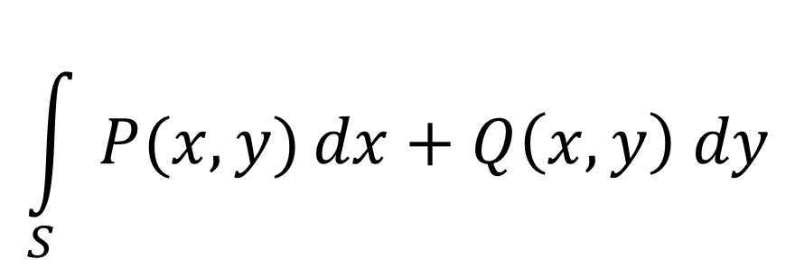
$$\int{\frac{x^{3}−3}{x^{4}+10x^{2}+25}}= \frac{1}{2}\ln{|x^{2}+5|}+\frac{5}{2}⋅\frac{1}{x^{2}+5}−\frac{3}{10}⋅\frac{x}{x^{2}+5}− \frac{3}{10\sqrt{5}}arc tg\left(\frac{x}{\sqrt{5}}\right)+C$$
$$SV_{i}\left(f\right)=\sum_{S⊆N∖\{i\}}{\frac{\left|S\right|!\left(\left|N\right|−\left|S\right|−1\right)!}{\left|N\right|!}\left(f\left(S∪\left\{i\right\}\right)−f(S)\right)}$$
$$e^{x}=1+\frac{x}{1!}+\frac{x^{2}}{2!}+\frac{x^{3}}{3!}+…$$
$$\int_{S}{P(x,y)}dx+Q\left(x,y\right) dy$$
$$\sin{α}±\sin{β}=2\sin{\frac{1}{2}\left(α±β\right)}\cos{\frac{1}{2}\left(α∓β\right)}$$

Slide 3
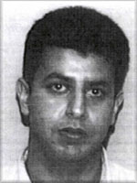
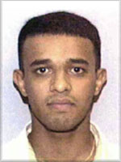
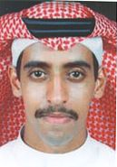
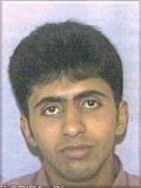
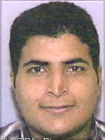
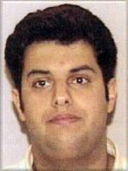
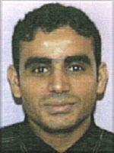
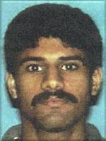
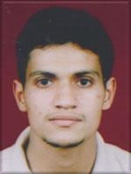
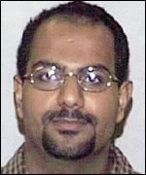
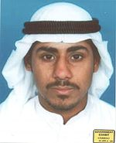
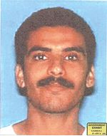
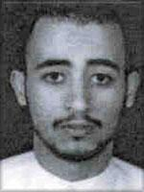
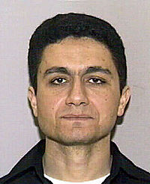
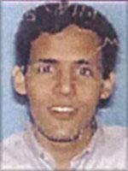
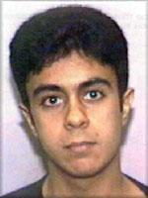
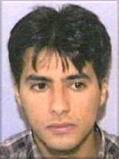
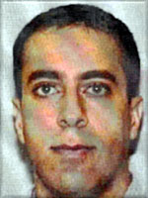
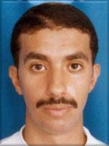
Źródło: wikipedia.org

Slide 4
Źródło: wikipedia.org

Slide 5
Źródło: wikipedia.org

Slide 6
Źródło: wikipedia.org

Slide 7
Źródło: wikipedia.org

Slide 9
Those who were trained to fly didn’t know the others. One group of people didn’t know the other group.
Osama Bin Laden

Slide 10
Źródło: wikipedia.org

Slide 11
Źródło: wikipedia.org

Slide 13
Celebryta

Slide 14
1
2
3
Koordynator

Slide 15
1
2
3
Pośrednik

Slide 16
1
2
3

Slide 20
?

Slide 22
22
18
DE
18
PL
PL
13
25
PL
18
DE
18
PL
US
18
PL
19
FR
17
PL

Slide 23
18
PL

Slide 24
18
PL

Slide 25
18
PL

