Slide 1
Higher-order organization of complex networks
Presentation based on a scientific article :
,,Higher-order organization of complex networks’’
Austin R. Benson,1 David F. Gleich,2 Jure Leskovec3
Performed: Nikola Wiejak

Slide 2
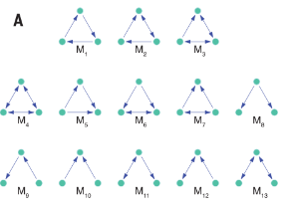
Introduction
Networks are a tool for analyzing complex systems in physics, biology, neurosciences, engineering, and social sciences.
The research focuses on higher-order connection patterns in small substructures, called network motifs.
Objective: Understanding higher-level organizations in complex systems.

Slide 3
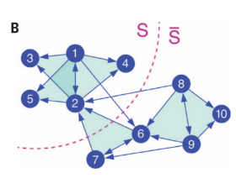
The Importance of Web Themes
Themes as basic units in networks :
Triangles – key in social networks.
Two-step paths – air traffic analysis.
Themes can reveal important patterns of higher-order organizations.

Slide 4
Higher-order classification algorithm
Algorithm Process:
Create an adjacency matrix for a selected theme.
Spectral Analysis of Laplace Matrices.
Motif conductance optimization.
The algorithm is scalable and can analyze networks with billions of edges.

Slide 5
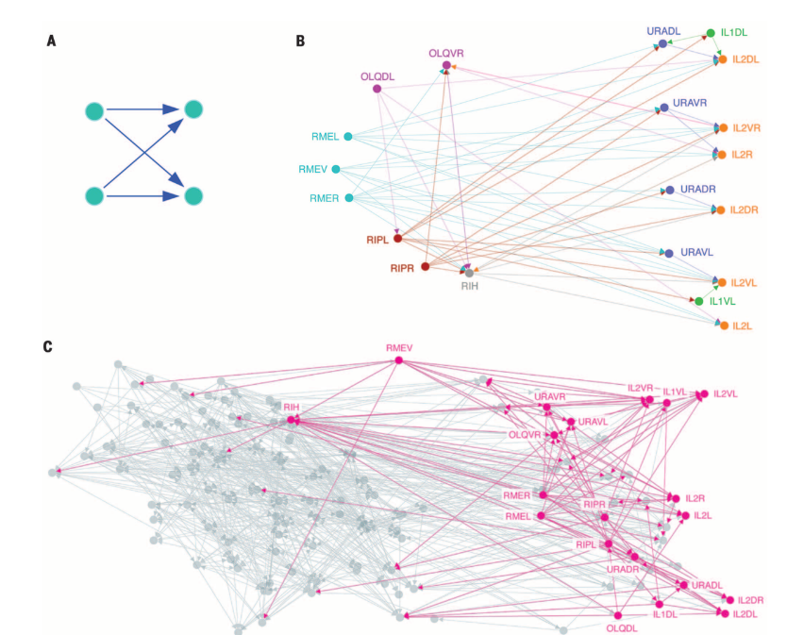
Application: C. elegans Neural Network
The study used the "bi-fan" motif in the analysis of the C. elegans neural network.
Results:
Three motor neurons as sources of information.
Sensory neurons as recipients of information.
Intermediate neuron (RIH) as a key factor in information propagation.

Slide 6
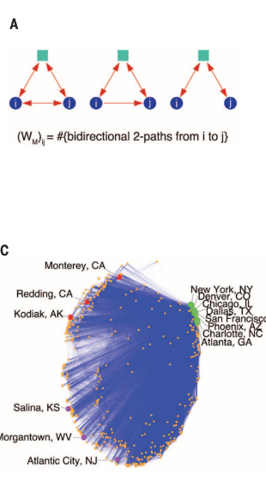
Application: Transportation Networks
Analysis of airport networks in the USA and Canada:
Two-hop motifs were used to identify hubs and geographical connections.
The results show the distribution of nodes based on their role in the network (hubs, non-hubs).
A new look at geographical and functional organization.

Slide 7
Conclusion & Significance
Higher-order clustering reveals new patterns of organization.
Can be used in various fields:
Neuroscience – analysis of neuronal structures.
Logistics – optimization of transport networks.
Social sciences – the study of social networks.
Future prospects: an analysis of new types of motifs. Uncovering hidden structures allows you to better understand different fields.

