Slide 1
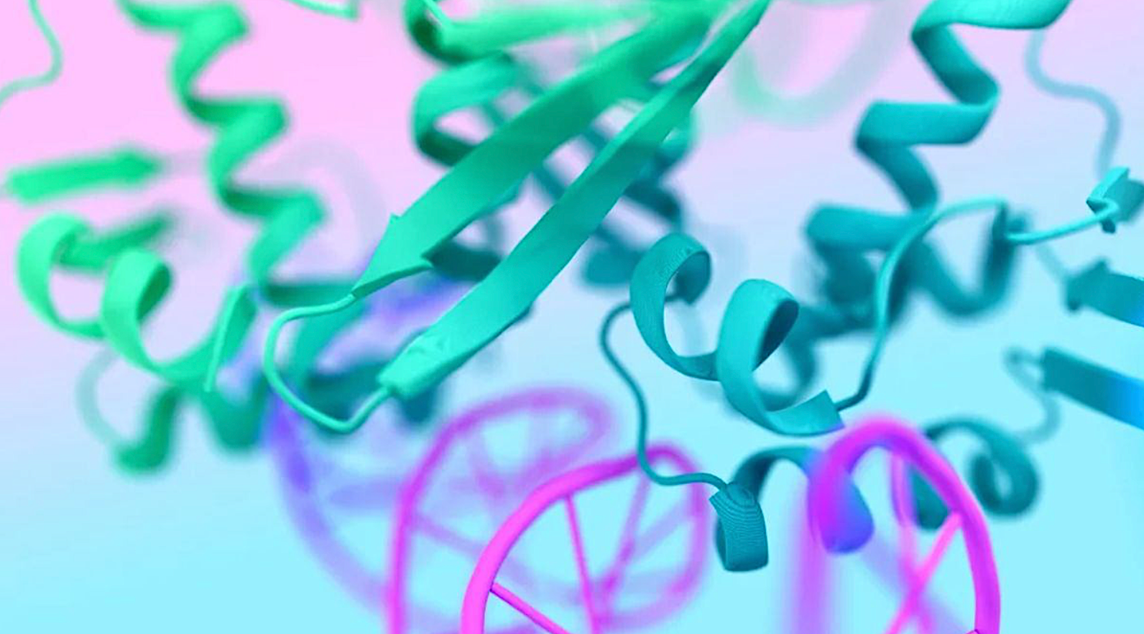
Integrating AlphaFold with Molecular Docking: A New Era in Drug Design
Julia Świątkowska

Slide 2
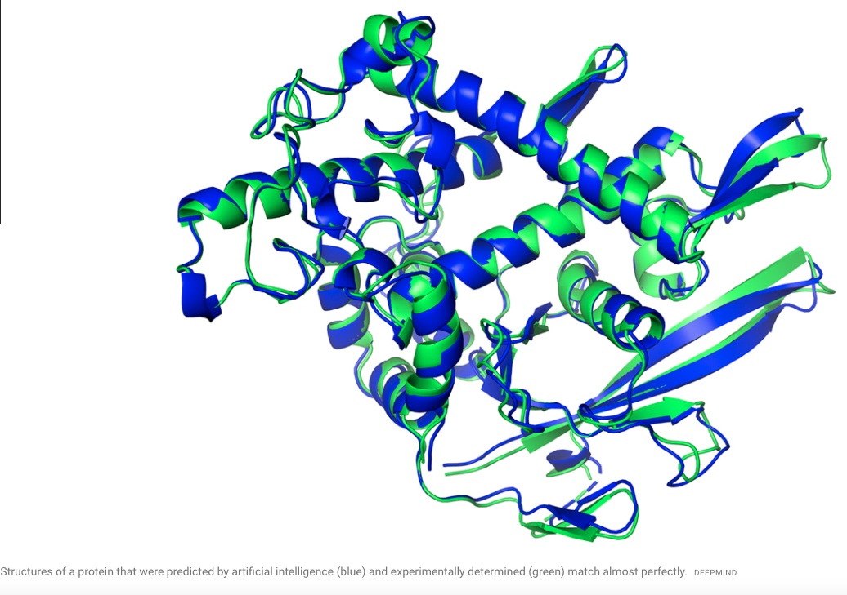
What is AlphaFold?
It uses deep learning to predict protein 3D structures from amino acid sequences with high accuracy.
AlphaFold has revolutionized structural biology by solving the "protein folding problem."
AlphaFold has predicted structures for nearly all known proteins (AlphaFold Protein Structure Database).
It has accelerated research in areas like drug discovery, enzyme design, and disease understanding.

Slide 4
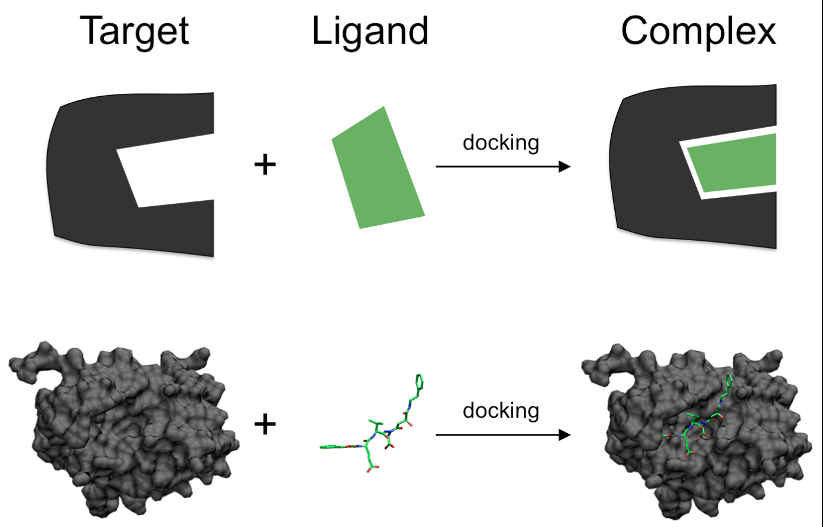
Molecular Docking in Drug Design
Molecular docking is a computational method used to predict how a small molecule (ligand) binds to a target protein.
It helps identify potential drug candidates by simulating interactions between proteins and ligands.

Slide 6
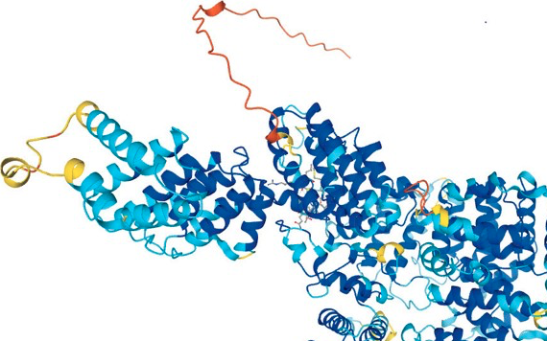
Integrating AlphaFold with Molecular Docking
AlphaFold provides high-accuracy protein structures for targets with no experimental data.
This expands the scope of docking to previously undruggable targets.
Example: AlphaFold-predicted structures used for virtual screening against SARS-CoV-2 proteins.

Slide 7
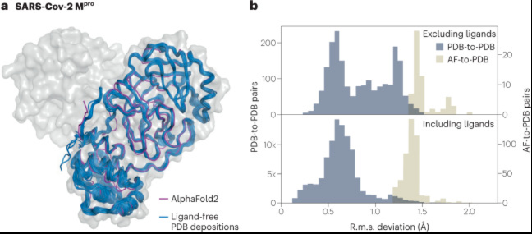
Key targets include the main protease (Mpro), spike protein, and RNA-dependent RNA polymerase (RdRp).
AlphaFold predicted the 3D structure of Mpro with high confidence, closely matching later experimental structures.
AlphaFold enabled virtual screening reduced the time required to identify potential drug candidates.

Slide 8
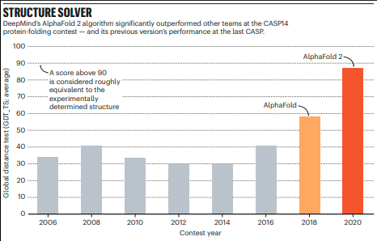
Advantages of the Integration
Expanding the Druggable Proteome
AlphaFold enables docking for proteins with no experimental structures.
This opens up new targets for drug discovery.
Speed and Cost Efficiency
Reduces reliance on expensive and time-consuming experimental methods.
Accelerates early-stage drug discovery.

Slide 9
Challenges and Limitations
Docking accuracy depends on the quality of the protein structure.
Experimental protein structures (e.g., from X-ray crystallography) are often unavailable or incomplete.
Integration with Docking Software
AlphaFold outputs may require preprocessing to be compatible with docking software (e.g., adding hydrogens, optimizing side chains).
Need for post-prediction refinement (e.g., molecular dynamics simulations) to improve docking accuracy.

Slide 10
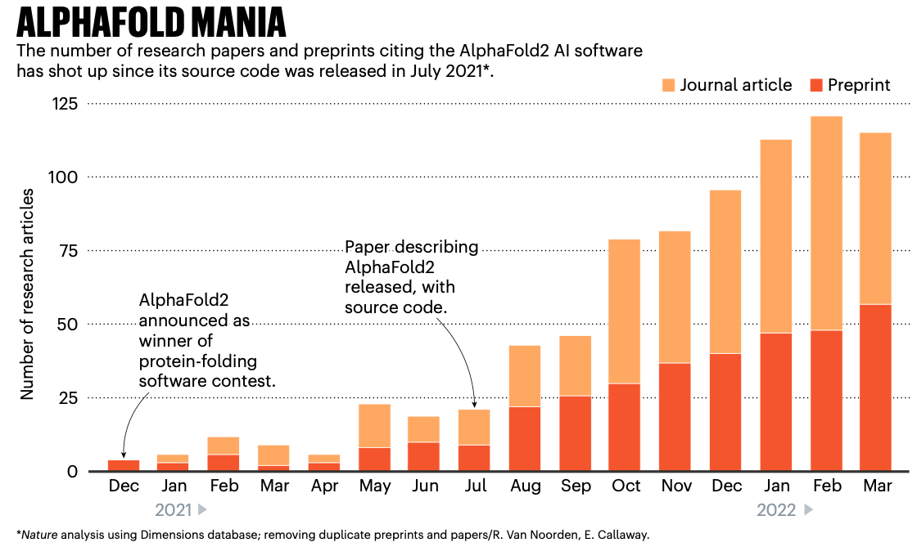
Summary

Slide 11
References:
Lane TJ. Protein structure prediction has reached the single-structure frontier. Nat Methods. 2023 Feb;20(2):170-173. doi: 10.1038/s41592-022-01760-4. PMID: 36639584; PMCID: PMC9839224.
Kitchen, D. B., Decornez, H., Furr, J. R., & Bajorath, J. (2004). Docking and scoring in virtual screening for drug discovery: methods and applications. Nature Reviews Drug Discovery, 3(11), 935–949. doi:10.1038/nrd1549
Warren, G. L., Andrews, C. W., Capelli, A.-M., Clarke, B., LaLonde, J., Lambert, M. H., … Head, M. S. (2006). A Critical Assessment of Docking Programs and Scoring Functions. Journal of Medicinal Chemistry, 49(20), 5912–5931.doi:10.1021/jm050362n
Russ B. Altman, M.D., Ph.D. (2023), A Holy Grail — The Prediction of Protein Structure, The New England Journal of Medicine, 398(15), DOI: 10.1056/NEJMcibr2307735
Ewen Callaway (2022), What's next for AlphaFold and the AI protein-folding revolution - DeepMind software that can predict the 3D shape of proteins is already changing biology.,, Nature, 604, 234-238
Jumper, J., Evans, R., Pritzel, A. et al. Highly accurate protein structure prediction with AlphaFold. Nature 596, 583–589 (2021). https://doi.org/10.1038/s41586-021-03819-2

