Slide 1
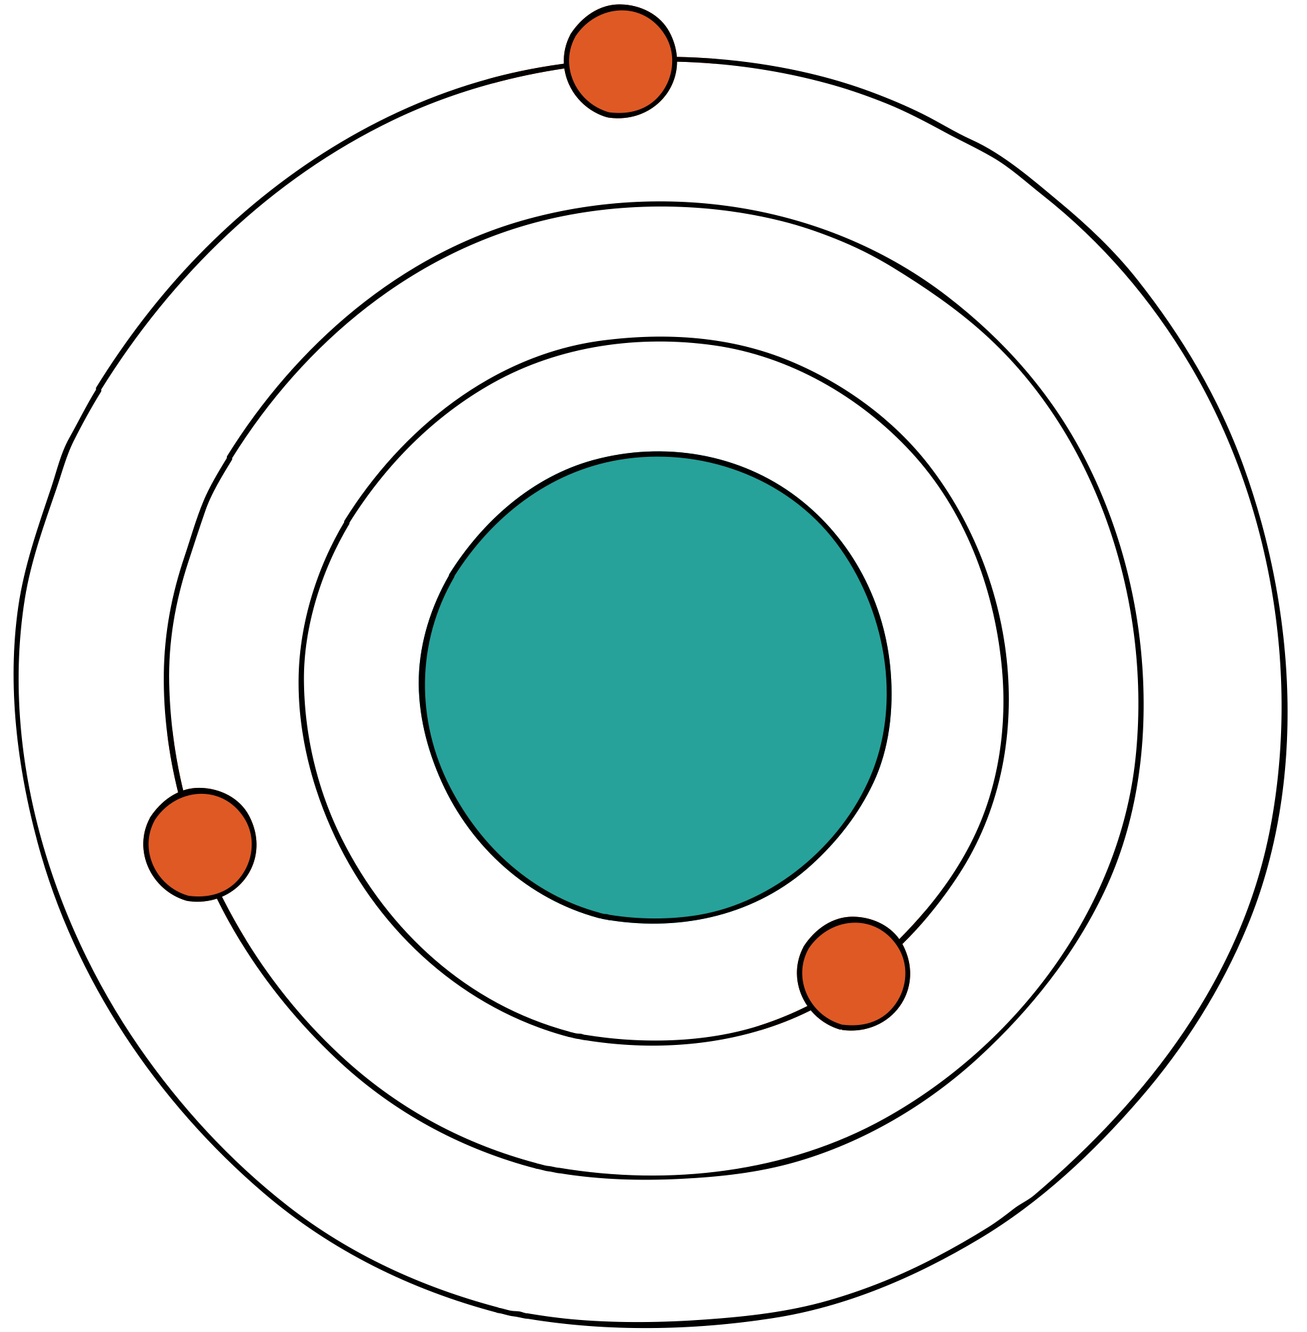
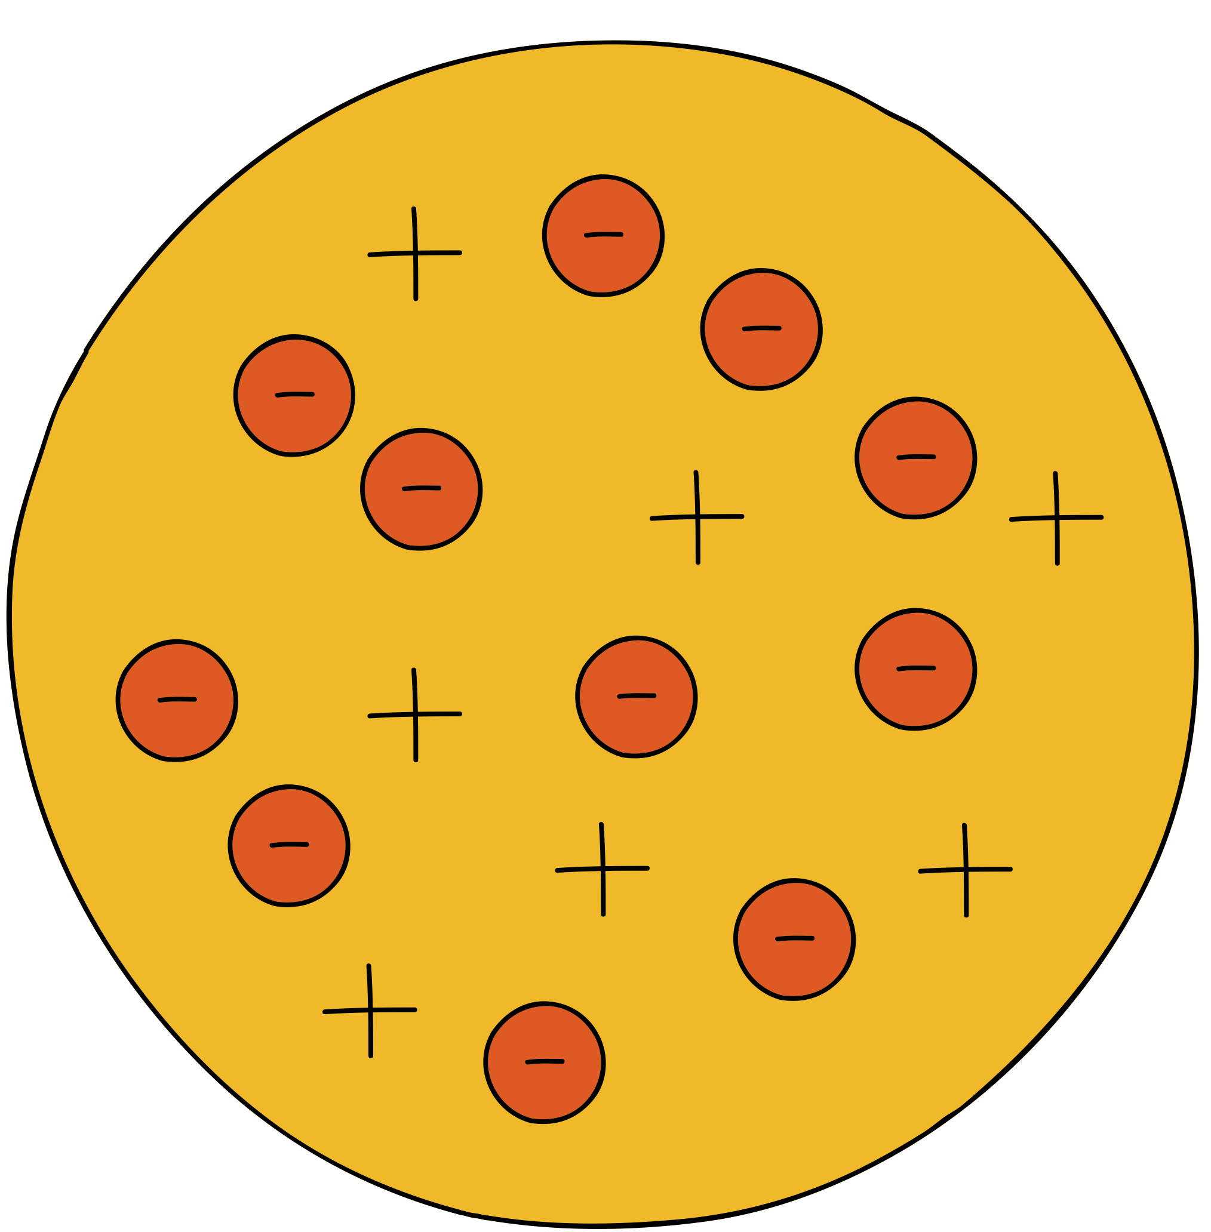

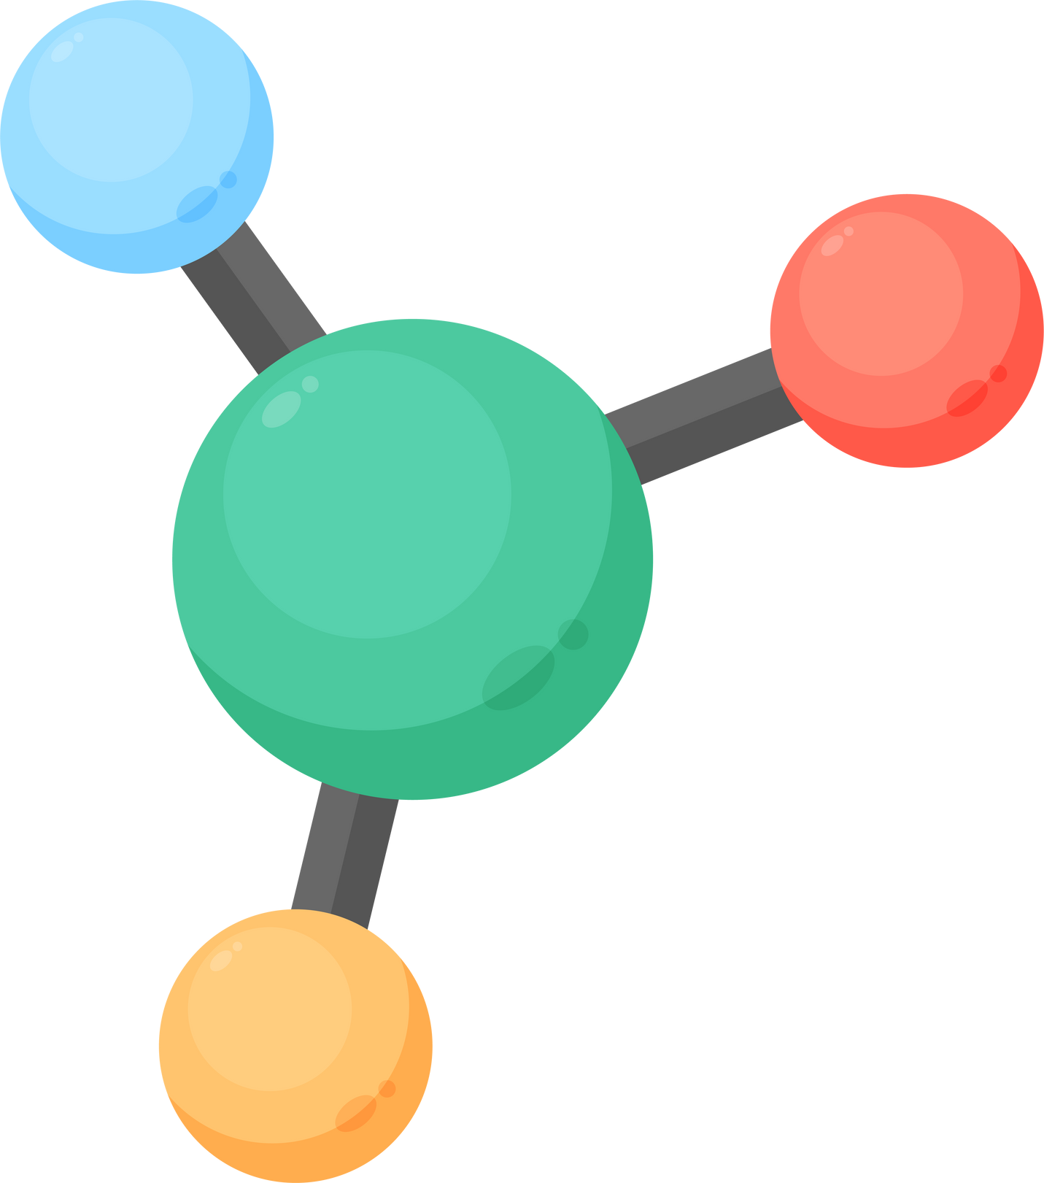
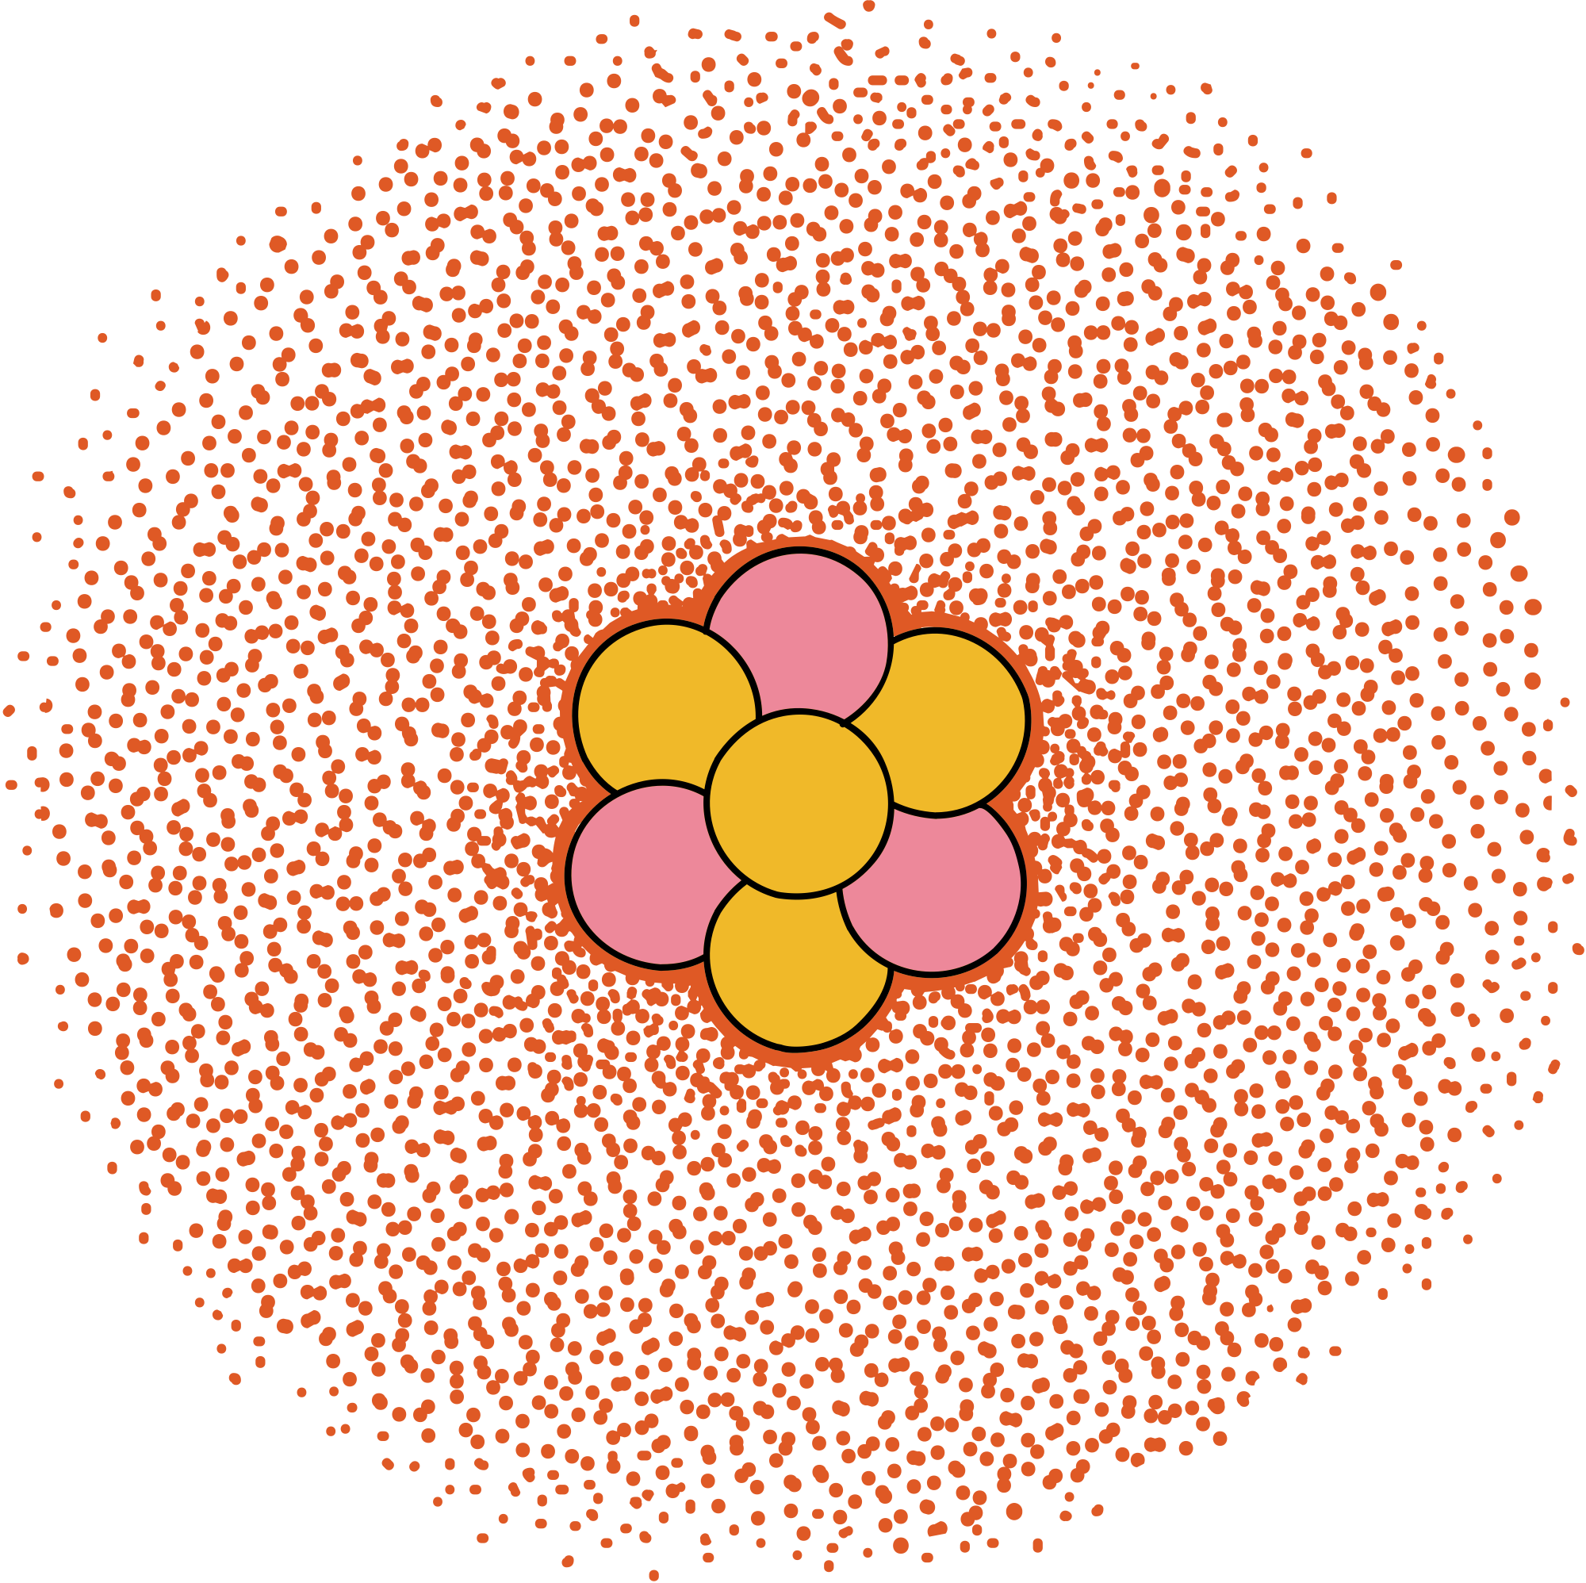
Shuguang Yuan, H.C. Stephen Chan & Zhenquan Hu
USING PYMOL AS A PLATFORM FOR COMPUTATIONAL DRUG DESIGN
Olliwia Kozłowska

Slide 2
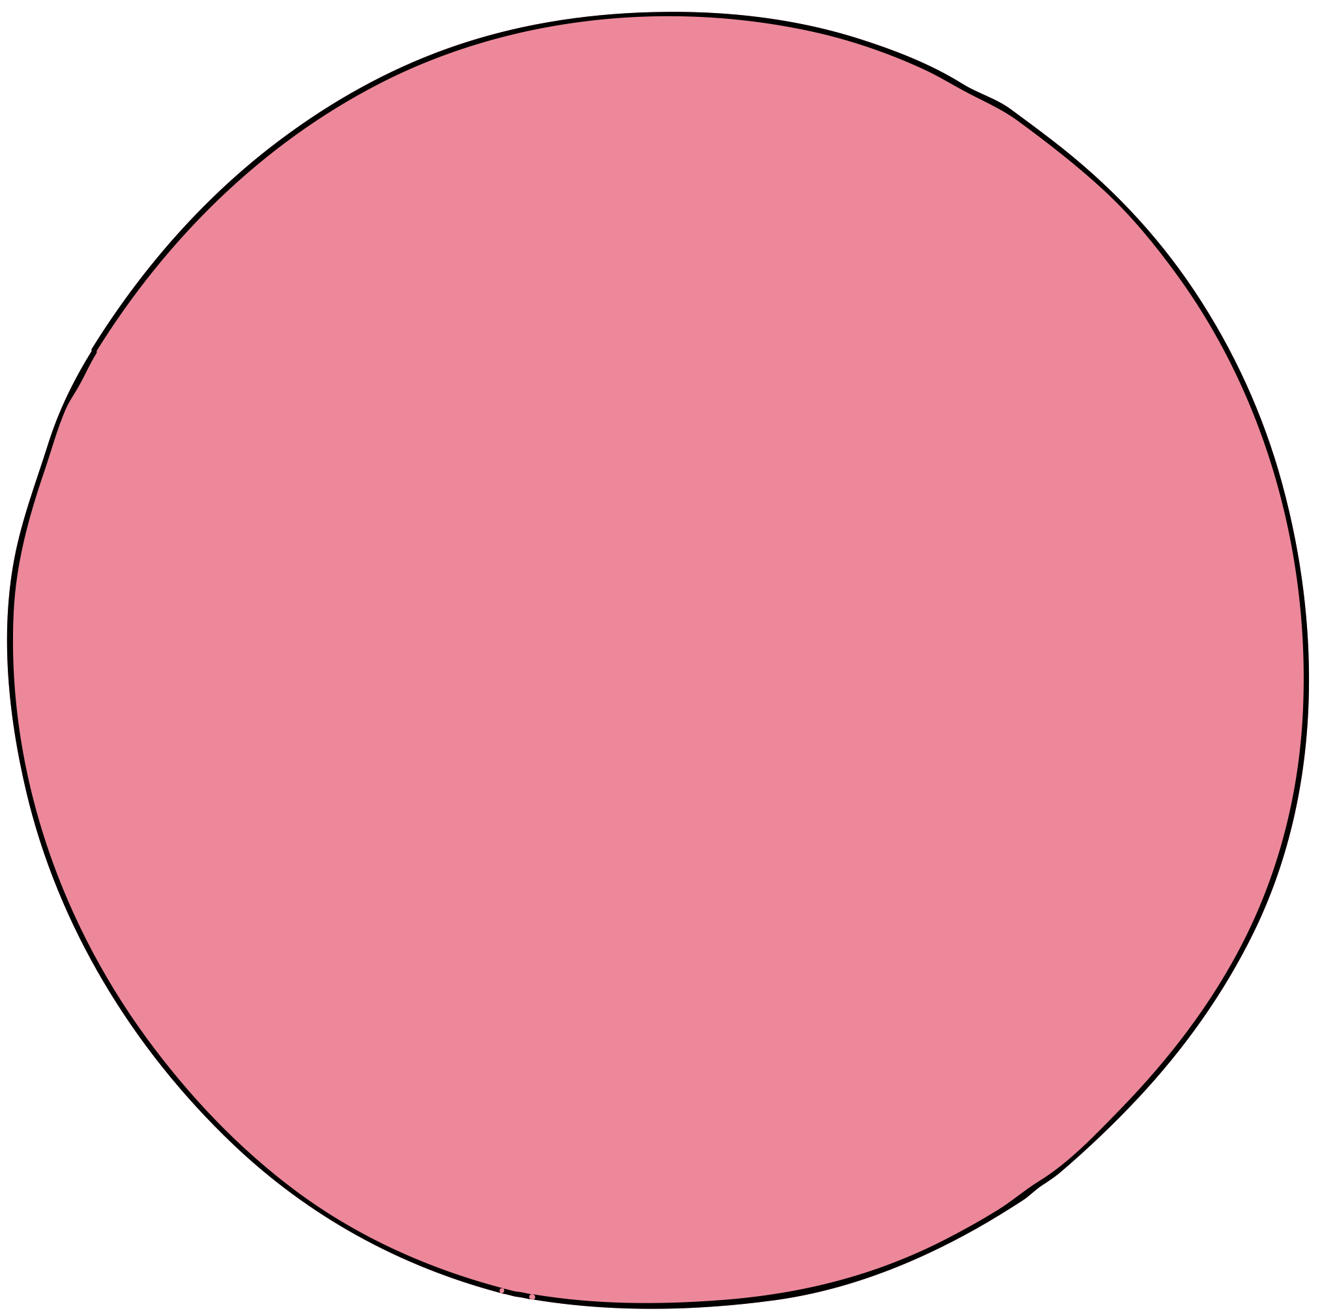
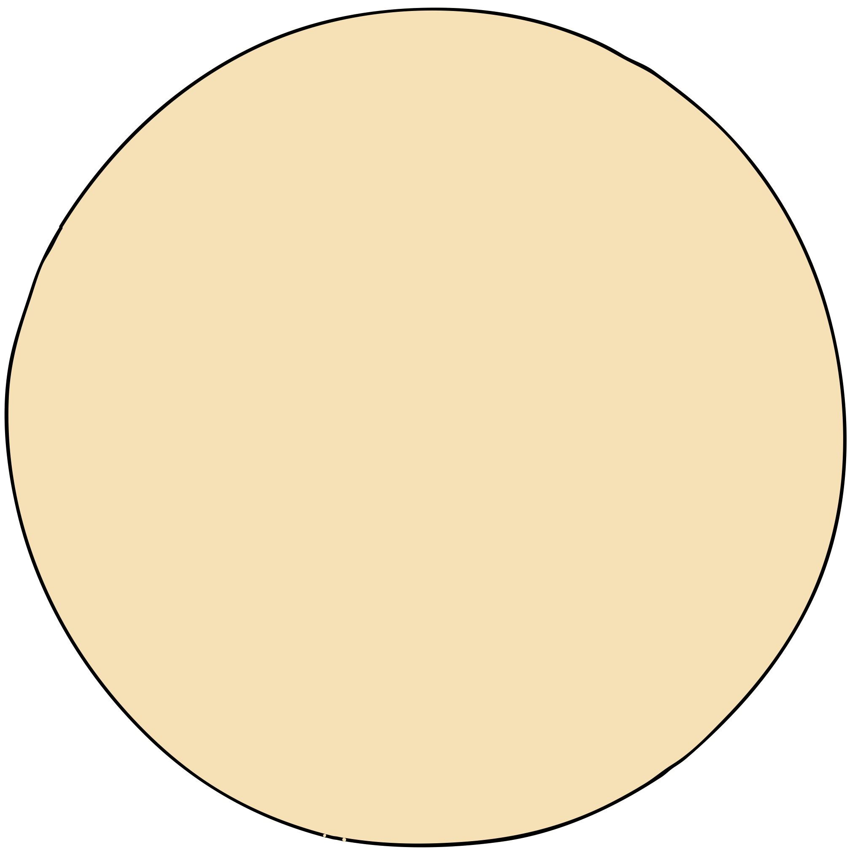
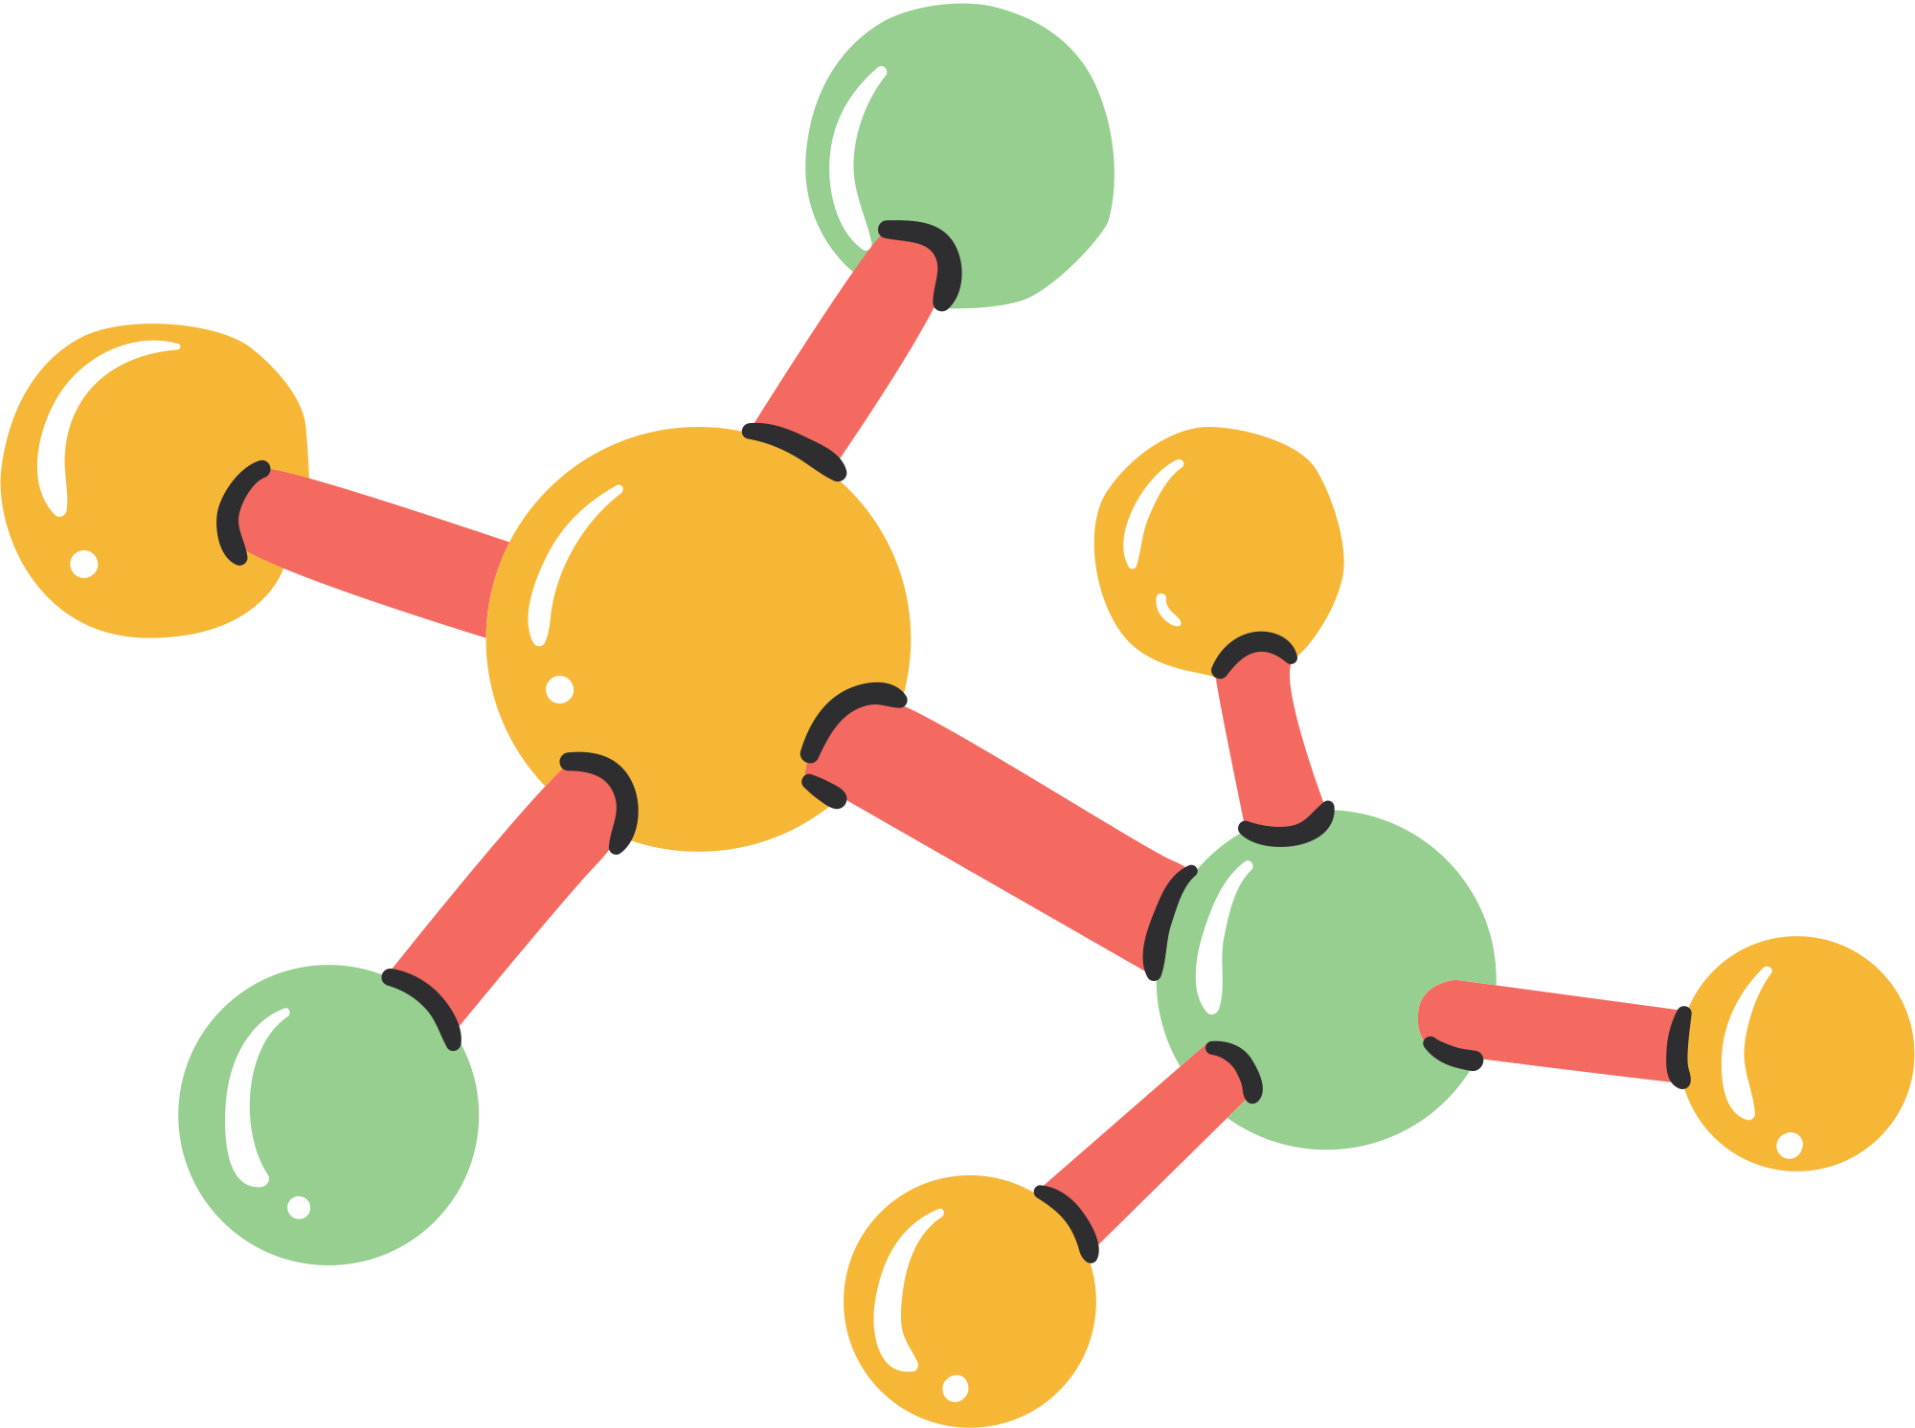
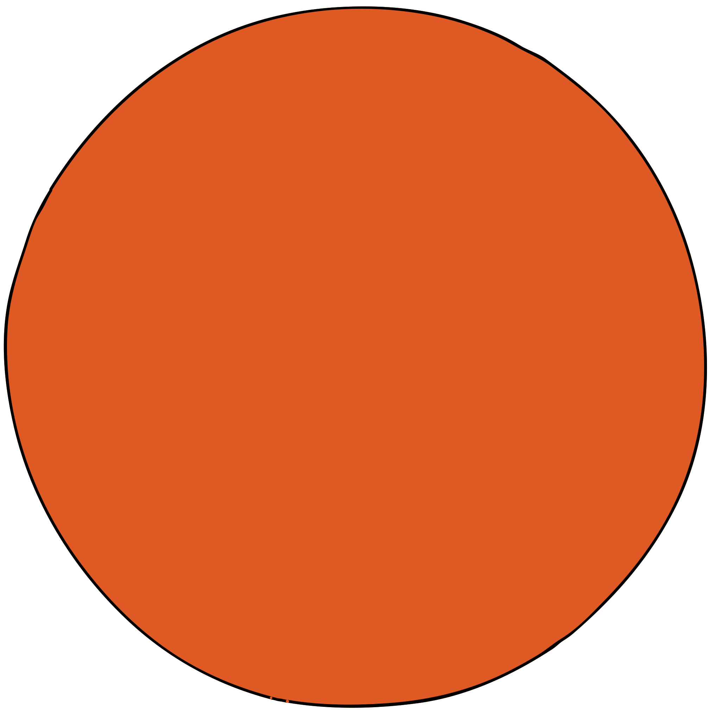
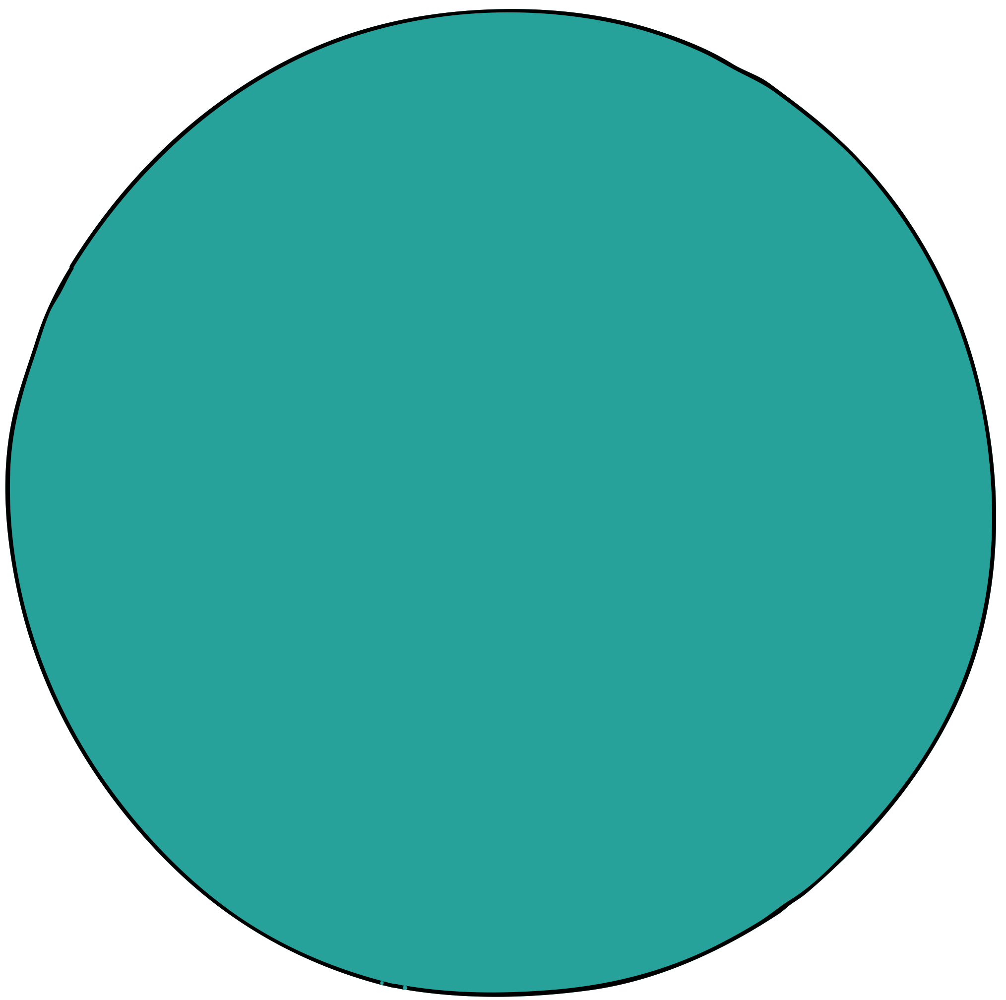

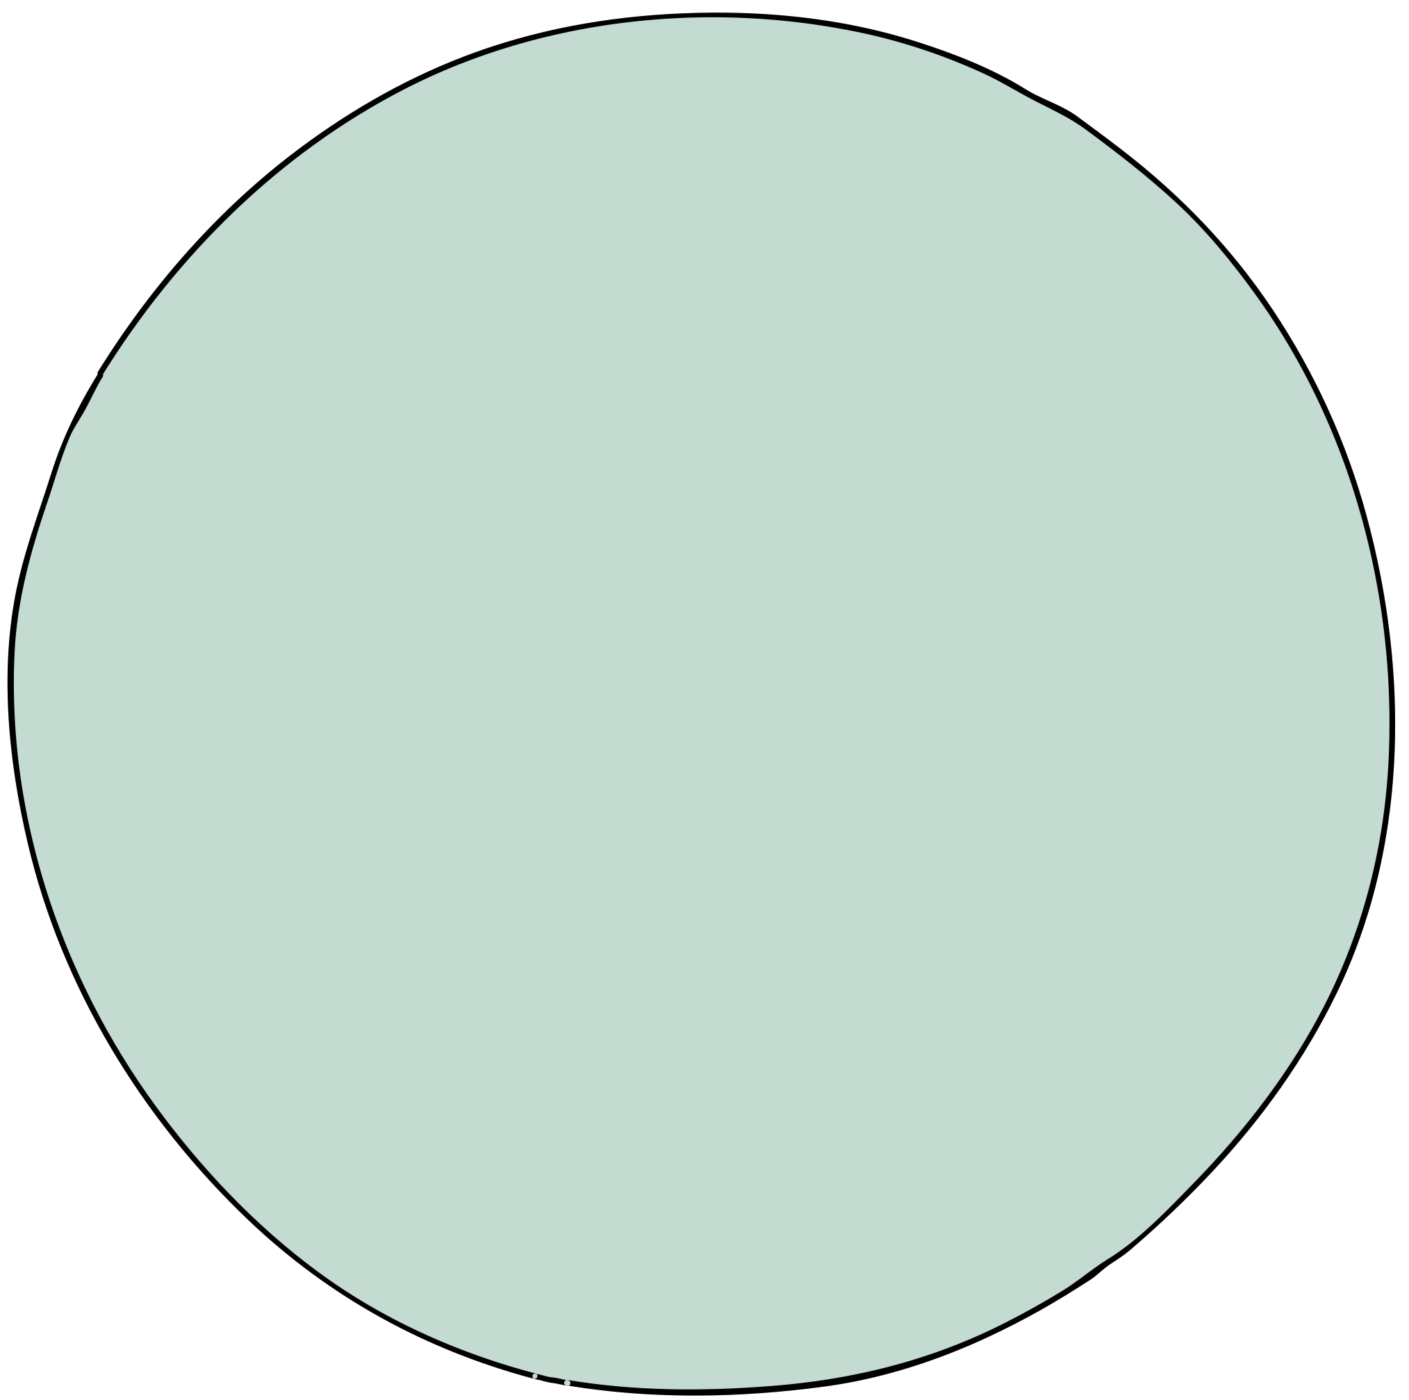
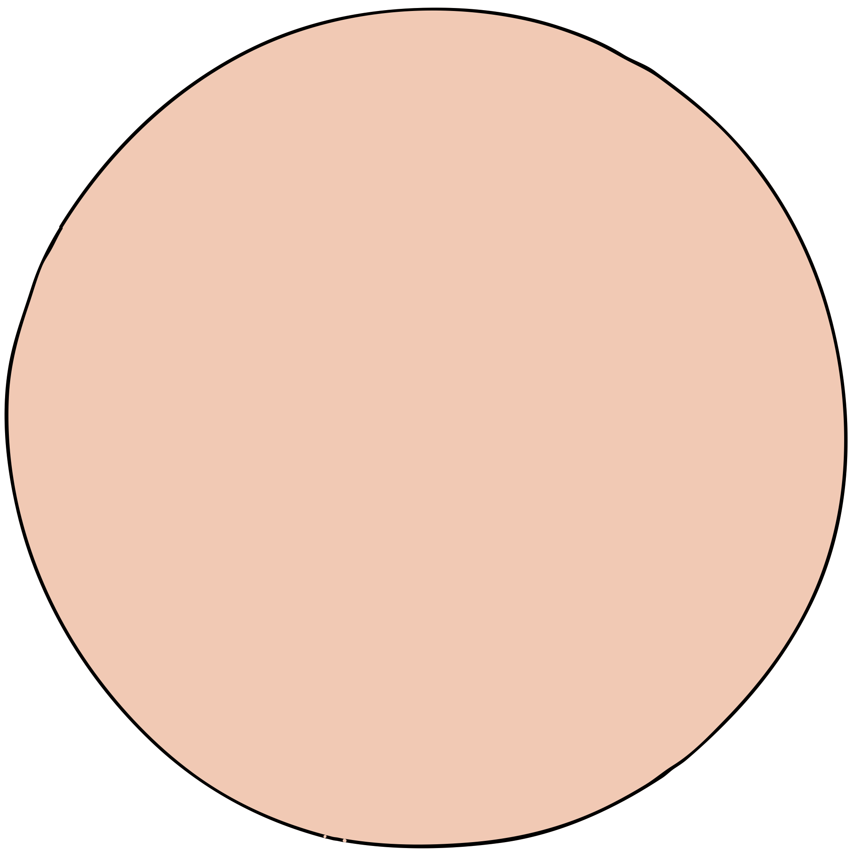
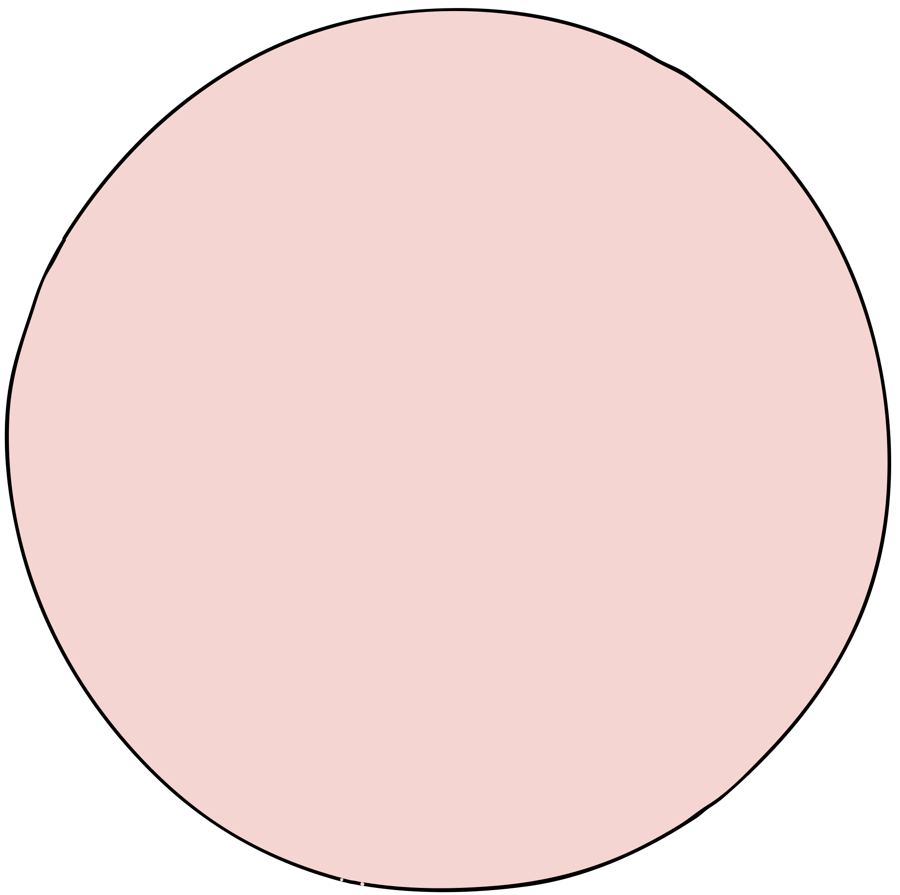
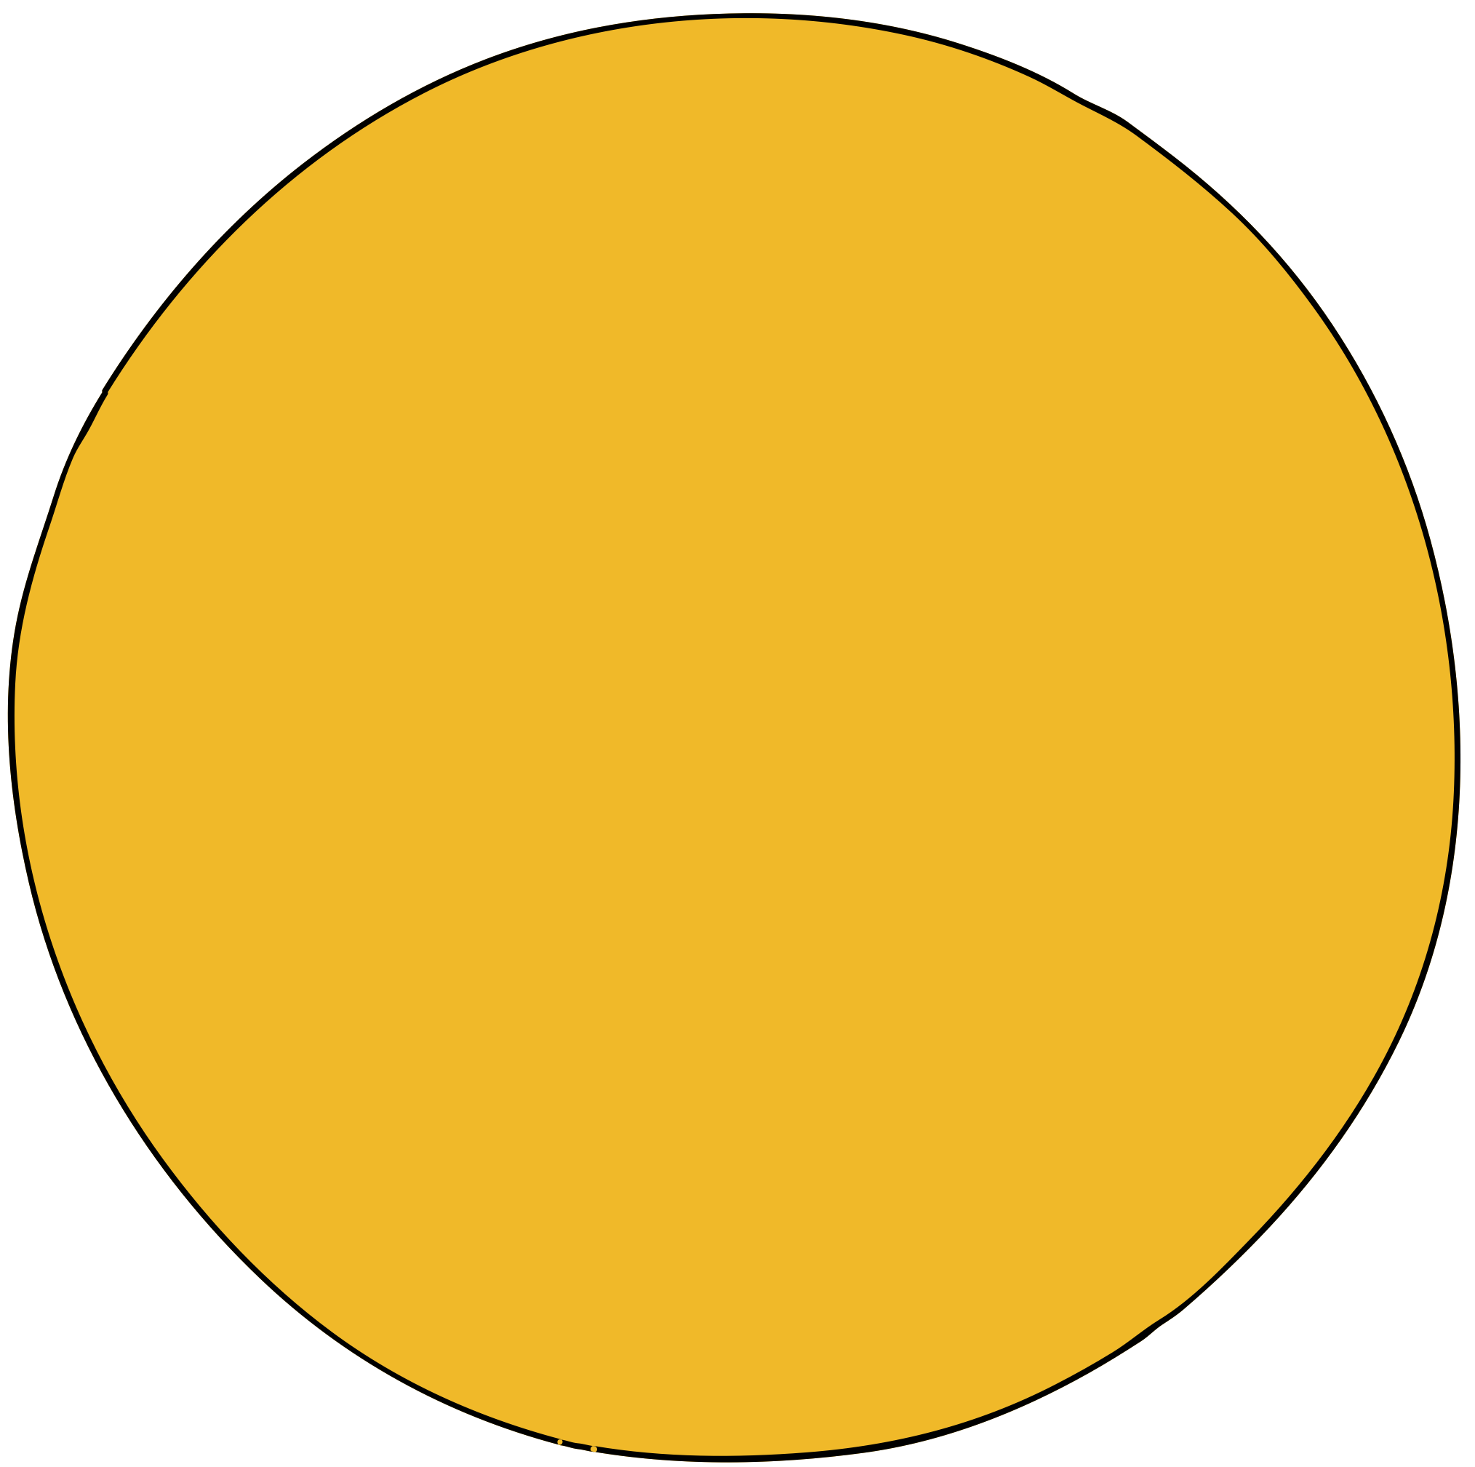
PURPOSE OF THE WORK
A comprehensive introduction to using PyMOL in the context of computer-aided drug design.

Slide 3
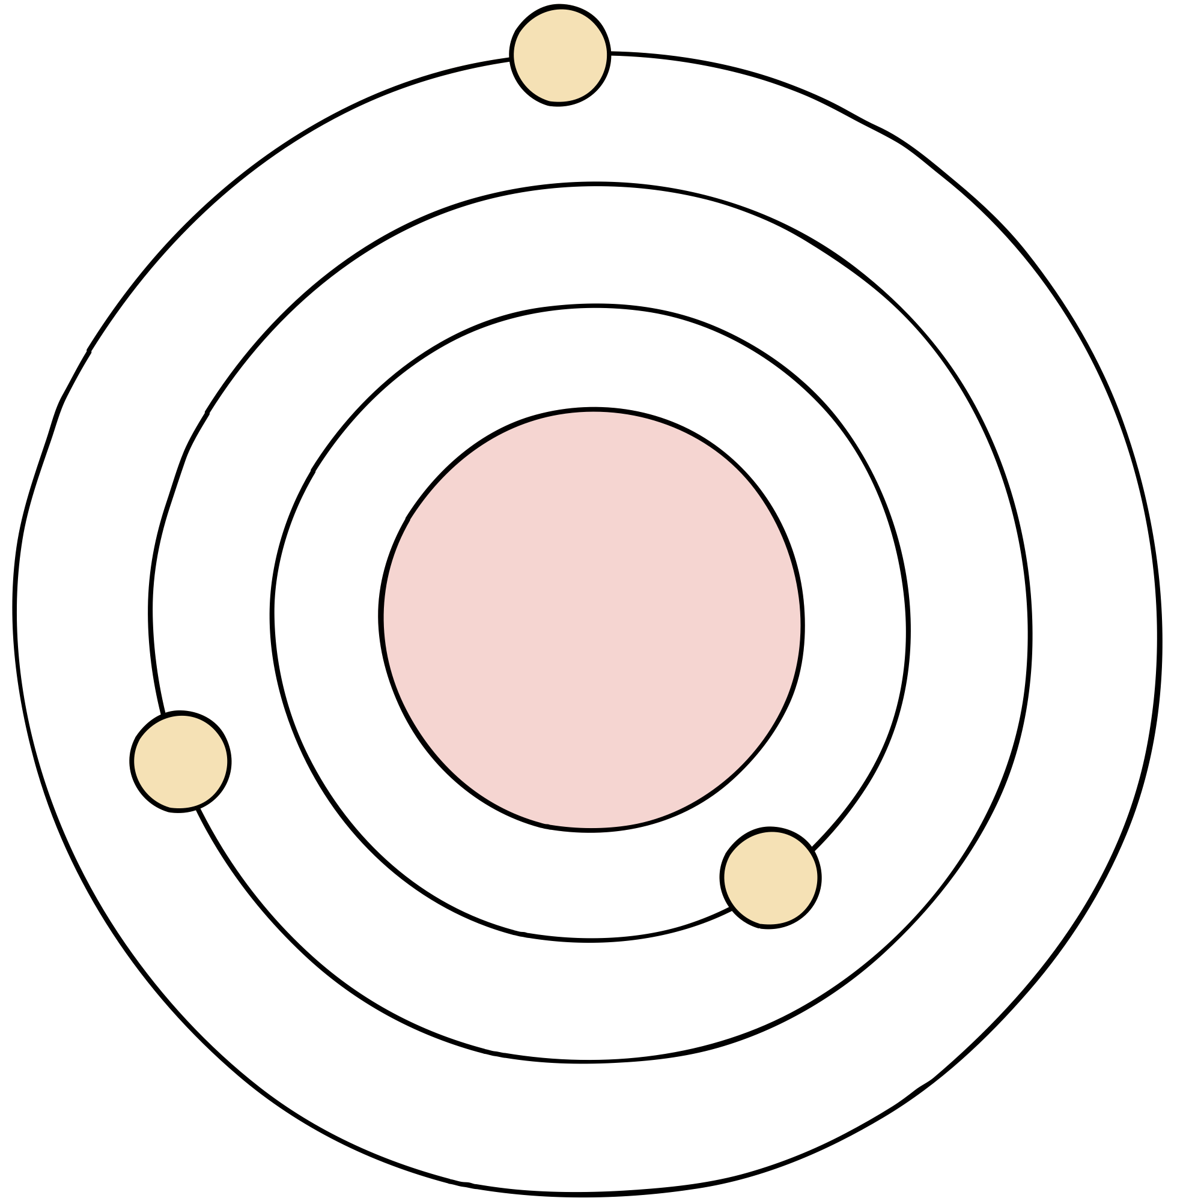
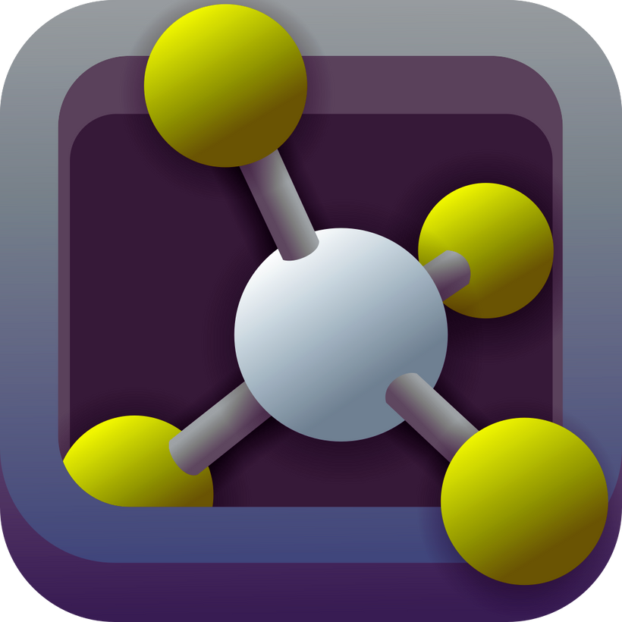
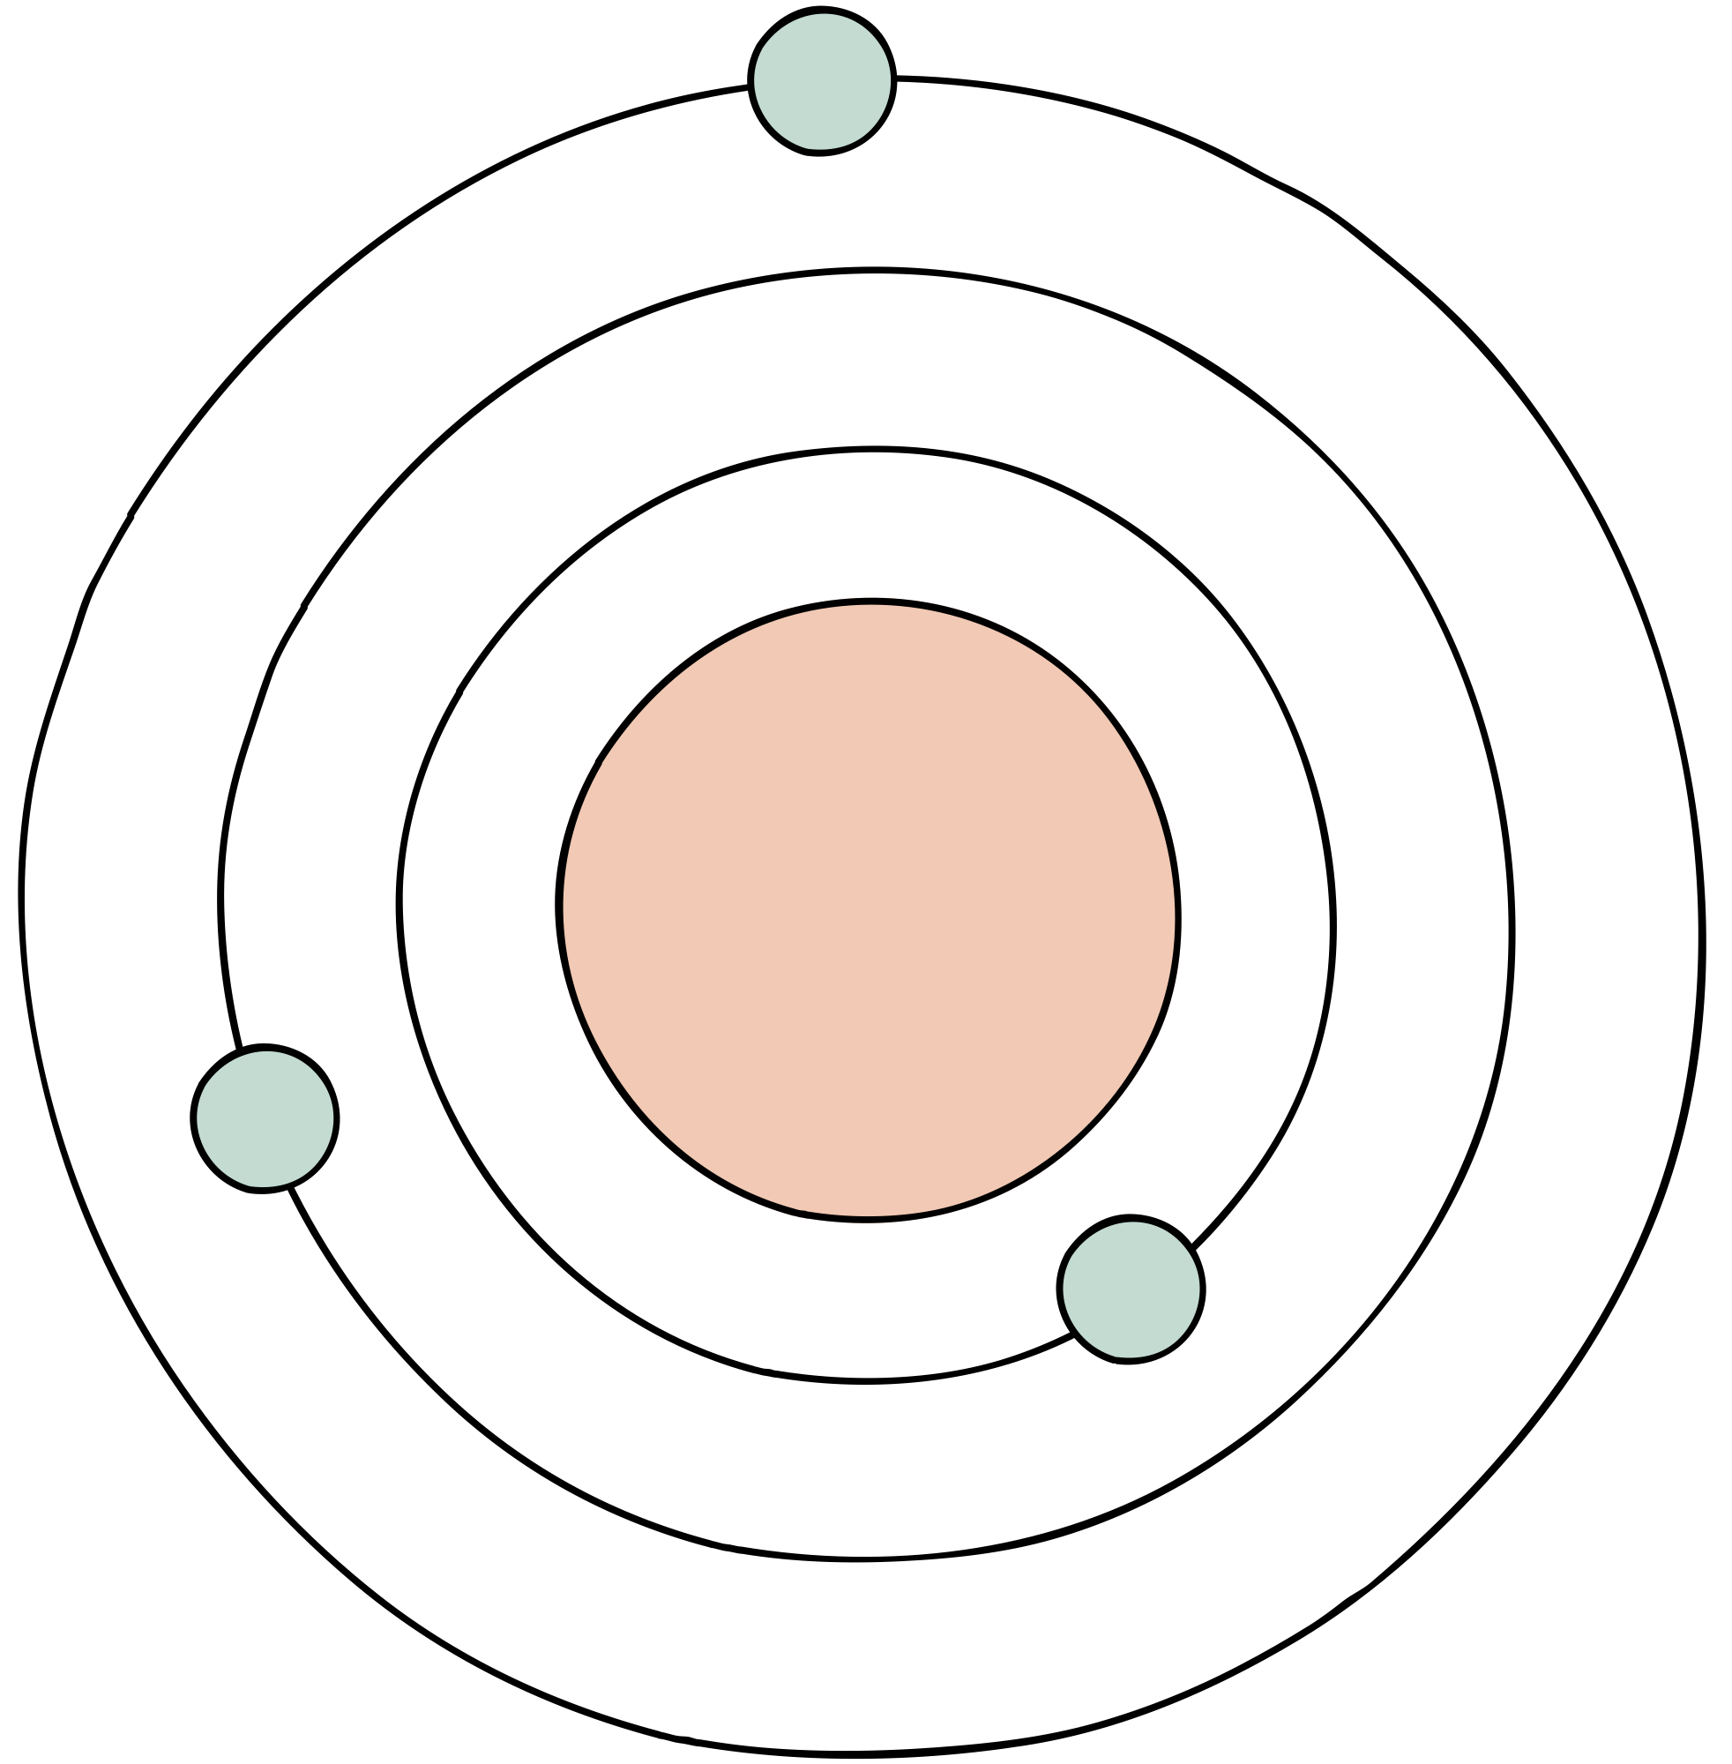
PYMOL
  This is molecular graphics tool.
  Python-based software developed to enhance its usability and facilitate drug design in PyMOL.
  Is used for three-dimensional (3D) visualization of proteins, nucleic acids, small molecules, electron densities, surfaces, and trajectories.
  It also capable of editing molecules, ray tracing, and making movies.

Slide 4
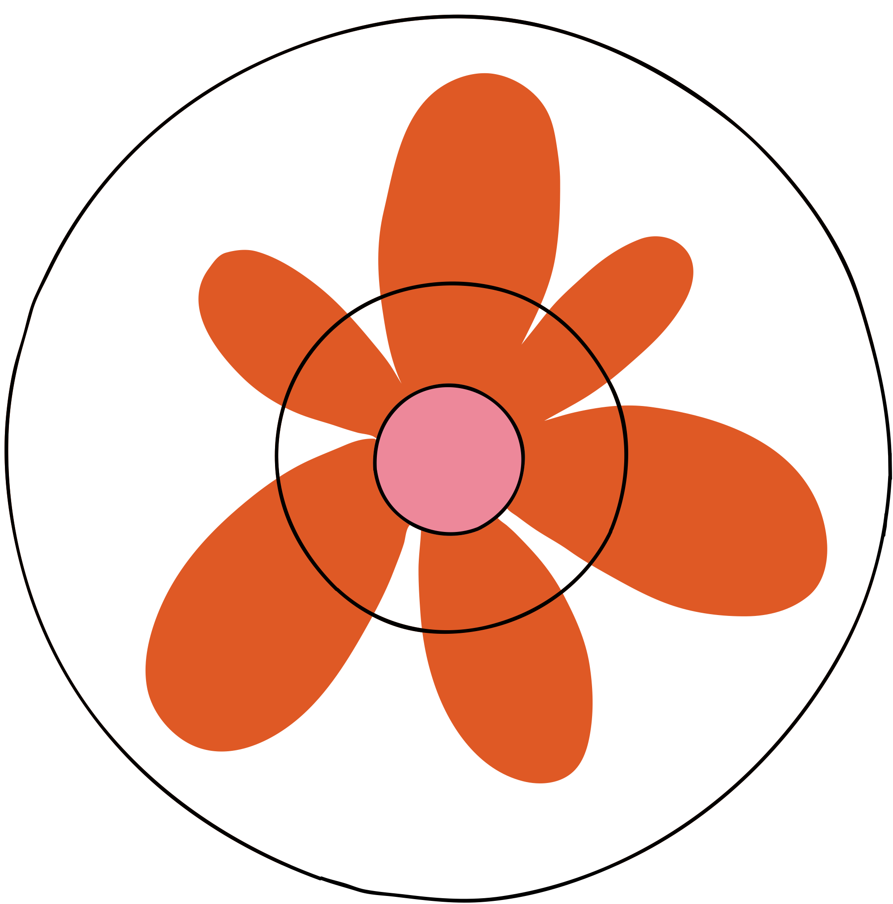

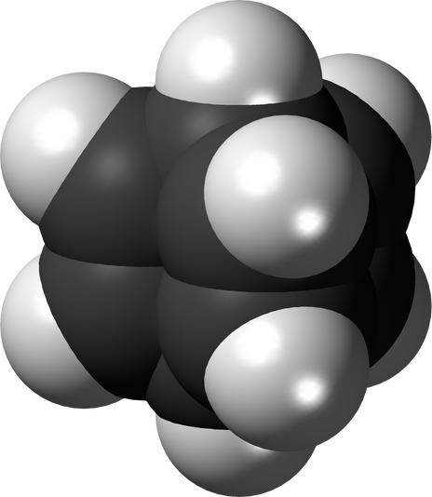
COMPUTER-AIDED
DRUG DESIGN (CADD)
1
MOLECULAR VISUALIZATION AND ANALYSIS
  2
  PROTEIN–LIGAND MODELING
  3
  VIRTUAL SCREENING
  4
  MOLECULAR SIMULATION

Slide 5
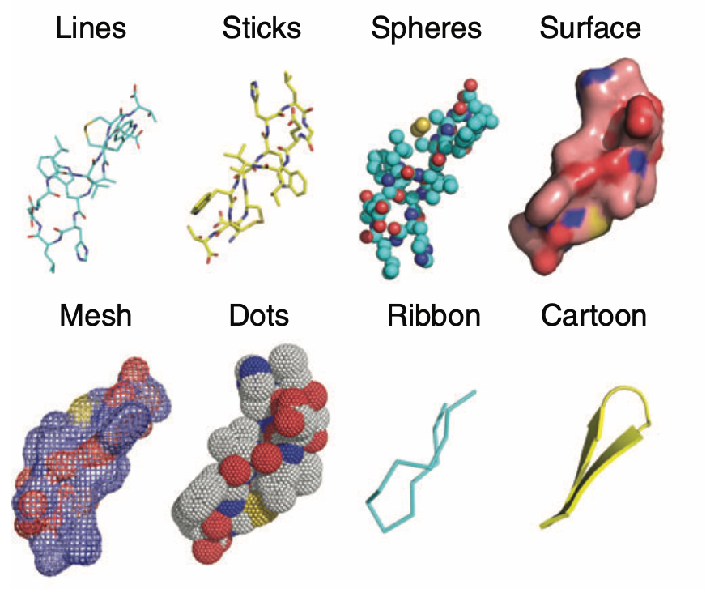
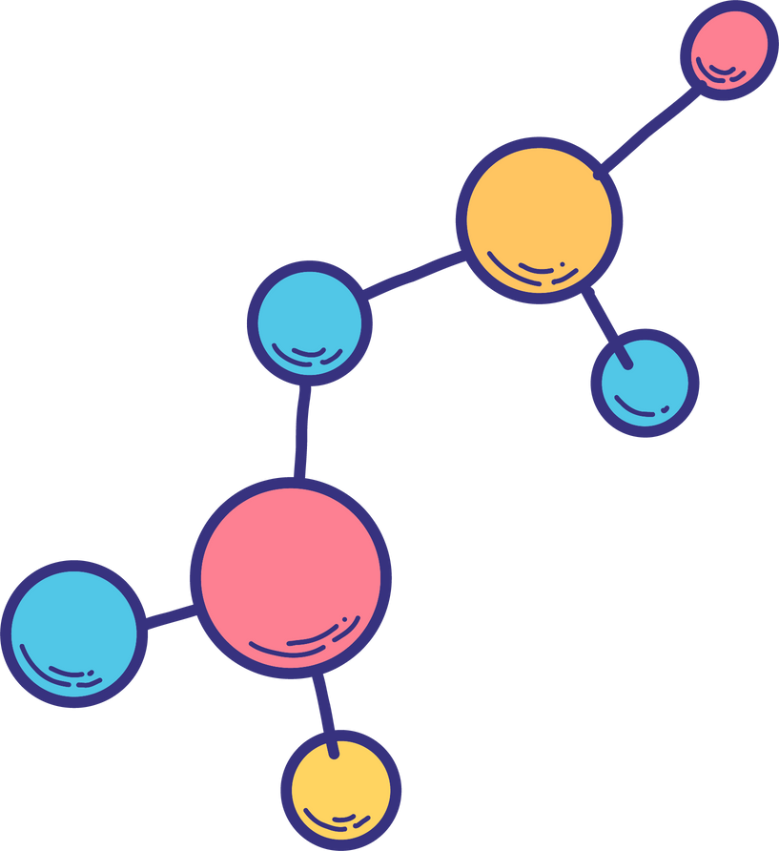
1
MOLECULAR VISUALIZATION AND ANALYSIS
PyMOL can display macromolecules in
different styles

Slide 6


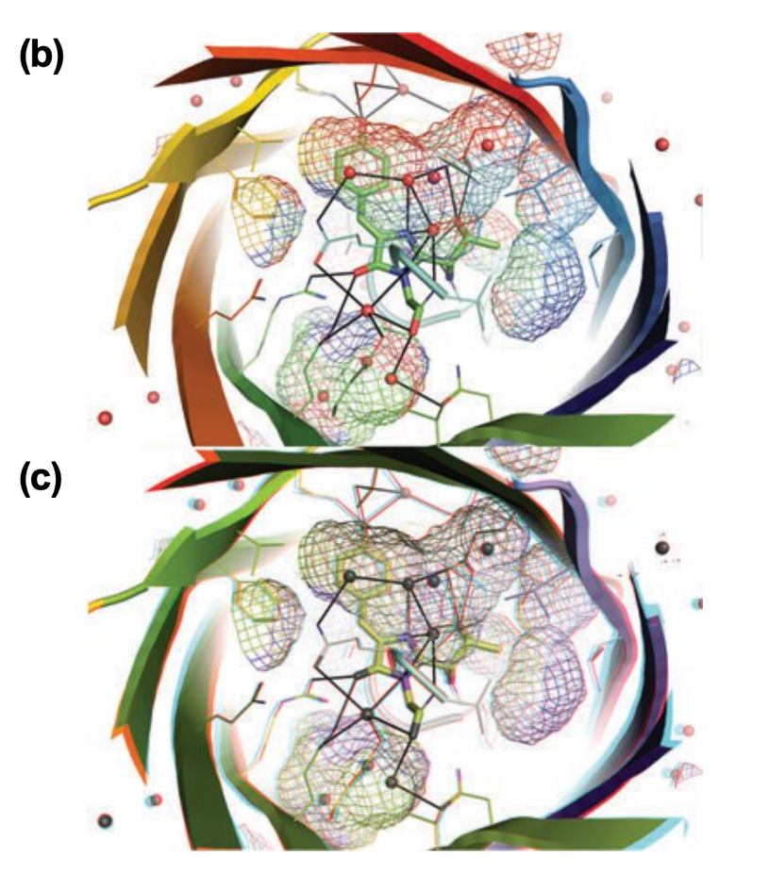
1
MOLECULAR VISUALIZATION AND ANALYSIS
THE STEREO EFFECT CAN BE VISUALIZED BY A PAIR OF RED–BLUE ANAGLYPH STEREO GLASSES.
(b) The binding pocket of the green fluorescent protein
displayed in nonstereo cartoon and mesh.
(c) The binding pocket of the green fluorescent protein displayed in anaglyph stereo mode.

Slide 7
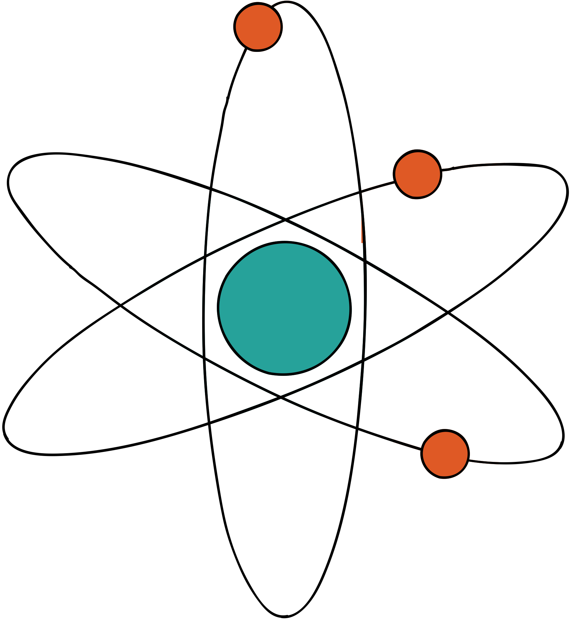
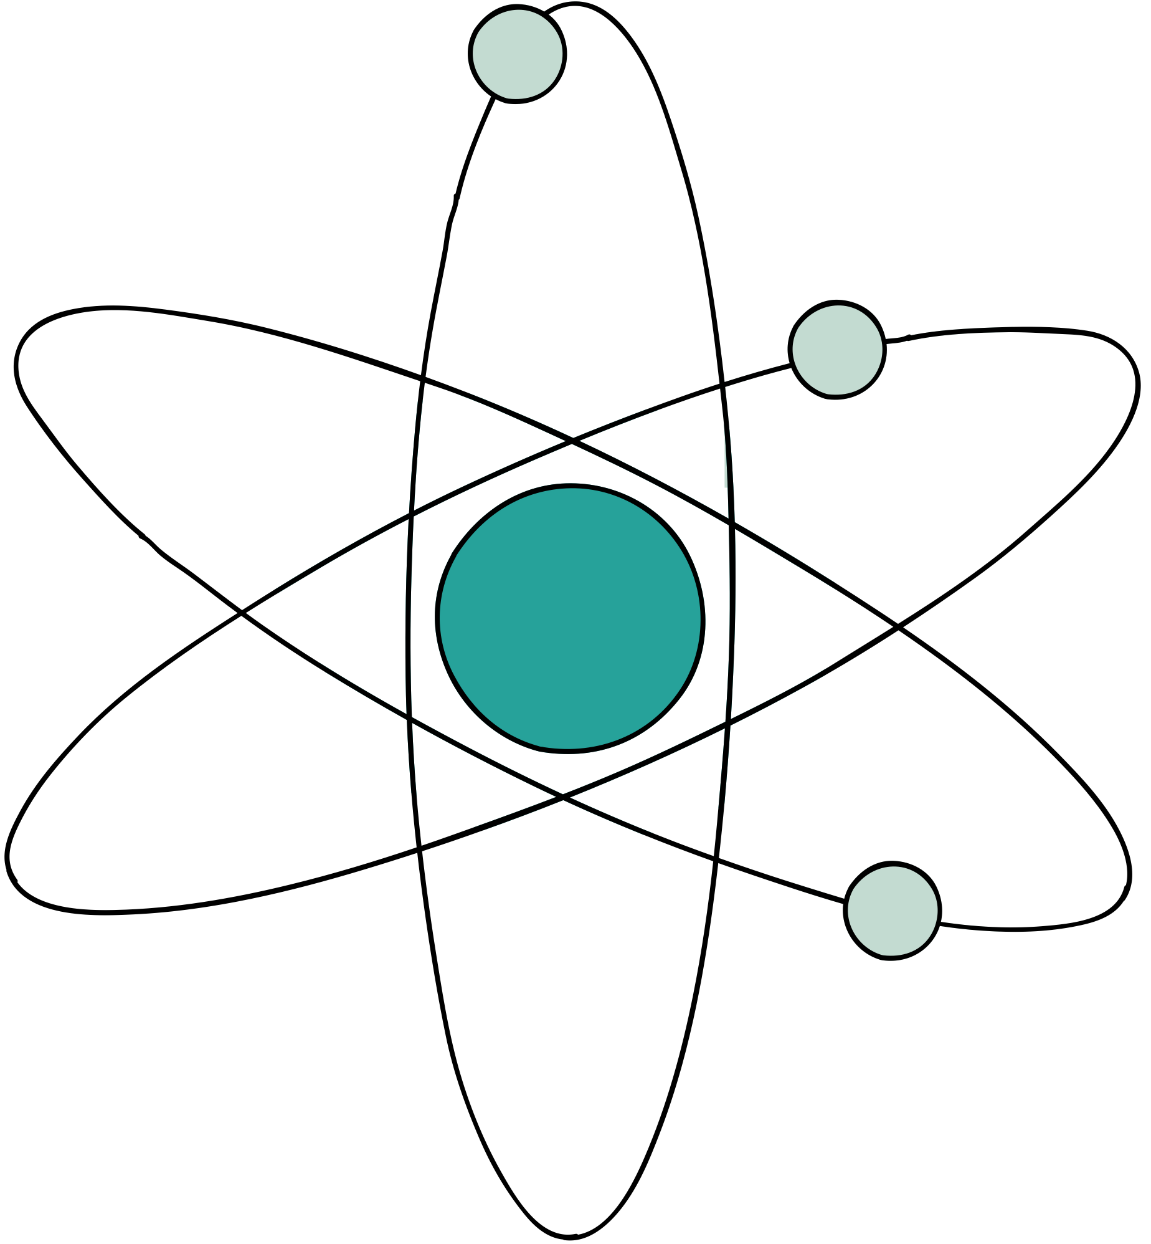
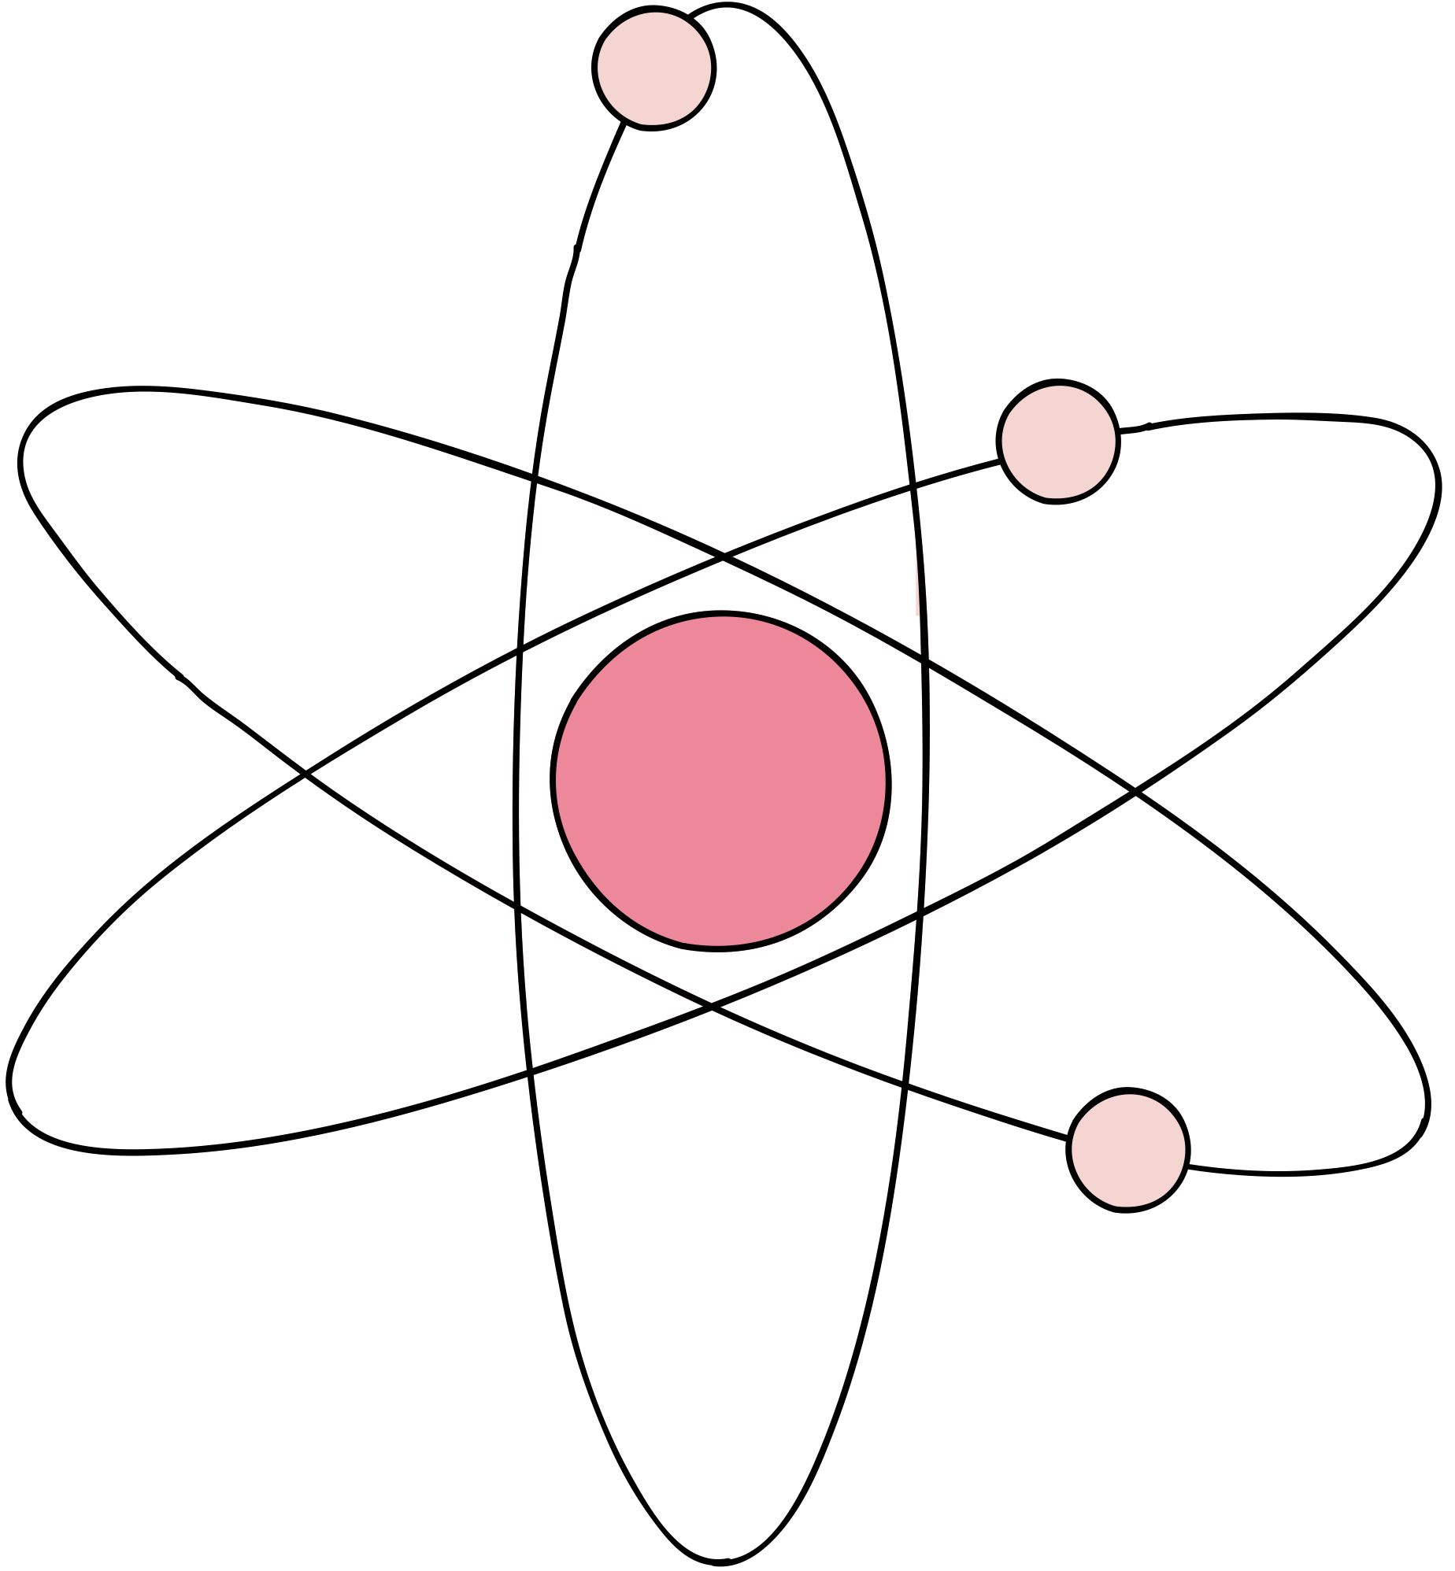
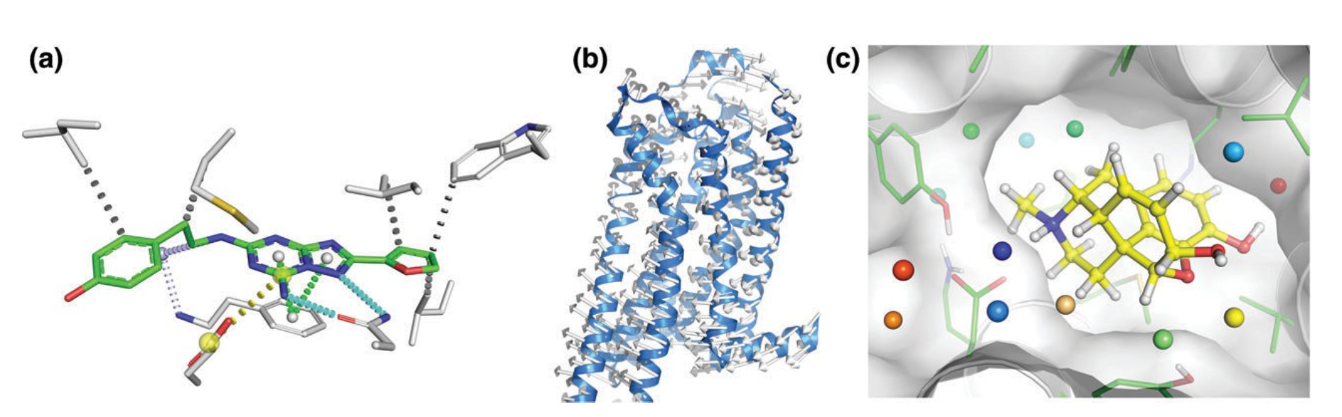
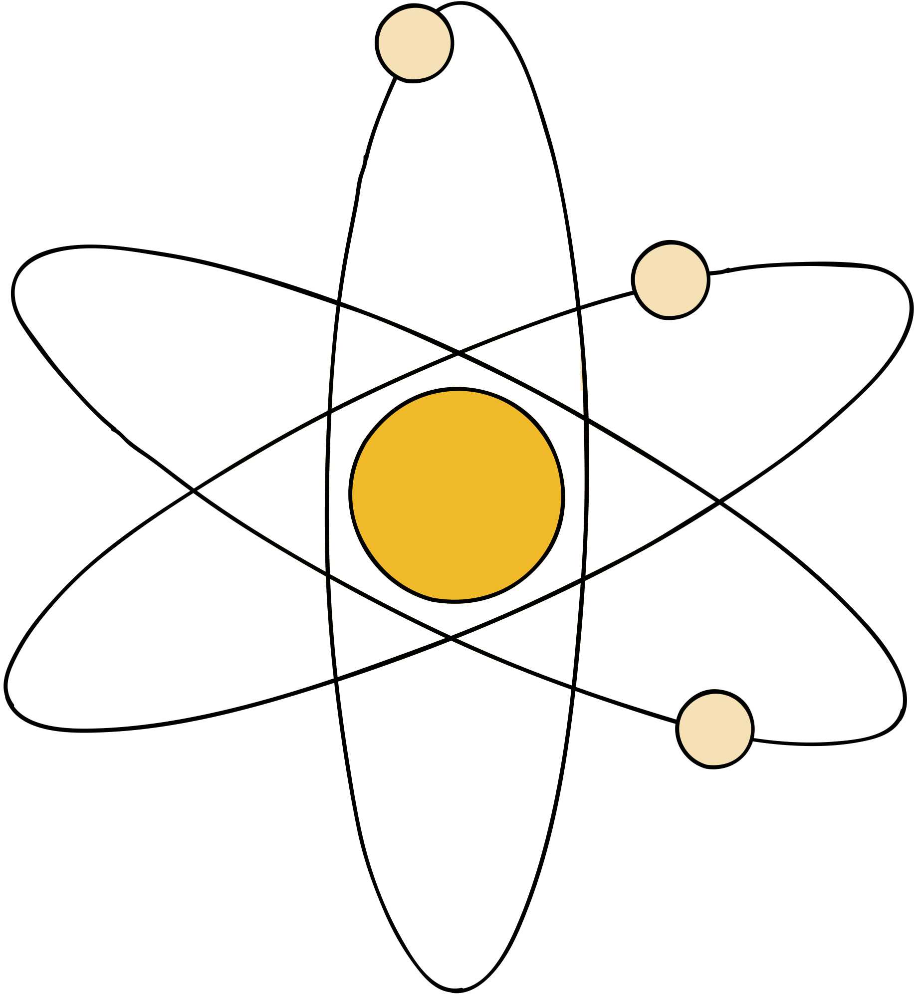
  2
PROTEIN–LIGAND MODELING
Involves to study the interactions between a ligand and a receptor and it is a critical step in drug discovery.
It includes:
  homology modeling,
  protein preparation,
  ligand alignment, ligand preparation,
  protein-ligand docking
Protein-ligand interaction of the Adenosine 2A receptor

Slide 8
  3
VIRTUAL SCREENING
  It is a computational method used in drug discovery to search small molecule libraries for compounds that bind to a specific protein.
  VS quickly identifies potential drug candidates, much faster than experimental high-throughput screening.

Slide 9
  4
MOLECULAR SIMULATION
It studies the physical movements of atoms and molecules, mimicking the physiological environment of macromolecules using water or lipid models.
Predicted hydration sites l for the μ-opioid receptor (μOR).

Slide 10

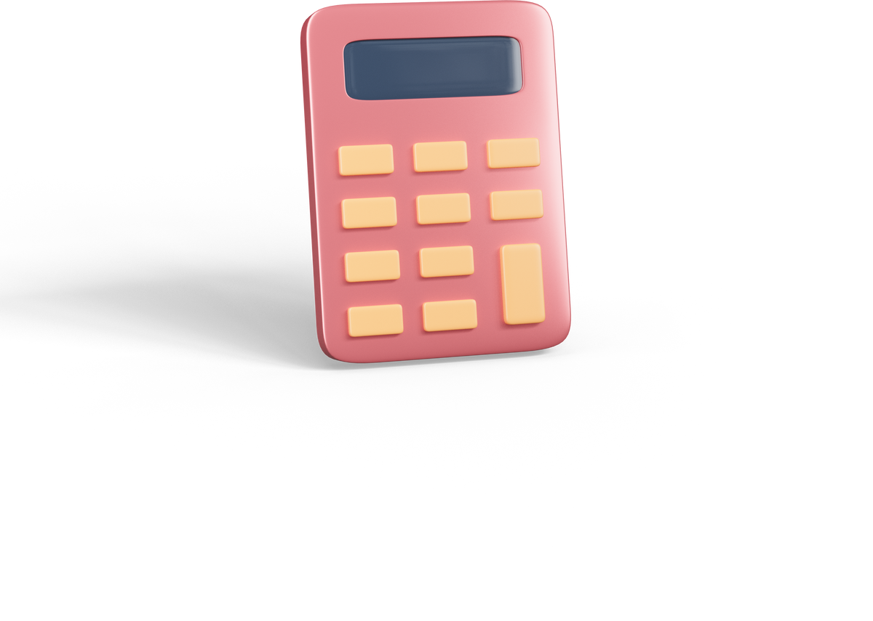
CONCLUSIONS
  PyMOL is a cross-platform molecular graphic tool and has been widely used for 3D visualization of macromolecules.
  With features such as molecular visualization and analysis, protein-ligand modeling, virtual screening and molecular simulation, PyMOL facilitates drug design, streamlining and improving the process.

Slide 11
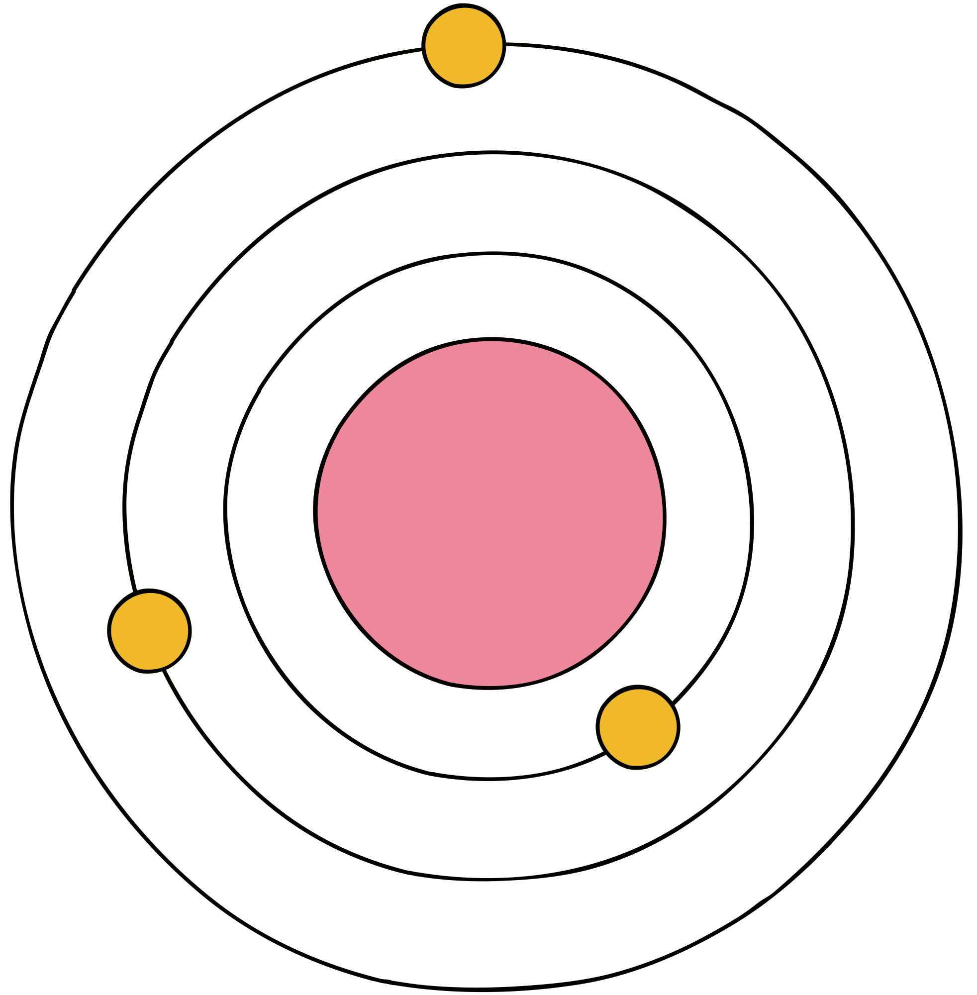









THANKS FOR YOUR

