Slide 1
Cheminformatics Microservice: Unifying Access to Open Cheminformatics Toolkits
Chandrasekhar, V., Sharma, N., Schaub, J., Steinbeck, C., & Rajan, K., (2023), Journal of Cheminformatics, 15, 98, 1-11
Prepared by: Barbara Pawlowska, 477701

Slide 2
Introduction
What is cheminformatics?
Challenges of using multiple cheminformatics toolkits
The need for a unified solution

Slide 3
Overview of Cheminformatics Microservice
What are microservices?
Open-source platform for cheminformatics data and tasks
Provides access to RDKit, CDK, and Open Babel
Simplifies toolkit integration and deployment
Usage for research in chemistry and drug discovery

Slide 4
Implementation
Uses Python-based FastAPI framework for generating RESTful APIs
Containerized with Docker
Five modules handle cheminformatics tasks
Can be accessed remotely, installed locally or on cloud servers
Versioning and documentation
Deployment and monitoring with Prometheus, Grafana and CI/CD.

Slide 5
Modules
API interactions (GET & POST)
Chem Module
Convert Module
Depict Module
OSCR Module
Tools Module

Slide 6
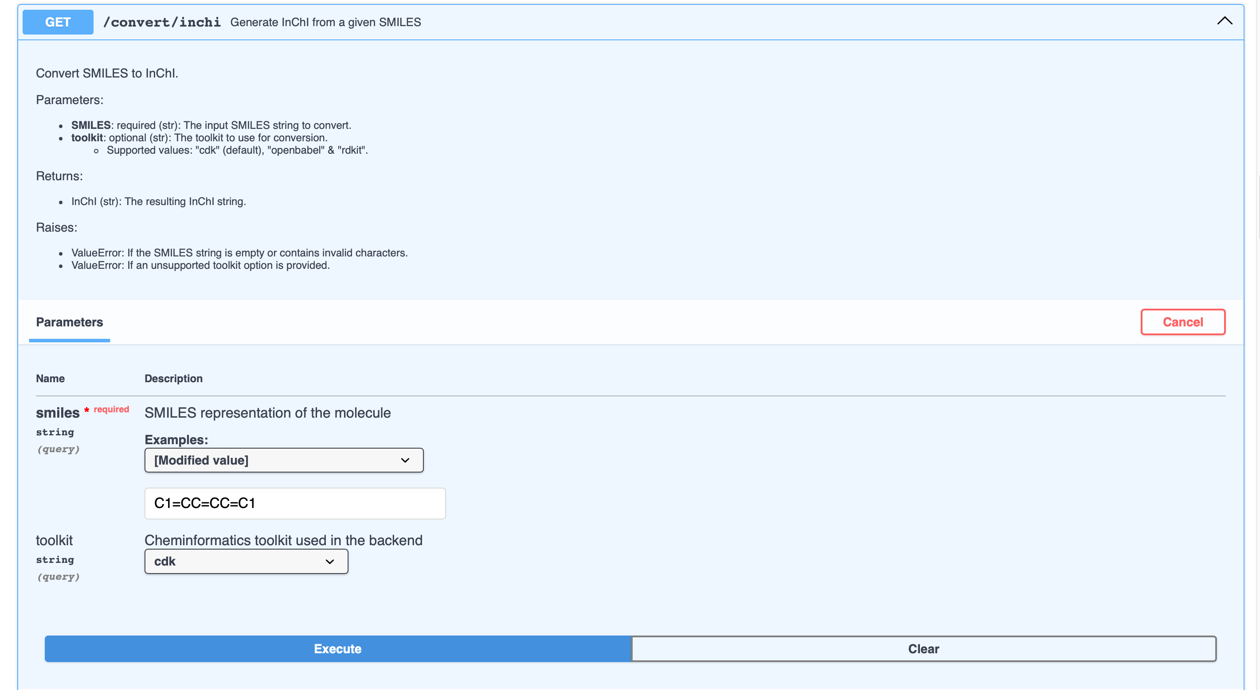

Slide 7
Results
Usage in in the COCONUT database
Public access and documentation
Scalability, stress testing and performance
Limitations

Slide 8
Conclusion
User-friendly and accessible service
Extensive toolset
Contribution to the scientific community

Slide 9
References
Chandrasekhar, V., Sharma, N., Schaub, J., Steinbeck, C., & Rajan, K. (2023). Cheminformatics Microservice: Unifying access to open cheminformatics toolkits. Journal of Cheminformatics, 15, 98, 1-11.
https://api.naturalproducts.net
GitHub: https://github.com/Steinbeck-Lab/cheminformatics-microservice

