Slide 1
Application of network analysis tools in understanding microbial community dynamics
Lidia Stadnik

Slide 2
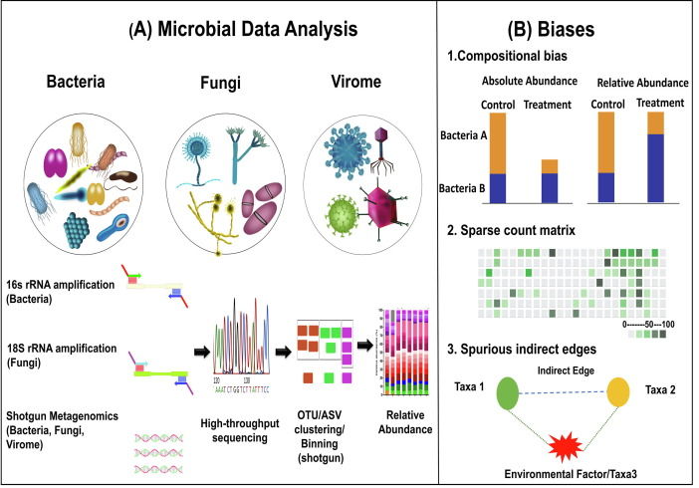
Characterizing microbial communities
Currently, the majority of network-based tools and models are used to study intra-kingdom interactions, mostly between bacteria.
Notes:
So right now the majority of network-based tools and models are used to study interactions within the same domain, mostly between bacteria. Detection of bacteria community is done mainly by sequencing conservative 16S ribosomal RNA gene amplicons.
Studying these relations is important for human health, our microbiota influences digestion, metabolism, and immune function.
Interactions within the microbiota can impact the balance between beneficial and harmful microorganisms, which can make us more susceptible for certain diseases such as obesity, inflammatory bowel disease, and infections

Slide 3
Network analysis
Network-based analytical approaches are used to decipher microbial co-occurrence patterns.
Decoding complex microbial co-occurrence relationships is associated with three main challenges.
Most of these methods employ linear models based on correlation, regression, and probabilistic graphical models.
Notes:
Firstly, microbiome data are compositional ; i.e. microbial counts represent proportions instead of absolute abundances.
A decrease in absolute abundance of just a single taxon is followed by an increase in relative abundances of all other taxa even if their absolute abundance does not change
Secondly, sparsity in the dataset can lead to false associations of microorganisms. A zero indicates either the absence of a microorganism, or an insufficient sequencing depth.
Thirdly, it is challenging to differentiate between direct and indirect associations, in particular if these are related to environmental factors

Slide 4
Correlation Analysis
Pearson or Spearman correlation methods are commonly used to estimate microbial interactions between pairs of taxa.
However, this analysis do not account for compositionality, leading to false associations between low-abundant microbial members in a community.
To address this, compositional data analysis techniques are employed.
Notes:
First method of estimating interactions between microbiom is Correlation Analysis

Slide 5
Overcoming Sparsity in Microbial Interaction Analysis
Centered log ratio transformation (CLR) can be utilized as a pre-processing step (e.g., SparCC).
Bootstrapping techniques (e.g., CoNet).
Challenge: selecting a suitable correlation cut-off to control network sparsity.
MENAP automates the selection of the optimal correlation threshold using a random matrix theory-based method.
Notes:
Ratio transformations ensure that the ratios between two features are the same whether the data are absolute counts or proportions. It takes the logarithm of these counts making the data more symmetric and linearly related. In result the log ratio of two taxa is completely independent of other taxa
CoNet further employs similarity (Steinhaus, distance correlation) and dissimilarity measures (Euclidean, Jensen-Shannon, Kullback Leibler, Bray Curtis) as alternatives to correlation coefficients.
to simulate a random background

Slide 6
Regularized linear regression models
It builds models where the abundance of each taxon is predicted using the abundance of all other taxa.
The coefficient of each taxon serves as a linear measure for the interaction strength of two taxa.
To prevent overfitting due to the large number of features, penalty terms like the ℓ1-penalty (lasso) are introduced.
The ℓ1-penalty drives the coefficients of less influential taxa to zero, making the solution sparse (CCLasso, REBACCA).
Compared to correlation methods there’s improved detection of false relations.
Notes:
An alternative to correlation analysis are regularized linear regression models
In these models the abundance of each taxon is modelled as a response variable using the abundance of all other taxa as explanatory variables.
What’s problematic here is that there’s large number of features, and to prevent overfitting, penalty terms like lasso are used. It drives the coefficients of less influential taxa to zero, making the solution sparse (CCLasso, REBACCA)

Slide 7
Meta-Network
Association rule mining techniques can detect both direct and indirect relationships, including non-linear associations.
It initially generates presence-absence indicator matrices for each sample.
Co-occurrence frequencies of taxa pairs are then computed to derive a co-occurrence probability matrix.
Using this matrix, a network is constructed with a predefined co-occurrence probability threshold (e.g., 80%).
Functional Similarity Weight (FS-Weight) algorithm to identify indirect relationships and The PCA-PMI method to detect non-linear associations
Notes:
Another method for Unveiling Microbial Interactions is through Meta-Network. Meta-Network utilizes association rule mining techniques to detect both direct and indirect relationships, including non-linear associations. It initially generates presence-absence indicator matrices for each sample. Co-occurrence frequencies of taxa pairs are then computed to derive a co-occurrence probability matrix.Using this matrix, a network is constructed with a predefined co-occurrence probability threshold (e.g., 80%).
To detect in indirect relationships within the network it uses the Functional Similarity Weight (FS-Weight) algorithm and to identify non-linear associations it uses PCA-PMI method (Path Consistency Algorithm with Pointwise Mutual Information).

Slide 8
Conditional dependence and graphical methods
Correlation based methods typically fail to differentiate between direct and indirect associations.
These can be distinguished using Partial correlation, resulting in an undirected weighted graph where the edges imply the conditional dependency between two taxa.
Most of these methods can also account for confounders such as biological covariates and technical biases.
Notes:
Correlation based methods typically fail to differentiate between direct and indirect associations. These can be distinguished using Partial correlation and some related approaches. We get undirected weighted graph where the edges imply the conditional dependency between two taxa.
Usually have a higher computational complexity and run-time than correlation-based methods. They have a higher run-time and require more computing power
.gCoda utilizes a logistic normal distribution and maximum likelihood model with ℓ1-penalty to address sparsity
On the plus side most of them can account for confounders such as biological covariates and technical biasessuch like sequencing depth

Slide 9
Conditional dependence and graphical methods
Technique SPIEC-EASI applies a CLR transformation to the data, and then generates graphical network by estimating sparse inverse covariance matrices
Other methods, like mLDM and HARMONIES, employ hierarchical Bayesian models and zero-inflated negative binomial distributions, respectively, to model microbial abundance and infer interactions.
COZINE introduces a novel approach to accommodate compositionality and zero inflation, using a Multivariate Gaussian Hurdle model for interaction inference.
Notes:
mLDM employs a hierarchical Bayesian model with three layers to model microbial abundance.
HARMONIES utilizes the zero-inflated negative binomial distribution and graphical lasso approach for interaction inference
Most of the methods which try to solve zero-inflation, introduce pseudo counts before log transformation. introducing pseudo counts may have a huge impact on downstream analysis and also may lead to spurious associations i.e. neglecting the fact that some taxa are completely absent in the data.

Slide 10
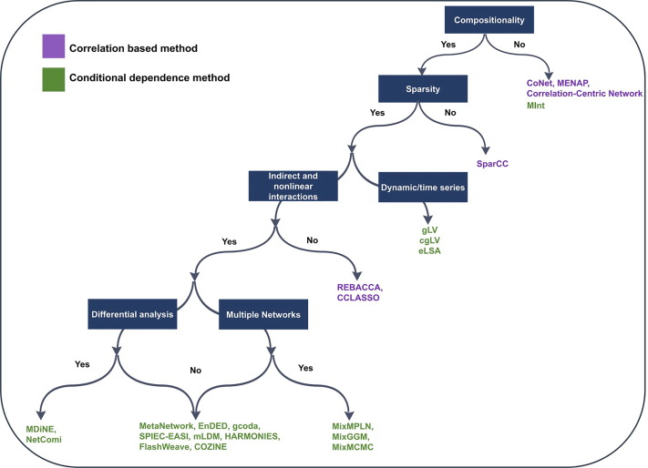
Workflow indicating the suitable network approaches depending upon different challenges

Slide 11
Conclusion
Currently available methods are not able to overcome all of the challenges associated with microbiome data including compositionality bias, overdispersion, a poor sample to feature ratio and trans-kingdom interactions.
Notes:
Each method has some limitations regarding to input data used which should be considered before proceeding with one.

Slide 12
Sources
Matchado, Monica Steffi, et al. "Network analysis methods for studying microbial communities: A mini review." Computational and structural biotechnology journal 19 (2021): 2687-2698.
Larsen, Peter, Yuki Hamada, and Jack Gilbert. "Modeling microbial communities: Current, developing, and future technologies for predicting microbial community interaction." Journal of Biotechnology 160.1-2 (2012): 17-24.

