Slide 1
FoPPS Summer school
Solving Temporal Credit Assignment
Doina Precup
McGill University and Google DeepMind Montreal
dprecup@cs.mcgill.ca
Slides edited from Rich Sutton and Andy Barto’s presentations for ``Reinforcement Learning: An Introduction (2nd ed.)
With thanks to Rich Sutton and the Reasoning & Learning Lab

Slide 2
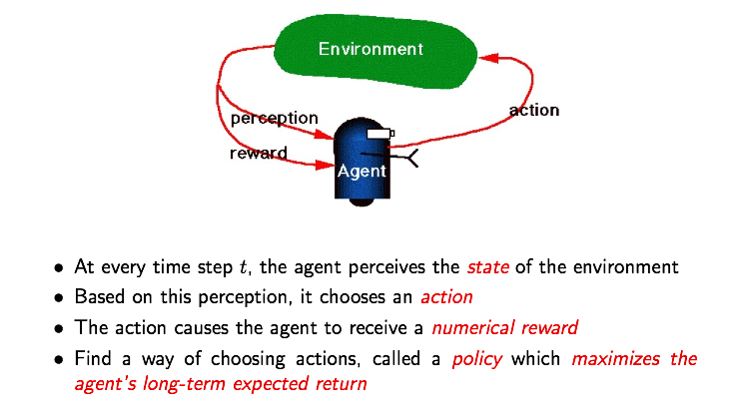
Recall: Computational framework

Slide 3
Some definitions

Slide 4
cf. Dynamic Programming
T
T
T
T
T
T
T
T
T
T
T
T
T

Slide 5
Curse of dimensionality

Slide 6
Simple Monte Carlo
St
T
T
T
T
T
T
T
T
T
T
T
T
T
T
T
T
T
T
T
T

Slide 7
Simplest TD Method
T
T
T
T
T
T
T
T
T
T
T
T
T
T
T
T
T
T
T
T

Slide 8
TD methods bootstrap and sample
Bootstrapping: update involves an estimate
MC does not bootstrap
DP bootstraps
TD bootstraps
Sampling: update does not involve an expected value
MC samples
DP does not sample
TD samples

Slide 9
TD Prediction
Policy Evaluation (the prediction problem):
for a given policy π, compute the state-value function vπ
Recall: Simple every-visit Monte Carlo method:
target: the actual return after time t
The simplest temporal-difference method TD(0):
target: an estimate of the return

Slide 10
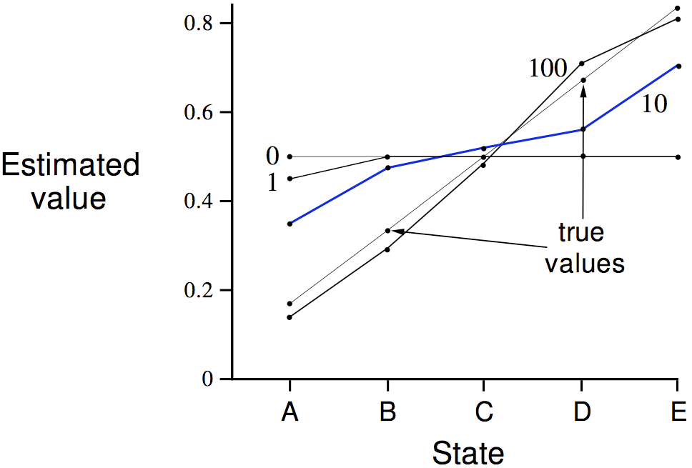
Random Walk Example
Values learned by TD after
various numbers of episodes

Slide 11
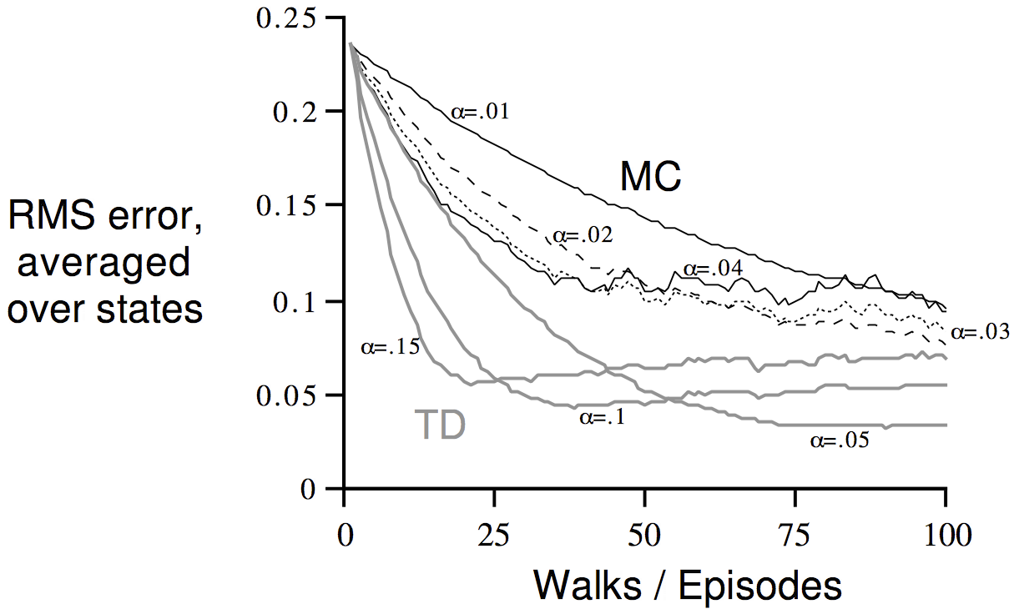
TD and MC on the Random Walk
Data averaged over
100 sequences of episodes

Slide 12
You are the Predictor
Suppose you observe the following 8 episodes:
A, 0, B, 0
B, 1
B, 1
B, 1
B, 1
B, 1
B, 1
B, 0
V(B)?
V(A)?
Assume Markov states, no discounting (𝜸 = 1)

Slide 13
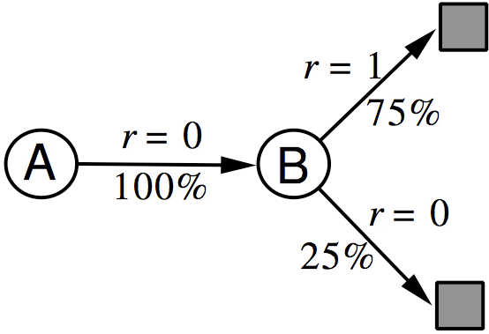
You are the Predictor

Slide 14
You are the Predictor
The prediction that best matches the training data is V(A)=0
This minimizes the mean-square-error on the training set
This is what a batch Monte Carlo method gets
If we consider the sequentiality of the problem, then we would set V(A)=.75
This is correct for the maximum likelihood estimate of a Markov model generating the data
i.e, if we do a best fit Markov model, and assume it is exactly correct, and then compute what it predicts (how?)
This is called the certainty-equivalence estimate
This is what TD gets

Slide 15
Value function approximation (VFA) replaces the table with a general parameterized form

Slide 16
Stochastic Gradient Descent (SGD) is the idea behind most approximate learning
General SGD:
For VFA:
Chain rule:
Semi-gradient:
Linear case:
Action-value form:

Slide 17
A natural objective in VFA
is to minimize the Mean Square Value Error
where is the fraction of time steps spent in state
True SGD will converge to a local minimum of the error objective
In linear VFA, there is only one minimum: local=global

Slide 18
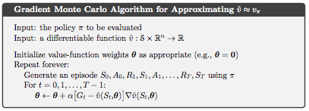

Slide 19
State aggregation is the simplest kind of VFA
States are partitioned into disjoint subsets (groups)
One component of 𝜽 is allocated to each group
Recall:

Slide 20
The 1000-state random walk example
States are numbered 1 to 1000
Walks start in the near middle, at state 500
At each step, jump to one of the 100 states to the right, or to one of the 100 states to the left
If the jump goes beyond 1 or 1000, terminates with a reward of −1 or +1 (otherwise Rt=0)

Slide 21
State aggregation into 10 groups of 100
group 1
group 2
group 3
group 4
group 5
group 6
group 7
group 8
group 9
group 10
The whole value function over 1000 states will be approximated with 10 numbers!

Slide 22
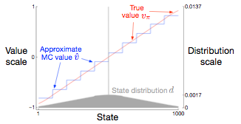
Gradient MC works well on the 1000-state random walk using state aggregation
10 groups of 100 states
after 100,000 episodes
α = 2 x 10⁻⁵
state distribution affects accuracy

Slide 23
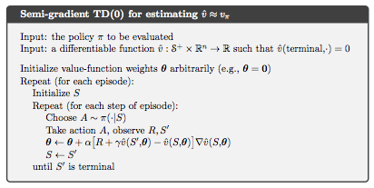

Slide 24
TD converges to the TD fixedpoint, ,
a biased but interesting answer
TD(0) update:
Fixed-point analysis:
In expectation:
Guarantee:

Slide 25
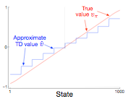
Gradient TD is less accurate than MC on the 1000-state random walk using state aggregation
10 groups of 100 states
after 100,000 episodes
α = 2 x 10⁻⁵
Relative values are
still pretty accurate

Slide 26
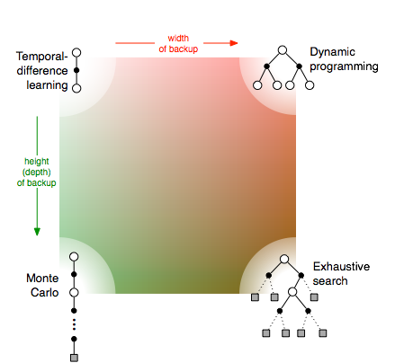
Unified View

Slide 27
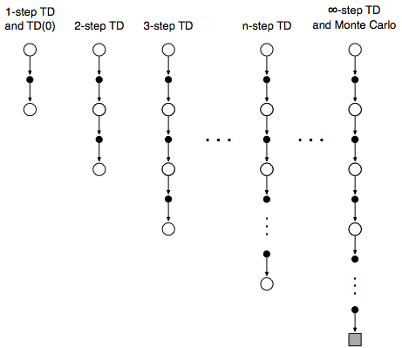
n-step TD Prediction
Idea: Look farther into the future when you do TD —
backup (1, 2, 3, …, n steps)

Slide 28
n-step TD Returns/Targets
Monte Carlo:
TD:
Use Vt to estimate remaining return
n-step TD:
2 step return:
n-step return:
with

Slide 29
Forward View of n-step TD and TD(λ)
Look forward from each state to determine update from future states and rewards:

Slide 30
n-step TD
Recall the n-step return:
Of course, this is not available until time t+n
The natural algorithm is thus to wait until then:
This is called n-step TD

Slide 31
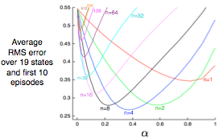
19-state Random Walk
n-step TD
results
An intermediate α is best
An intermediate n is best
Do you think there is an optimal n? for every task?

Slide 32
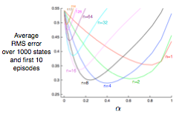
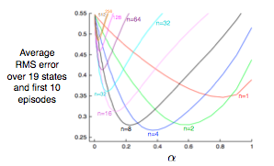
Bootstrapping still greatly speeds learning
very much like the tabular 19-state walk
1000 states aggregated
into 20 groups of 50
19 states tabular

Slide 33
Error-reduction property
Error reduction property of n-step returns
Using this, you can show that n-step methods converge
Maximum error using n-step return
Maximum error using V

Slide 39
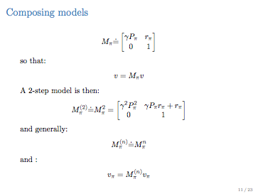

Slide 40
Learning An Action-Value Function
Estimate qπ for the current policy π

Slide 41
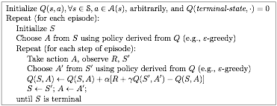
Sarsa: On-Policy TD Control
Turn this into a control method by always updating the
policy to be greedy with respect to the current estimate:

Slide 42
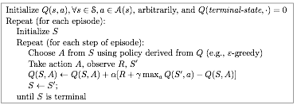
Q-Learning: Off-Policy TD Control
One-step Q-learning:

Slide 43
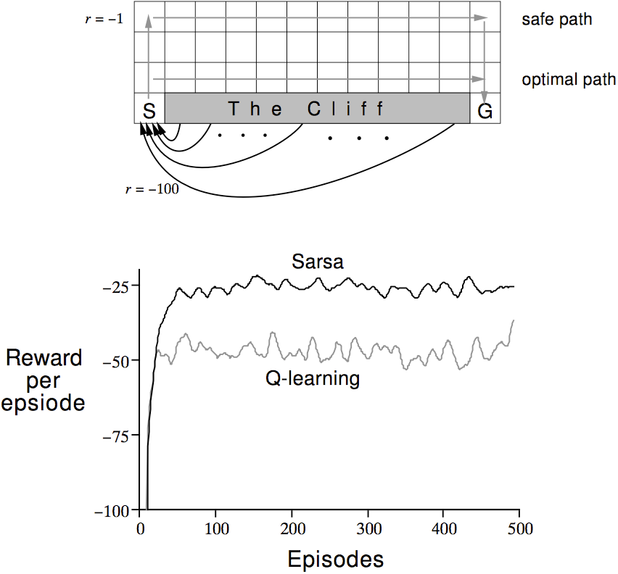
Cliffwalking
R
R
ε−greedy, ε = 0.1

Slide 44
Expected Sarsa
a

Slide 45
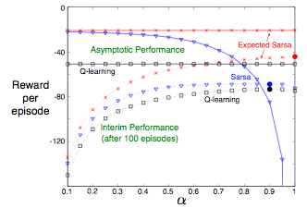
Performance on the Cliff-walking Task
van Seijen, van Hasselt, Whiteson, & Wiering 2009

Slide 46
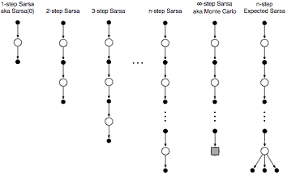
n-step is much the same for action values

Slide 47
(Semi-)gradient methods carry over to control
in the usual on-policy GPI way
Always learn the action-value function of the current policy
Always act near-greedily wrt the current action-value estimates
The learning rule is the same as in Chapter 9:
update target, e.g.,
(MC)
(Sarsa)
(Expected Sarsa)
(DP)

Slide 48
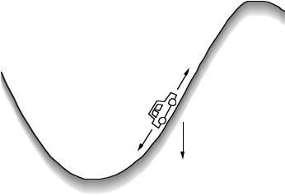
Example: The Mountain-Car problem
Goal
SITUATIONS: car's position and velocity
ACTIONS: three thrusts: forward, reverse, none
REWARDS: always –1 until car reaches the goal
Episodic, No Discounting, 𝜸=1
Gravity wins
Minimum-Time-to-Goal Problem

Slide 49
On-policy n-step Action-value Methods
Action-value form of n-step return
n-step Sarsa:
n-step Expected Sarsa is the same update with a slightly different n-step return:

Slide 50
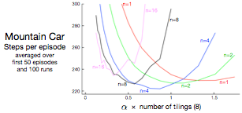
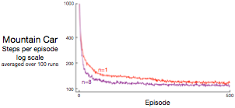
n-step semi-gradient Sarsa is better for n>1

Slide 51
Off-policy n-step Methods by Importance Sampling
Use importance-sampling ratio:
We get off-policy methods by weighting updates by this ratio
Off-policy n-step TD:
Off-policy n-step Sarsa:
Off-policy n-step Expected Sarsa:

Slide 52
Conclusions Regarding n-step Methods
Generalize Temporal-Difference and Monte Carlo learning methods, sliding from one to the other as n increases
n = 1 is TD
n = ∞ is MC
an intermediate n is often much better than either extreme
applicable to both continuing and episodic problems
There is some cost in computation
need to remember the last n states, learning delayed by n steps
but, very natural match for using replay buffers (deep RL)
per-step computation is small and uniform, like TD
Everything generalizes nicely: error-reduction theory, Sarsa, off-policy by importance sampling, Expected Sarsa

Slide 53
Unified View
Multi-step
bootstrapping

Slide 54
Eligibility traces are:
Another way of interpolating between MC and TD methods
A way of implementing compound λ-return targets
A basic mechanistic idea — a short-term, fading memory
A new style of algorithm development/analysis
the forward-view ⇔ backward-view transformation
Forward view: conceptually simple — good for theory, intuition
Backward view: computational implementation of the forward view

Slide 55
Recall n-step targets
For example, in the episodic case, now assuming linear function approximation:
2-step target:
n-step target:
with

Slide 56
Any set of update targets can be averaged
to produce new compound update targets
A compound backup
For example, half a 2-step plus half a 4-step
Called a compound backup
Draw each component
Label with the weights for that component

Slide 57
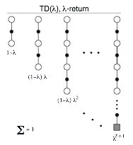
The λ-return is a compound update target
The λ-return a target that averages all n-step targets
each weighted by λ^{n-1}

Slide 58
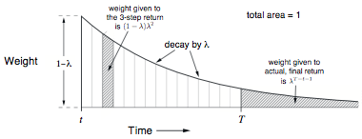
λ-return Weighting Function
Until termination
After termination

Slide 59
Relation to TD(0) and MC
The λ-return can be rewritten as:
If λ = 1, you get the MC target:
If λ = 0, you get the TD(0) target:
Until termination
After termination

Slide 60
The off-line λ-return “algorithm”
Wait until the end of the episode (offline)
Then go back over the time steps, updating

Slide 61
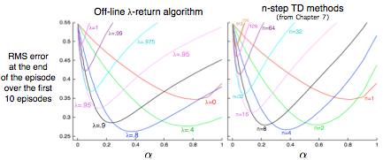
The λ-return alg performs similarly to n-step algs on the 19-state random walk (Tabular)
Intermediate λ is best (just like intermediate n is best)
λ-return slightly better than n-step

Slide 62
The forward view looks forward from the state being updated to future states and rewards

Slide 63
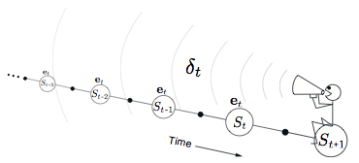
The backward view looks back
to the recently visited states (marked by eligibility traces)
Shout the TD error backwards
The traces fade with temporal distance by γλ

Slide 64
Demo
Here we are marking state-action pairs with a replacing eligibility trace

Slide 65
Eligibility traces (mechanism)
The forward view was for theory
The backward view is for mechanism
New memory vector called eligibility trace
On each step, decay each component by γλ and increment the trace for the current state by 1
Accumulating trace
Replacing trace: trace becomes 1 when state is visited
same shape as 𝜽

Slide 66
The Semi-gradient TD(λ) algorithm

Slide 67
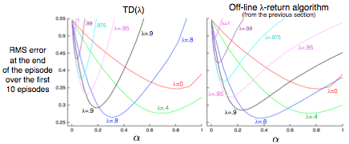
TD(λ) performs similarly to offline λ-return alg.
Tabular 19-state random walk task

Slide 68
Conclusions regarding Eligibility Traces
Provide an efficient, incremental way to combine MC and TD
Includes advantages of MC (better when non-Markov)
Includes advantages of TD (faster, comp. congenial)
True online TD(λ) is new and best
Is exactly equivalent to online λ-return algorithm
Three varieties of traces: accumulating, dutch, (replacing)
Traces to control in on-policy and off-policy forms
Traces do have a small cost in computation (≈x2)

Slide 69
Approaches to control
Previous approach: Action-value methods:
learn the value of each action;
pick the max (usually)
New approach: Policy-gradient methods:
learn the parameters of a stochastic policy
update by gradient ascent in performance
includes actor-critic methods, which learn both value and policy parameters

Slide 70
Action-value methods
The value of an action in a state given a policy is the expected future reward starting from the state taking that first action, then following the policy thereafter
Policy: pick the max most of the time but sometimes pick at random (𝜀-greedy)

Slide 71
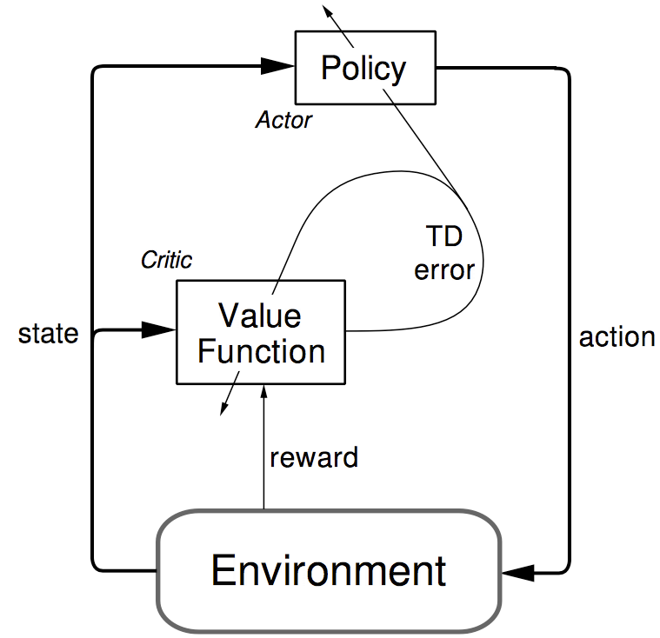
Actor-critic architecture
World

Slide 72
Why approximate policies rather than values?
In many problems, the policy is simpler to approximate than the value function
In many problems, the optimal policy is stochastic
e.g., bluffing, POMDPs
To enable smoother change in policies
To avoid a search on every step (the max)

Slide 73
Policy-gradient setup
Given a policy parameterization:
And objective:
(or average reward)
Approximate stochastic gradient ascent:
Typically, based on the Policy-Gradient Theorem:

Slide 74
Proof of the
Policy-Gradient
Theorem
(from the 2nd Edition)

Slide 75
Deriving REINFORCE from the PGT
Thus

Slide 76
REINFORCE with baseline
Policy-gradient theorem with baseline:
any function of state, not action
Because
Thus
^

Slide 77
Actor-critic architecture
World

Slide 78
Actor-Critic methods
REINFORCE with baseline:
^
Actor-Critic method:
^
^
^

Slide 79
The generality of the
policy-gradient strategy
Can be applied whenever we can compute the effect of parameter changes on action probabilities
E.g., has been applied to spiking neuron models
There are many possibilities for policy parametrization: linear-exponential, linear-gaussian, mixture of fixed policies, drift/diffusion models
At the origin of popular state-of-art algorithms such as DDPG, TRPO

Slide 80
Example: DDPG
https://www.youtube.com/watch?v=iFg5lcUzSYU

